Slide 1
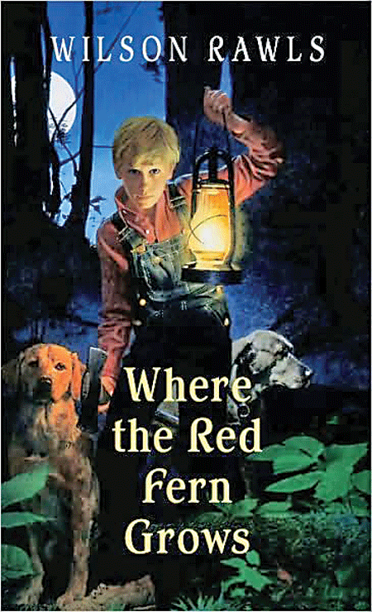

Slide 2
Main Characters
Billy Colman: Narrator (tells the story),10 year old boy that loves to hunt.
Old Dan and Little Ann: Billy’s coonhounds that hunt raccoons.
Grandpa: Billy’s grandfather who owns his own store.
Papa and Mama: Billy’s parents.
Rainie and Rubin: Two brothers that are never up to any good.
Sisters: Billy’s sisters that are all younger than him.

Slide 3
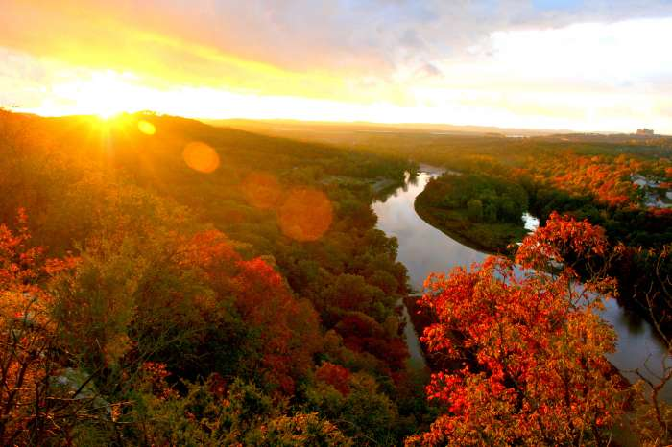
Setting
Ozark Mountains, Oklahoma
Year: 1920’s

Slide 4
Chapter 1
A man is walking home from work when he sees a fight between a group of dogs and a small hound dog.
The man saves the small dog and sees that it is wearing a collar and name tag around its neck. His name is Buddie.

Slide 5
Chapter 1
He feeds Buddie and gives him water before letting the dog run back to its home.
The man remembers when he owned two hound dogs years ago and begins to tell a story about his childhood.

Slide 6
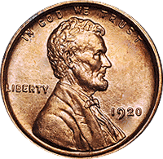
Chapter 2
It is the 1920’s and Billy is 10 years old. He wants to buy two coonhounds (dogs that hunt raccoons).
His parents do not have enough money and cannot help Billy.
Billy is upset and begins to lose weight and not sleep because he wants the dogs so badly.

Slide 7
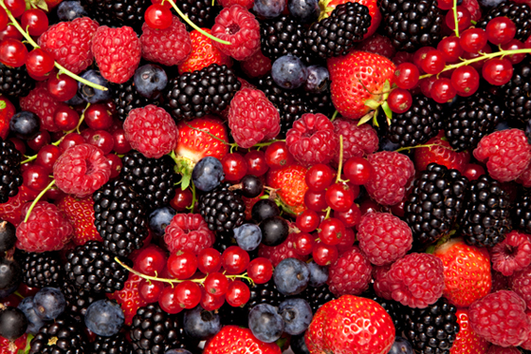
Chapter 3
The following day, Billy sees a sales ad in a magazine for two coonhounds for $50.
He decides to make money by selling berries and vegetables in the summer and by catching raccoons in the winter.
After two years, Billy saves up enough money and goes to his grandpa’s store.
His grandpa orders the dogs for him and gives him a bag of candy that he shares with his sisters.

Slide 8
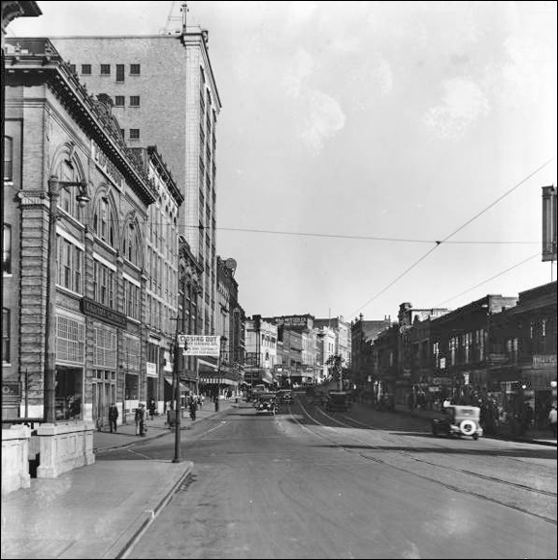
Chapter 4
After a couple of weeks, Billy’s grandpa gets a letter that the puppies will arrive in two weeks.
They will be delivered to a town called Tahlequah, that is 30 miles away.
Two weeks pass and Billy hears that his dogs have arrived, but no one can drive him to get them for one more week.

Slide 9
Chapter 4
Alone, Billy decides to walk to get his puppies through the woods without telling his family.
The town is big and Billy is scared because it is different from where he is from.

Slide 10
Chapter 5
After a little while, Billy makes it to the station to get his puppies.
Once he gets there, a worker shows him his new dogs and they crawl right up to his feet.
Billy leaves happy but soon gets into a fight with a group of boys who make fun of his dogs causing him to punch one of the boys in the face.

Slide 11
Chapter 5
A marshal (policeman) arrives and helps Billy and then sends him on his way back home.
That night, Billy and his dogs sleep in a cave and wake up to a roaring lion.
He builds a fire to scare it away and the puppies sit next to Billy until the lion leaves.
Questions: What are 2 ways that Billy has shown bravery? Do you think you could be as brave as Billy ?

Slide 12
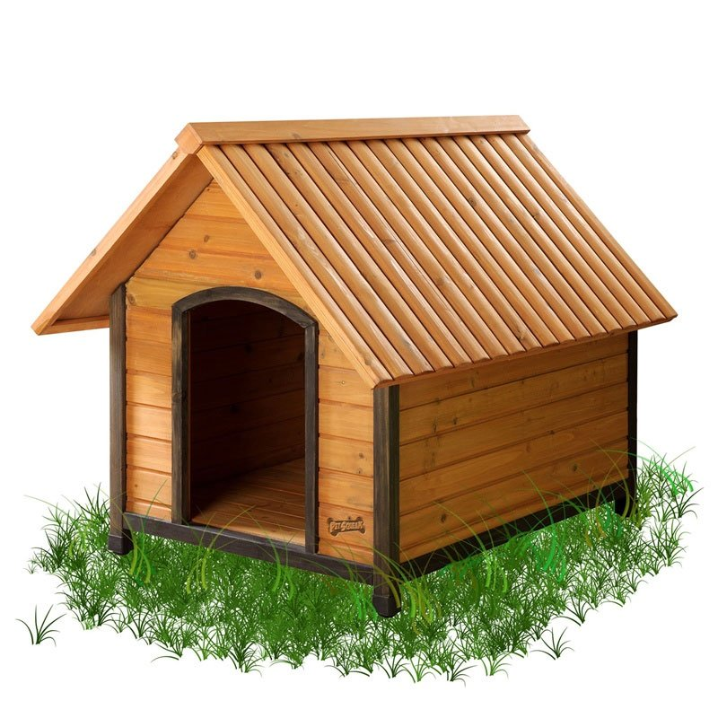
Chapter 6
The next morning, Billy and the puppies head home.
While walking, Billy sees a tree with the names Dan and Ann carved into it and decides to name his puppies , Dan and Ann.
When he gets home, Billy’s parents tell him that they were worried but that his Grandpa told them where he was the whole time.

Slide 13
Chapter 6
They tell him to never do that again, but are excited to have two dogs.
Billy builds them a doghouse and makes them collars.

Slide 14
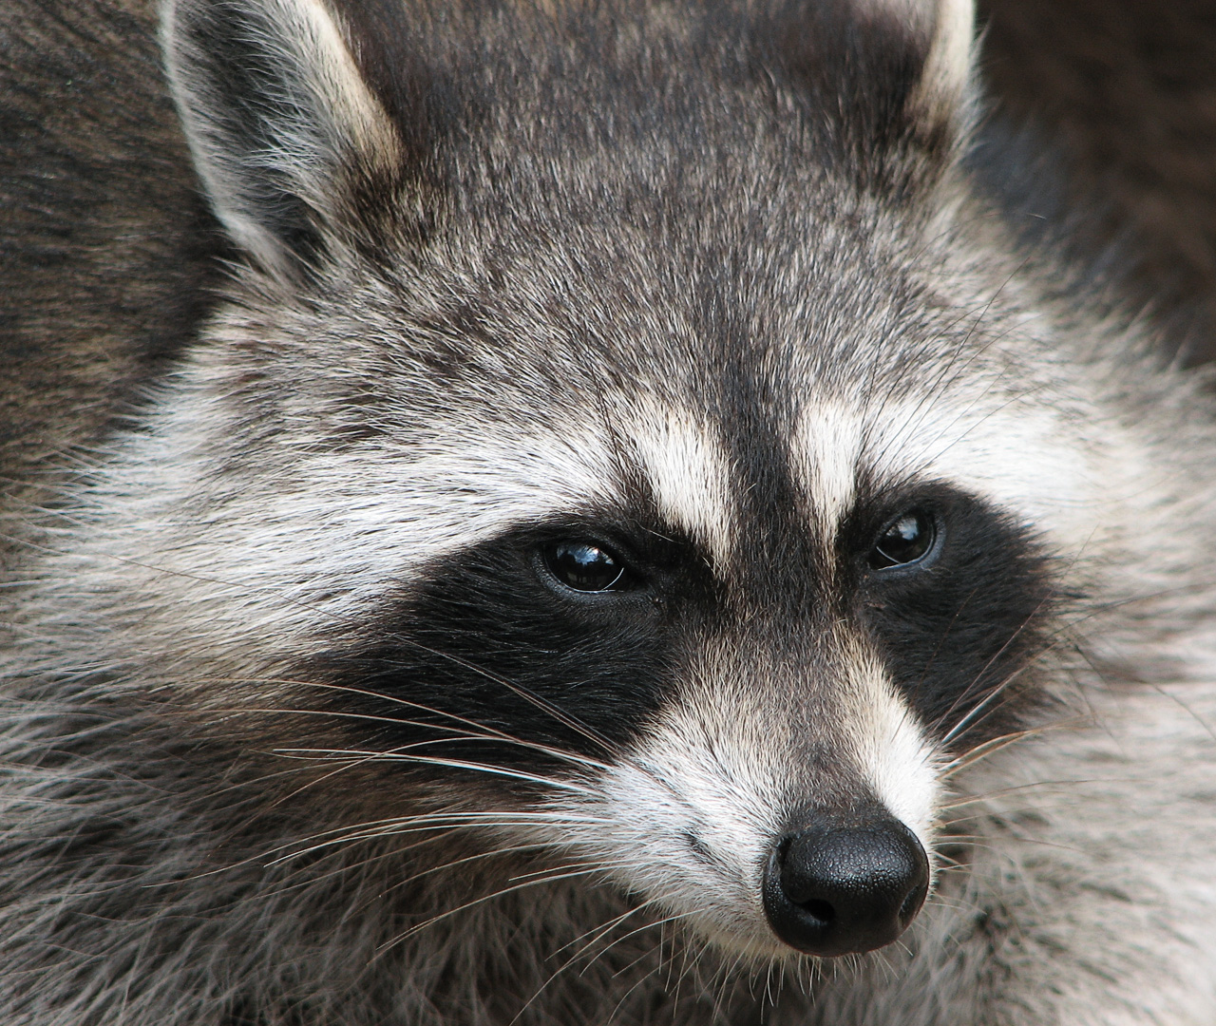
Chapter 7
The next day, Billy decides to train the pups on how to catch and recognize the smell of raccoons.
His grandpa shows him how to make his own traps.
A week or two passes before Billy catches a raccoon and Old Dan and Little Ann run to the trap to get it.

Slide 15
Chapter 7
Billy’s dad tells him that this is a good sign because they are already going after the raccoons.
Hunting season is coming up and Billy is excited to see what his dogs can do.

Slide 16
Chapter 8
Hunting season arrives and Billy, Little Ann, and Old Dan go out at night to catch raccoons.
The dogs spot one and chase after it, swimming across the river and watching it run up a tree to hide.
Billy wants to find another raccoon but the dogs want this one.

Slide 17
Chapter 8
He decides to try and chop down the tree, no matter how long it will take him.
Question: The tree is very big, do you remember where Billy lives that grows trees this large?

Slide 18
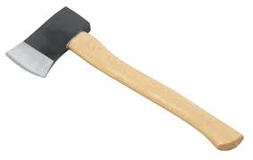
Chapter 9
Billy keeps chopping the tree trunk with his axe and later that night his grandpa comes and tells him to go home.
Before leaving, Billy and his grandpa build a scarecrow to keep the raccoon in the tree overnight.

Slide 19
Chapter 9
Billy goes home to bed and wakes up the next morning to go back to the tree.
He finally chops down the tree and the dogs capture the raccoon.
Billy’s dad helps him make the raccoon skin into a fur coat.

Slide 20
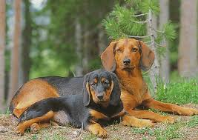
Chapter 10
Billy begins hunting day and night.
He makes a lot of money selling raccoon skins and gives the money to his papa.
One night, Old Dan gets stuck in a muskrat den and Little Ann barks until Billy comes over.
Billy saves Old Dan and gets a shovel to get him out of the hole.

Slide 21
Chapter 11
As time passes, the weather changes and because it snows Billy is not able to hunt.
Once it stops, Billy, Little Ann, and Old Dan go out to hunt.
Little Ann walks on a frozen pond but falls in when the ice breaks.
Billy is able to rescue her by grabbing her collar and warms her up with his lantern.

Slide 22
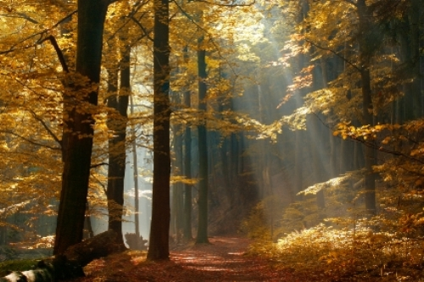
Chapter 12
Several days later, Billy meets Rubin and Rainie Prichard, two young kids that are never up to any good.
They challenge him to a raccoon hunt and he accepts.
The Prichard boys bet $2 that Little Ann and Old Dan will not be able to catch a well-known fast raccoon that no one can get.

Slide 23
Chapter 12
Later that night they go to the woods to begin the hunt.
Within minutes the dogs smell the raccoon and run to catch it.
Old Dan barks and the boys go to find him.

Slide 24
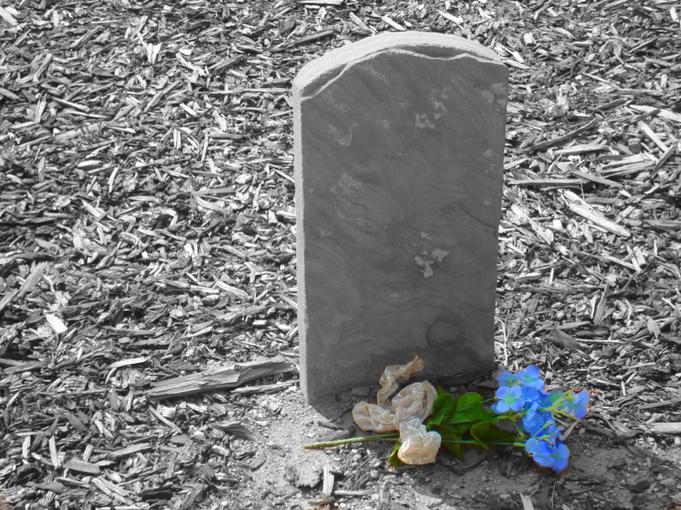
Chapter 13
The dogs catch up with the raccoon and force it up a tree.
Billy climbs up the tree to get it out but does not want his dogs to kill it.
Billy and Rubin get in a fight because Rubin won’t give the $2 to Billy for finding the raccoon.
The Prichard’s dog, Old Blue, shows up and begins to fight with Old Dan.

Slide 25
Chapter 13
Rubin picks up an axe and tries to kill Old Dan, but falls on it and dies.
Billy goes home and sadly tells his parents what happened.
After a couple of days, Billy brings flowers to Rubin’s grave and decides to start hunting again.

Slide 26
Chapter 14
The following day, Billy goes to his grandpa’s store.
His grandpa signed him up for a Championship Coon Hunt that starts in a few days.
Billy is excited and dreams of winning first place and the gold cup.
Billy, Papa, his grandpa, and the dogs get in grandpa’s car and head to the competition.
What do you think is going to happen next?

Slide 27
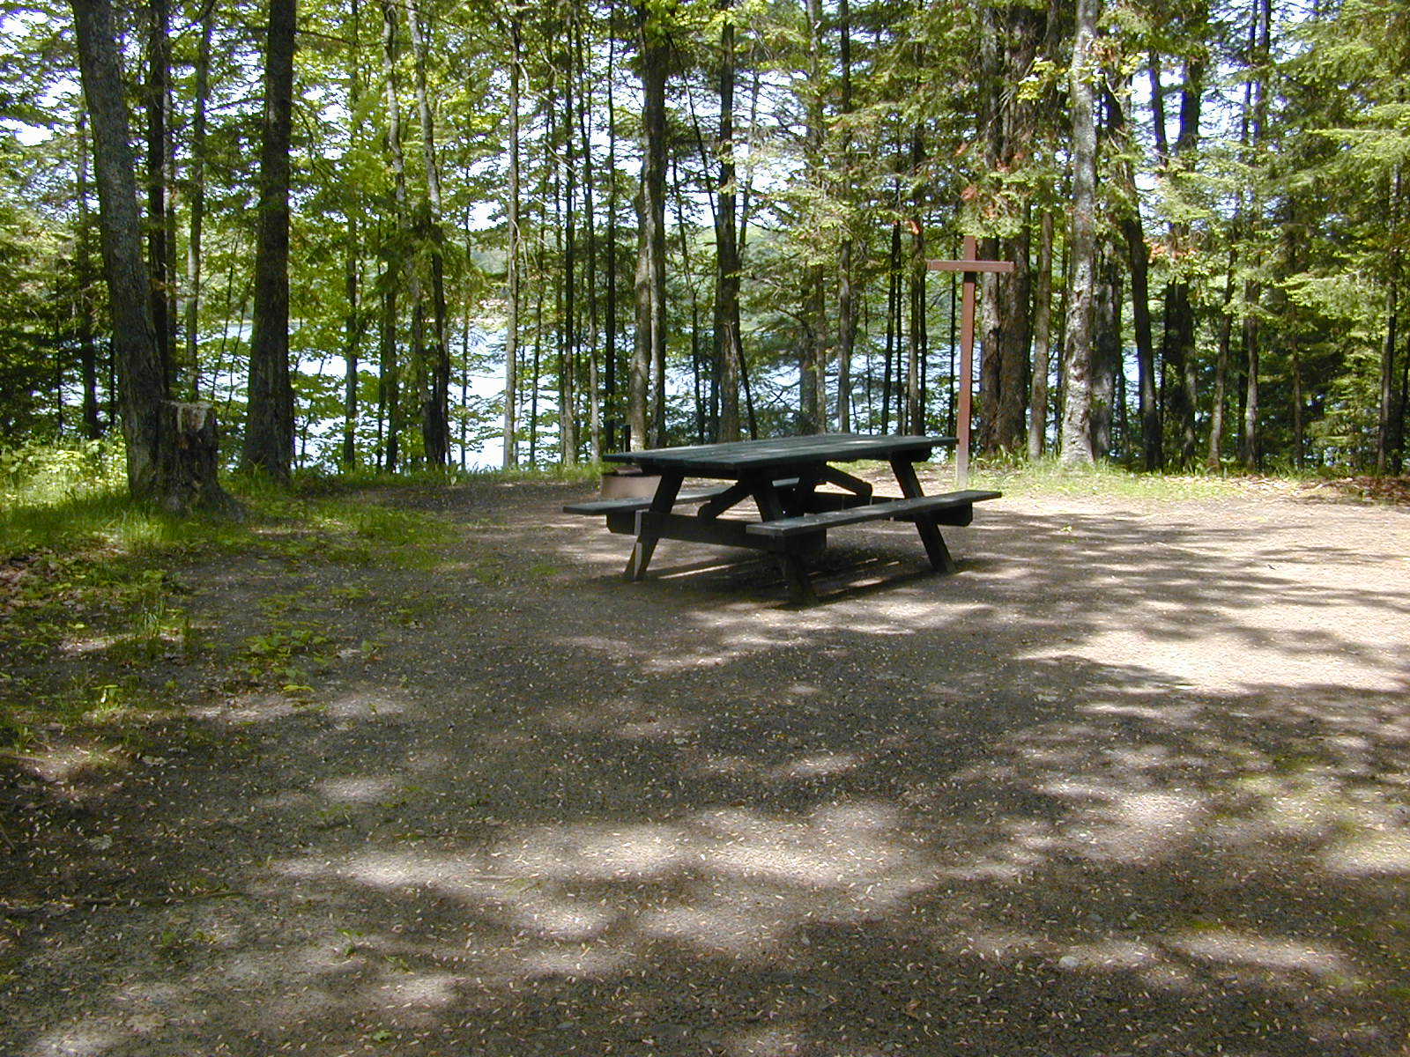
Chapter 15
Two days later, they arrive at the campground for the competition.
They enter a best-looking hound competition.
Little Ann wins! Billy is so happy that he cries.
The judges tell everyone that there are twenty-five men competing and five will compete each night (This is a total of five nights).

Slide 28
Chapter 15
Billy goes on the fourth night.
One man that went before Billy caught three raccoons.
Billy must get three or more to stay in the competition.
Billy is now about to compete.

Slide 29
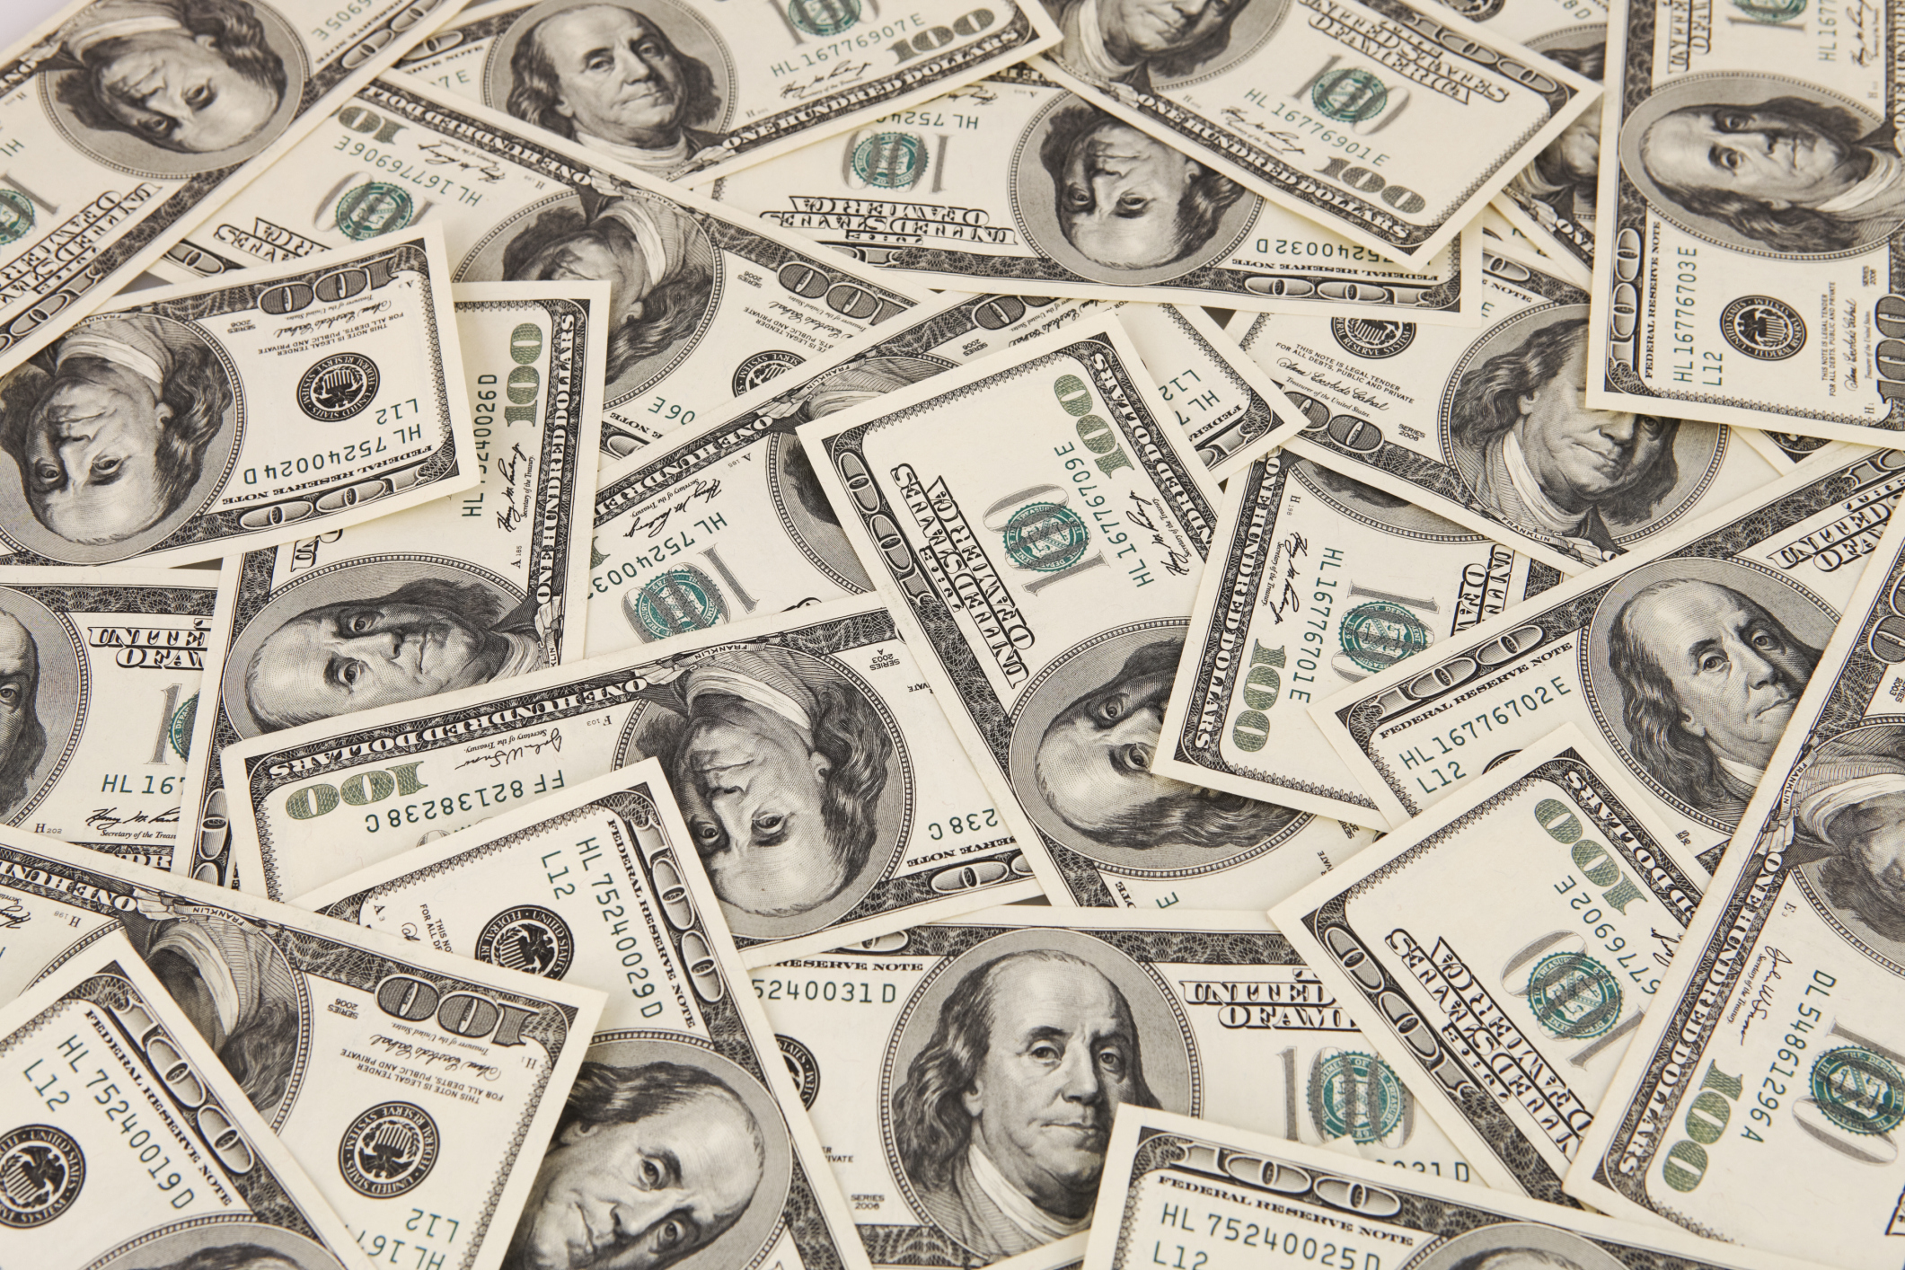
Chapter 16
Little Ann and Old Dan catch two raccoons in very little time.
A couple hours go by and they need to find one more to stay in the competition.
They catch one more and Billy moves on to the final round.

Slide 30
Chapter 16
Very tired, Billy goes to sleep and wakes up the next morning to compete again.
Billy is competing against two other people and finds out that the winner gets money.
The last competition begins and the dogs find one raccoon.

Slide 31
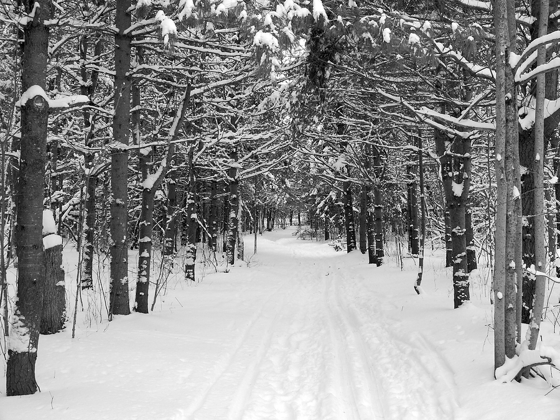
Chapter 17
It begins to storm and snow is falling.
Billy hears his dogs barking about a raccoon but cannot
find them.
Billy, his papa, his grandpa and a few other men go and look for them.

Slide 32
Chapter 17
They find the dogs barking at a tree.
Billy’s papa cuts down the tree and three raccoons fall out.
Both dogs get a raccoon and then chase after the third.

Slide 33
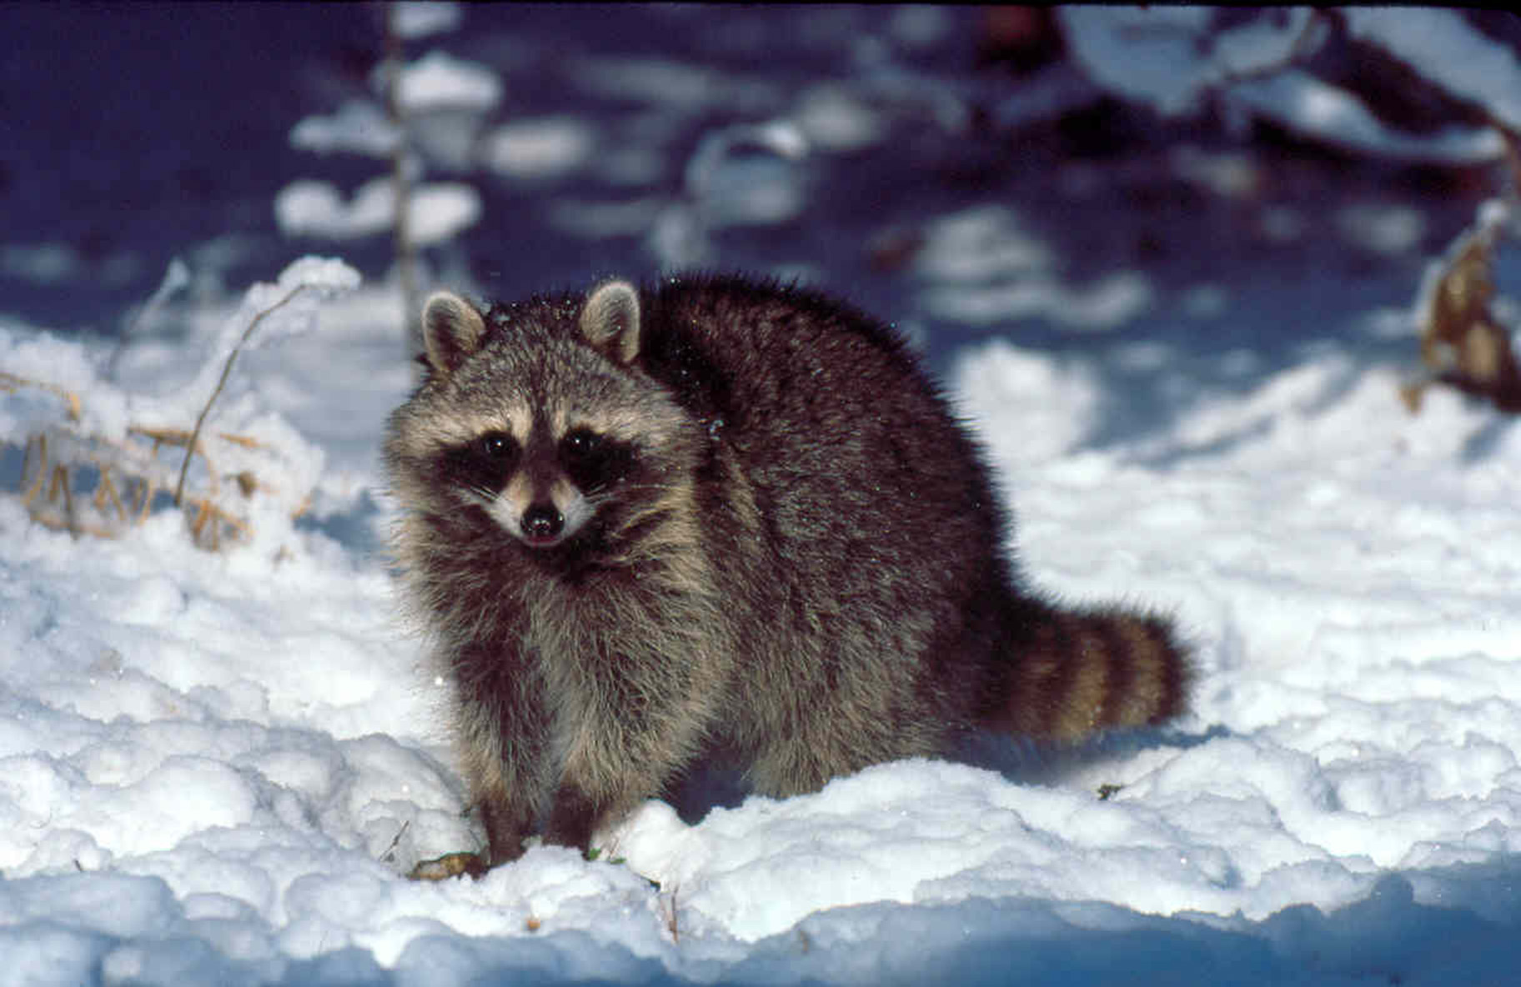
Chapter 18
Little Ann and Old Dan finally catch the last raccoon!
Billy takes all four raccoon skins back to the camp and wins $300!
Billy goes home and celebrates with his family about winning the competition and the money.
Everyone is happy.
What was the cost of Little Ann and Old Dan?

Slide 34
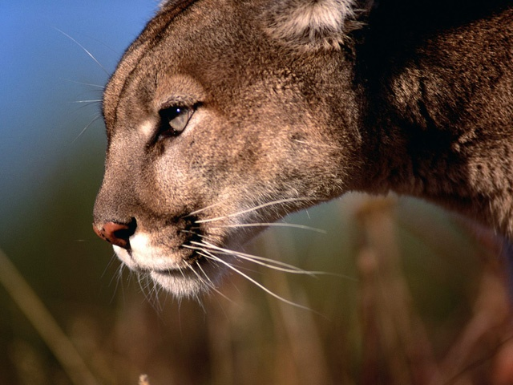
Chapter 19
The next night Little Ann, Old Dan, and Billy go to hunt.
While hunting, the dogs are attacked by a very big mountain lion.
The lion also tries to hurt Billy but the dogs save him.
Old Dan gets injured in the fight and dies.

Slide 35
Chapter 19
Billy is very sad and buries his dog.
The next day, Little Ann goes missing and Billy finds her at Old Dan’s grave.
She was so sad about Old Dan dying that she dies too. Billy buries her right next to him.
He wonders if the dogs went to Heaven.

Slide 36
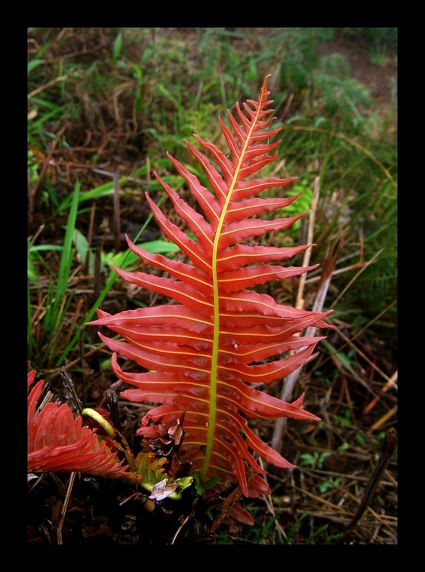
Chapter 20
Spring arrives and Billy and his family decide to move to the city with the $300 he won.
Before leaving, Billy visits the graves of his dogs and sees a red fern leaf (plant).
An old legend states that red ferns only grow with the help of an angel.

Slide 37
Chapter 20
Billy happily believes his dogs went to Heaven and leaves his home for the city.
Back in the present, Billy is an old man thinking about visiting his childhood home.
He believes that if he goes back the red fern will still be there.

Slide 38
The End

