Slide 1
Wonder by R.J. Palacio

Slide 2
Part 1: August

Slide 3
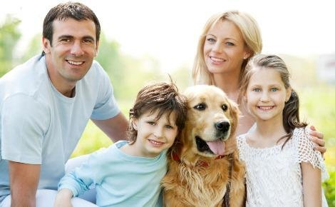
My name is Auggie Pullman. I live with my Mom, my Dad, my older sister Via, and my dog, Daisy.

Slide 4
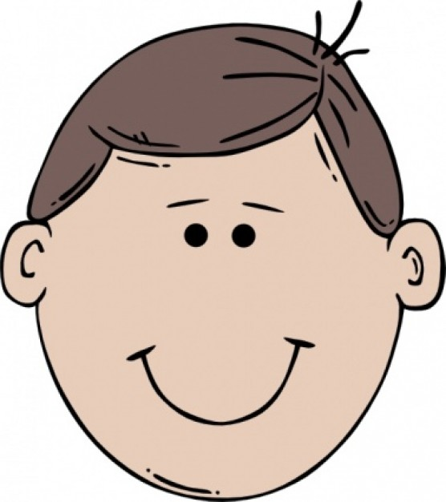
I am ten years old. My family thinks that I am extraordinary, but I am not. I am not even ordinary. I wish I was. I “wish that I had a normal face that no one ever noticed at all.”

Slide 5
I was born with my face like this. I have bad eyes and wear glasses. My mouth looks funny. I do not have normal ears and it makes it hard to hear.

Slide 6
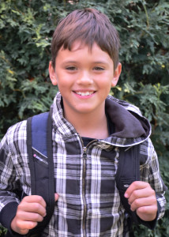
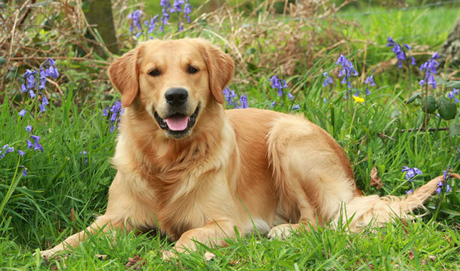
I am in fifth grade. I have never been to a real school before. I want to go to school so that I can make many friends. My only friends are Christopher and my dog, Daisy.

Slide 7
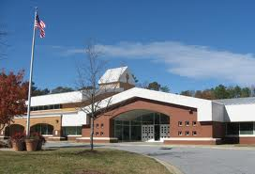
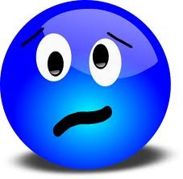
This year I am going to school. Mom and I go visit Beecher Prep School to see if I like it. I am a little nervous.

Slide 8
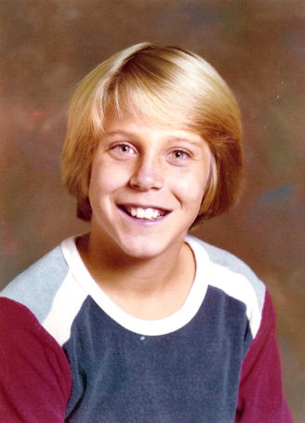
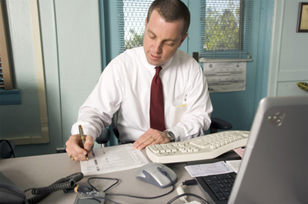
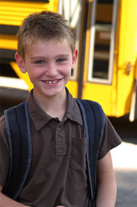
← Charlotte
→
Jack Will
Julian →
At Beecher Prep, we meet Principal Tushman. He asked some students to show me the school. Their names are Julian, Jack Will, and Charlotte.

Slide 9
They keep staring at me because of my face. Julian iss the meanest to me, asking “what is wrong with your face?”

Slide 10
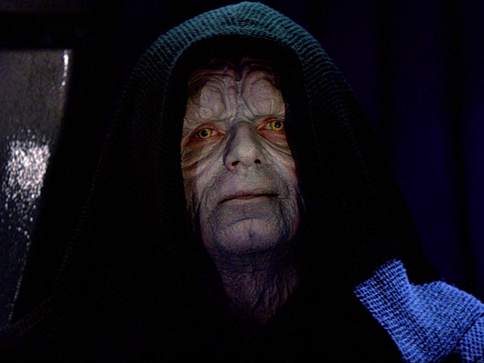
I was nervous for my first day of school. Everyone was watching me. Jack Will talked to me but the other kids were making fun of me. They called me Darth Sidious from Star Wars.

Slide 11
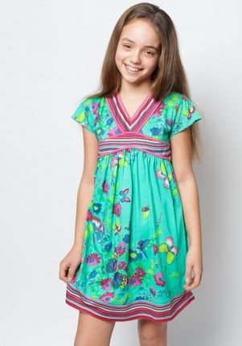
A girl named Summer sat with me at lunch.

Slide 12
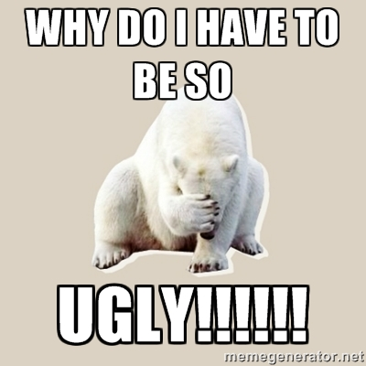
I do not think I like school. I have no friends because I am different. “Why do I have to be so ugly?”

Slide 13
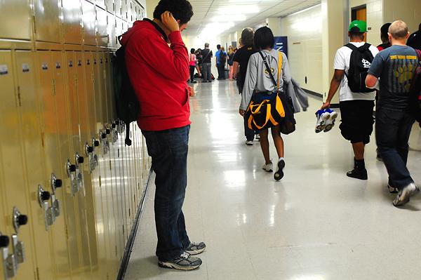
Going to school is not easy. People do not like walking next to me. They think I have germs. They talk about me when I am not there. It is okay because my face scares everyone.

Slide 14
My new friends at school are Jack Will and Summer. They helped me pick a costume for Halloween, my favorite holiday. It is the one day I wear a mask so no one can see my face.

Slide 15
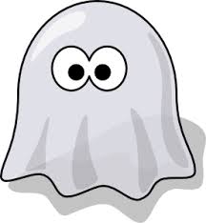
On Halloween, no one knew me. It was like I was a ghost. It was great.

Slide 16
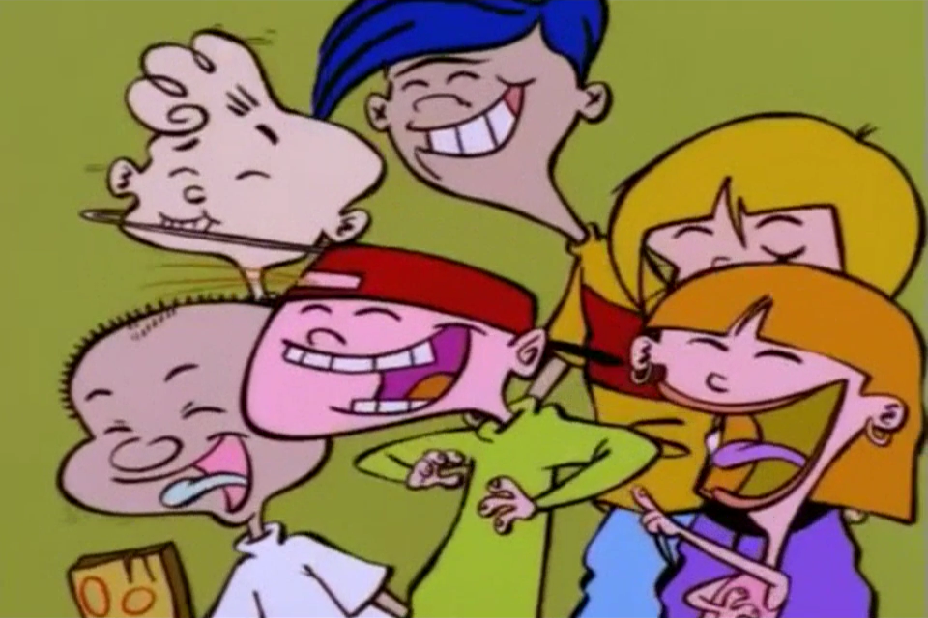
I heard Julian and some kids making fun of me. Even Jack Will did not want to be my friend.

Slide 17
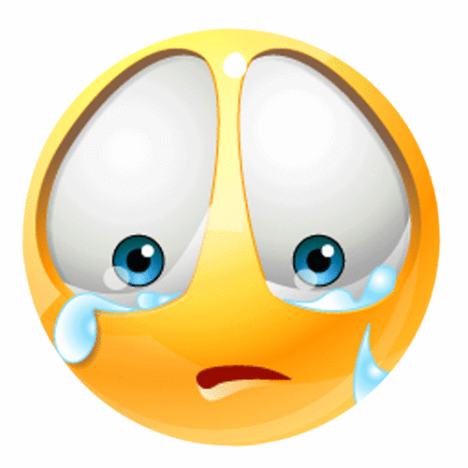
I was very upset and cried. I never want to go to school again.

Slide 18
Part 2: Olivia

Slide 19
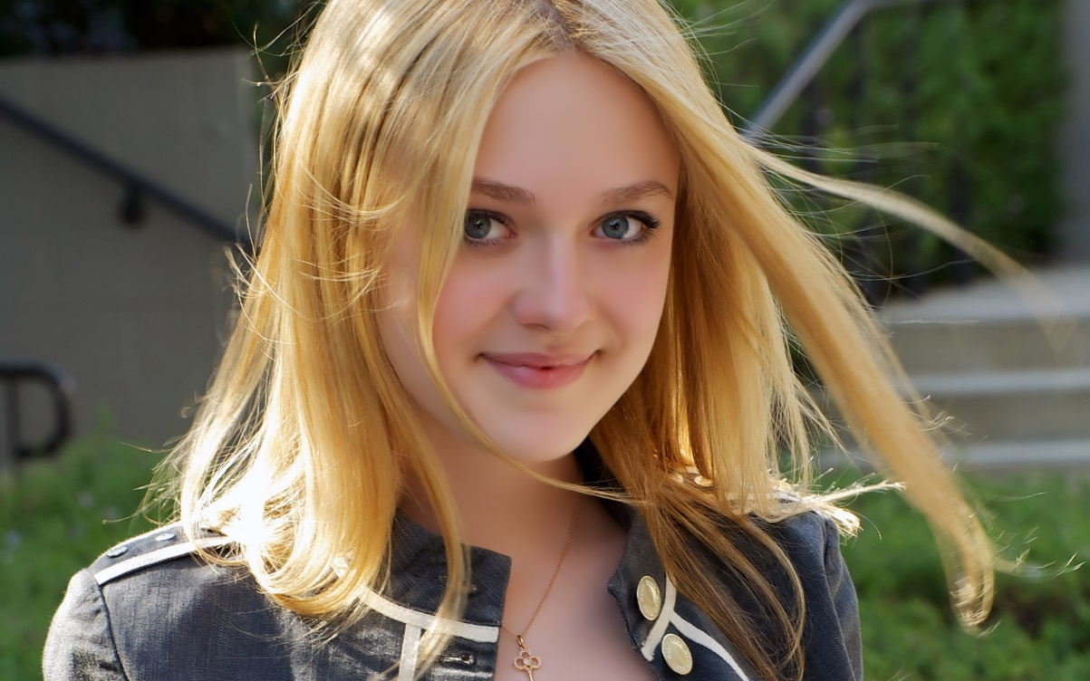
My name is Via. I am Auggie’s older sister. I do not look like Auggie.

Slide 20
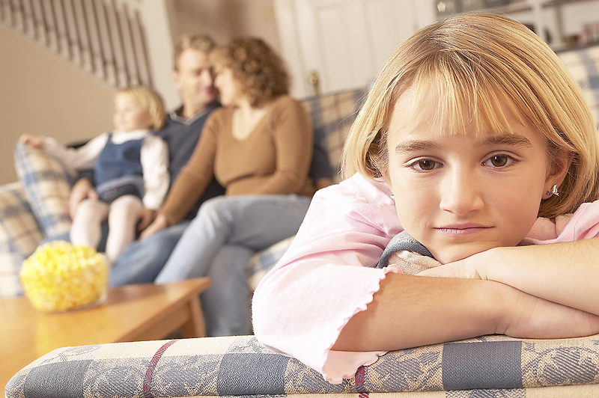
Mom and Dad spend more time with Auggie than with me. It is okay because Auggie has special needs and I do not.

Slide 21
I get angry when people stare at Auggie. I know he is different from other kids. I love my little brother, but sometimes I wish he was normal.

Slide 22
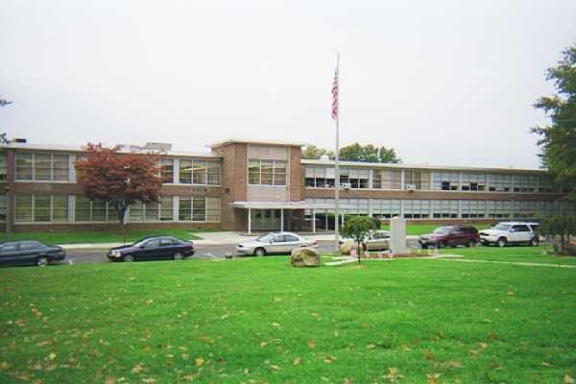
I go to high school. No one knows about Auggie there and I like that.

Slide 23
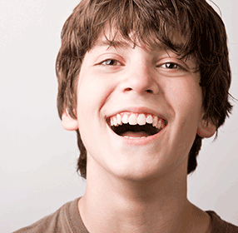
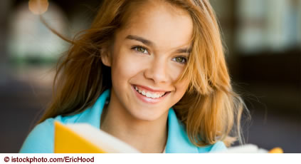
I made new friends in high school. Their names are Eleanor and Justin. I have a crush on Justin, but I do not tell anyone.

Slide 24
I asked Auggie about his first day of school. He told me it was good, but I do not believe him.

Slide 25
Auggie told me that his friend Jack Will made fun of him on Halloween. I was really sad about it. Auggie thinks he is weird, but I do not.

Slide 26
Part 3: Summer

Slide 27
My name is Summer. I go to school with Auggie at Beecher Prep.

Slide 28
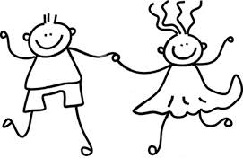
I sat with Auggie at lunch on the first day because he was all alone. I want to be friends with him. He is someone I can always talk to.

Slide 29
People think I am weird for being friends with Auggie. Our classmates think he has the “plague” because he looks different.
Weird

Slide 30
After Halloween, Auggie was different. I do not know why. He said I was not his friend. That is not true.

Slide 31
Auggie told me what happened on Halloween. I promised not to tell anyone.

Slide 32
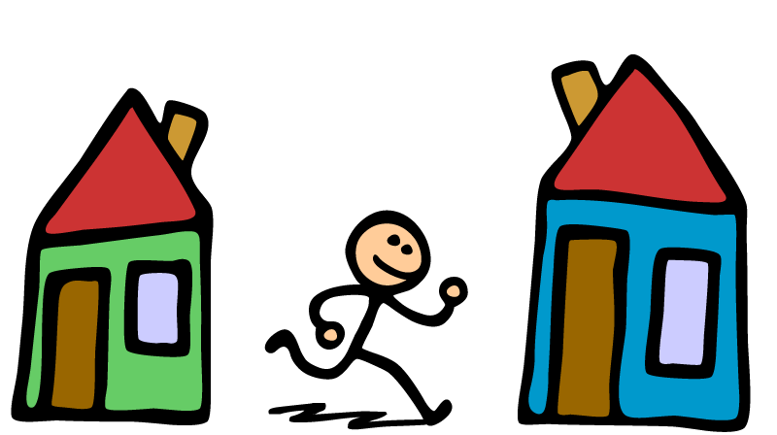
Auggie and I are good friends now. We go to each other’s houses.

Slide 33
Jack Will asked me why Auggie was angry at him. I know I promised Auggie, but I gave Jack Will a hint about it.

Slide 34
Part 5: Jack Will

Slide 35
My name is Jack Will. I am in fifth grade and go to Beecher Prep with Auggie.

Slide 36
I first saw Auggie when I was little. He was scary looking. I was mean to him.

Slide 37
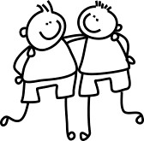
At first, I was only friends with Auggie because I had to be nice. Now, I want to be friends with Auggie. He is really cool and smart. I can tell him anything.

Slide 38
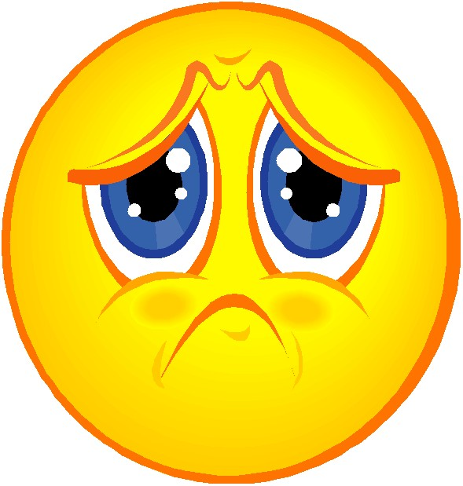
Auggie is not talking to me. He will not even look at me. I am sad, but now the other kids stopped calling me weird.

Slide 39
I know why Auggie is angry at me. I was so mean to him on Halloween. What I said is not true. I feel really bad.

Slide 40
Julian keeps making jokes about Auggie. I hate that. I got so mad at Julian that I punched him in the face.

Slide 41
I got in a lot of trouble for punching Julian. I could not tell Mr. Tushman why I did it. It would make school harder for Auggie.

Slide 42
People are really mean to Auggie. Even some parents. They want him kicked out of school. That is not fair. He belongs in school just like everyone else.

Slide 43
Auggie and I are friends again. I said I was sorry. I am happy. The other kids are not my friends anymore. That is okay. I do not want to be friends with mean people.

Slide 44
Part 5: Justin

Slide 45
My name is Justin. I am Via’s boyfriend. I go to high school with her. I like her a lot.

Slide 46
Via has told me about Auggie. I was very shocked when I met him. He looks different, but is a nice kid.

Slide 47
I am different like Auggie. I have tics. I blink a lot and move my head when I am nervous. When people make fun of him, I get upset and angry.

Slide 48
I think about Auggie a lot. The world “was not kind to him.” He does not have a normal face. It is sad, but his family is really nice. They make Auggie feel like a normal kid.

Slide 49
Part 6: Auggie

Slide 50
Julian keeps putting notes with mean words in my locker. He is mean to Jack Will and plays tricks on him. We can not say anything because it will get worse.

Slide 51
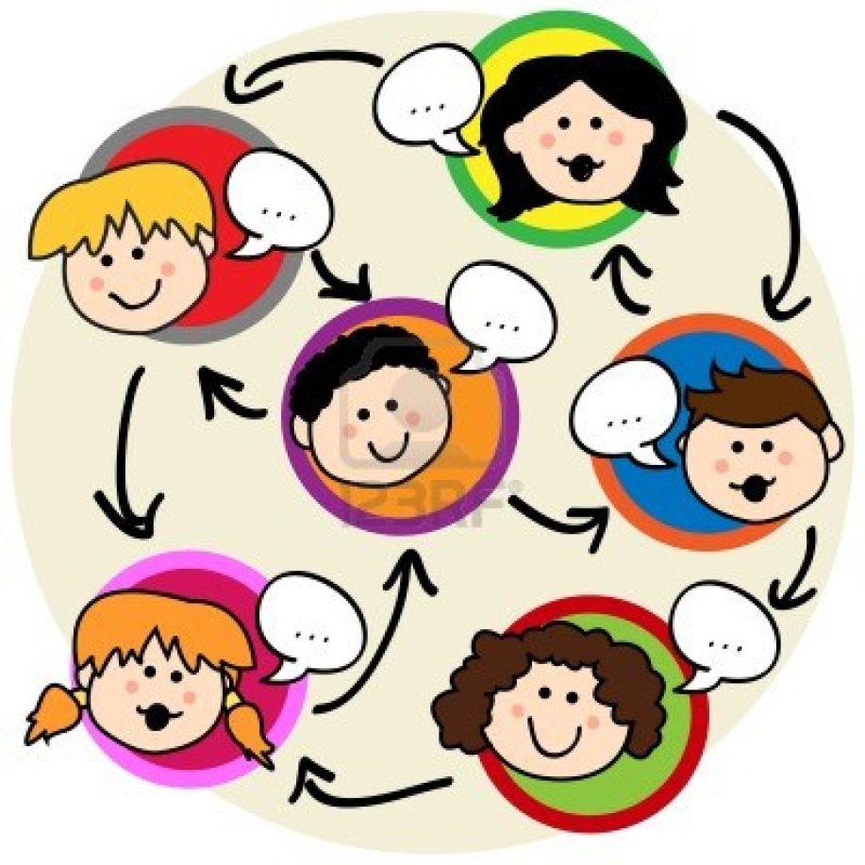
Other kids in school are starting to like me. They do not walk away from me. They talk to me. They do not make fun of my glasses or hearing aids.

Slide 52
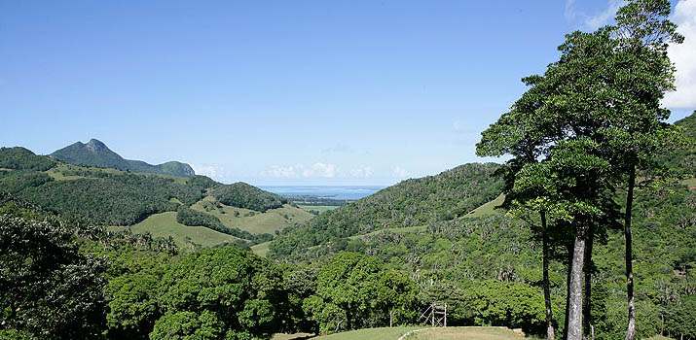
My fifth grade class was going on a nature trip. It was for three days! I was nervous. I never was away from home before.

Slide 53
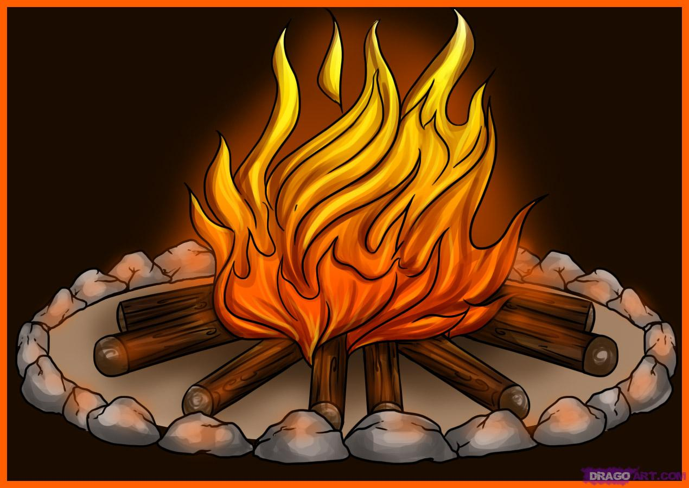
At the camp site, we all had cabins to sleep in. We went on hiking trips, saw a lot of birds, and had a campfire.

Slide 54
We went to watch a movie outside. There were three other schools there too.

Slide 55
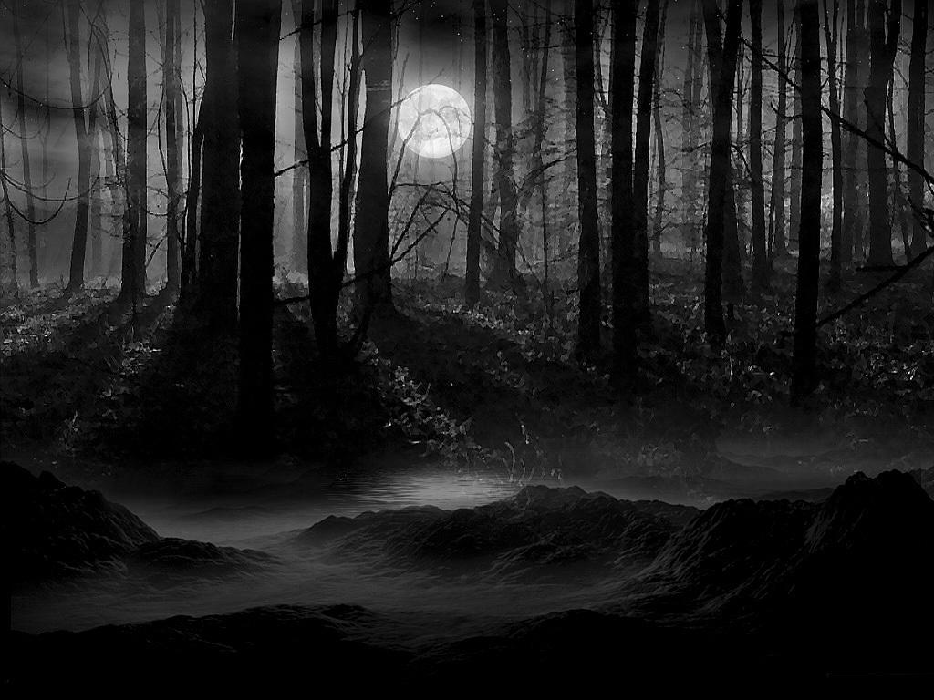
Jack Will and I left the movie to go into the woods. We saw some kids from our school there too.

Slide 56
We ran into some seventh graders. They were scary. They stared at me and called me mean names. They started pushing us.

Slide 57
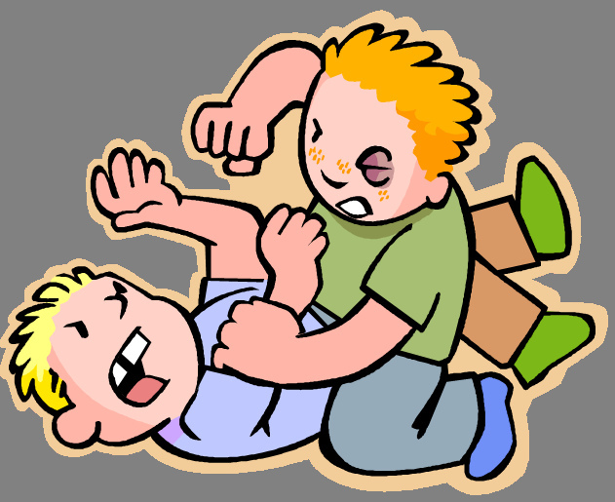
They pulled at my clothes. They broke my hearing aids. They started fighting us. Jack Will and the other kids helped me, and we ran out of the woods. I was really sad.

Slide 58
?
The camping trip was good, but the mean kids made me sad. “When I grow up, is it always going to be like this?”

Slide 59
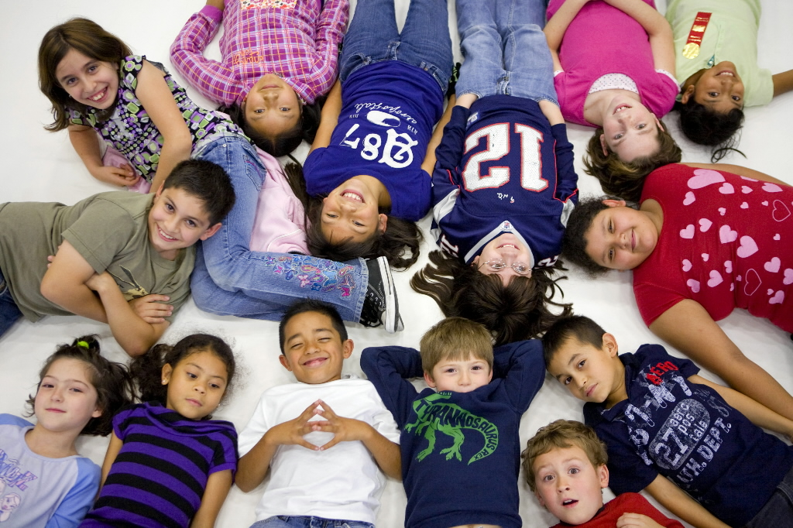
After the camping trip, people were nicer to me. I really like school now. I have many friends.

Slide 60
I graduated from fifth grade. It was a lot of fun. I even was given an award! Mr. Tushman told me I was a great student and courageous. I am very happy.

Slide 61
My first year at a real school was hard. I am happy I go to Beecher Prep.

Slide 62
Everyone sees me as being different. They do not know what my life is like. They think it is hard. To me, I think I am ordinary.

Slide 63
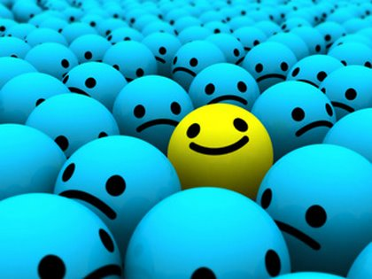
I do not have a normal face like my friends, but that does not mean that I am different or ugly. It just makes me unique.

Slide 64
The End

Slide 65
Definitions:
Extraordinary: special, not common
Weird: odd, unusual
Plague: a very bad sickness
Courageous: not being scared
Unique: different from everyone else

