Slide 1
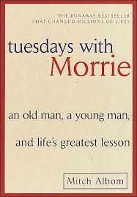
Tuesdays With Morrie By Mitch Albom

Slide 2
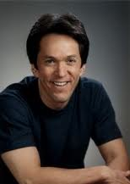
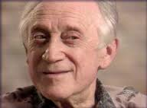
This is a true story. Mitch and Morrie were real people.

Slide 3
The Curriculum

Slide 4
Mitch just graduated from college.

Slide 5
After the ceremony he went to find his favorite professor.

Slide 6
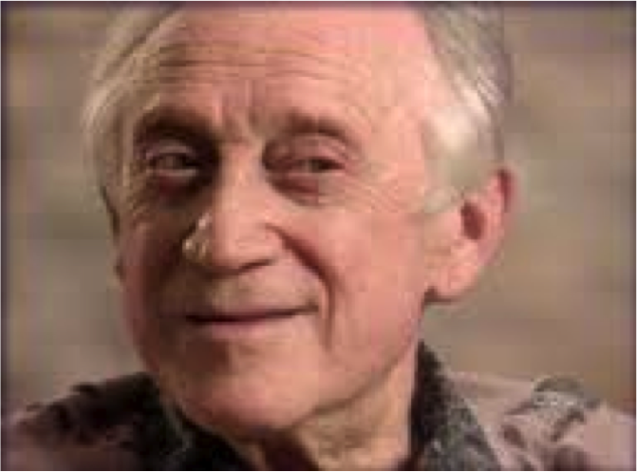
His name is Morrie.

Slide 7
Mitch gave Morrie a goodbye gift. The gift was a briefcase that had Morrie’s initials on it.

Slide 8
Morrie was so sad to see Mitch leave college he cried. He asked Mitch to keep in touch. Mitch said he would.

Slide 9
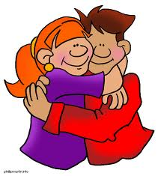
They hugged each other and said goodbye.

Slide 10
The Syllabus

Slide 11
16 years has passed since Mitch and Morrie said goodbye.

Slide 12
Morrie became very sick. He got a disease called Lou Gehrig’s disease.

Slide 13
Morrie would die because of his disease. This disease also made it hard or impossible to do things Morrie used to.

Slide 14
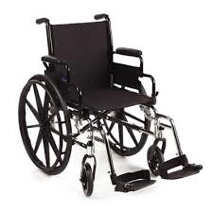
Morrie could no longer walk on his own. He had to use a wheelchair.

Slide 15
Morrie had people who would help him with other stuff. Like eating and getting dressed.

Slide 16
Even though he was sick Morrie always had many visitors. Like his family, friends, and people he worked with.

Slide 17
The Student

Slide 18
Mitch did not keep in touch with Morrie for the 16 years.

Slide 19
Since graduating from college a lot of things have happened to Mitch.

Slide 20
First Mitch’s favorite uncle died from cancer. This made Mitch very sad.

Slide 21
Then Mitch got a job writing about sports.

Slide 22
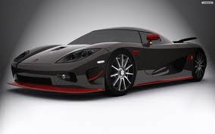
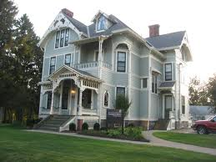
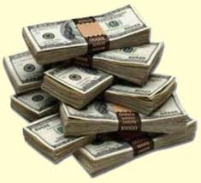
Next he bought a big house, a new car, and made a lot of money.

Slide 23
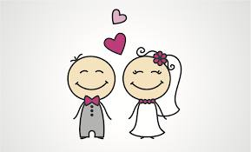
He also married a girl named Janine. Janine loves Mitch a lot.

Slide 24
Even with all things Mitch was sad.

Slide 25
The Audiovisual

Slide 26
Back at Morrie’s house, Morrie was getting ready to go on TV.

Slide 27
For someone was who dying, Morrie was still happy. He wanted to share all of his lessons he learned throughout his life. Morrie was very wise.

Slide 28
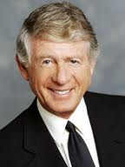
When a man named Ted Koppel found out about Morrie, he wanted to interview Morrie for his TV show called “Nightline.”

Slide 29
Mitch was watching TV at his home. Mitch ended up watching the show “Nightline.” When he heard his professor’s name and that he was dying, he froze.

Slide 30
Mitch became very sad and felt very guilty for not keeping in touch with Morrie.

Slide 31
The Orientation

Slide 32
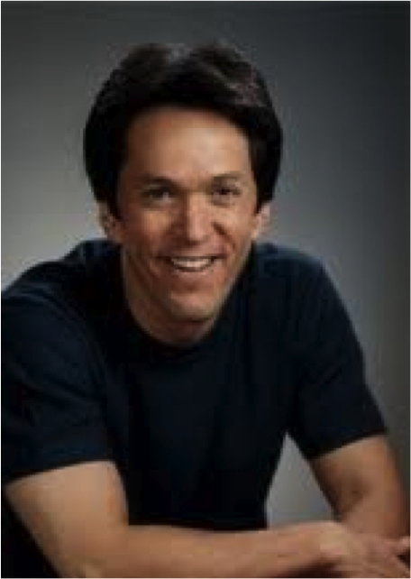
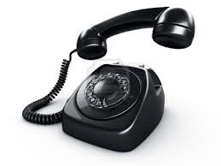
After seeing Morrie on TV Mitch called him. They made plans for Mitch to come and visit Morrie.

Slide 33
When Mitch got to Morrie’s house, Morrie was so happy to see Mitch that he gave Mitch a big hug.

Slide 34
Mitch was glad he got to see his friend, but he was very sad to see how sick Morrie looked.
Mitch
Morrie

Slide 35
The Classroom

Slide 36
Mitch and Morrie talked for hours.

Slide 37
They talked about many different things.

Slide 38
Morrie talked about his disease and how it was going to kill him.

Slide 39
Morrie predicted that he would die from choking. Since the disease made it very hard to breath.

Slide 40
After they finished talking Morrie asked Mitch to come visit him again. Mitch promised he would.

Slide 41
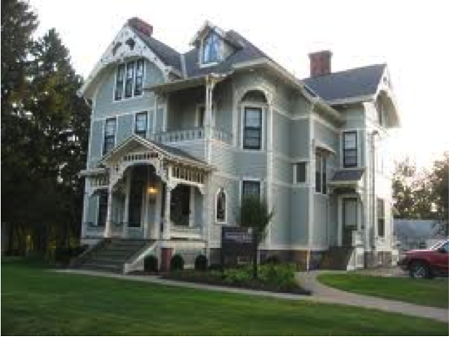
Then Mitch went home.

Slide 42
Taking Attendance

Slide 43
When Mitch went back home we had to go on a business trip to London.

Slide 44
While there he realized how busy everyone seemed to be. He thought about what Morrie said during their last visit.

Slide 45
Morrie said that people think always being busy will make them happy. But that is not true. By being so busy you miss the small things in life that make you happy.

Slide 46
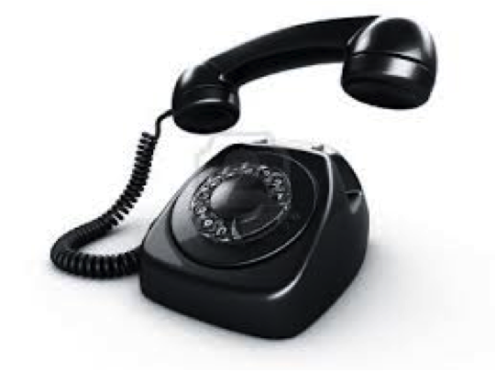
Mitch missed Morrie. So he called Morrie and they planed to meet on Tuesday.

Slide 47
The First Tuesday We Talked about the World

Slide 48
Mitch went to see Morrie. Mitch brought a lot of food with him, because when Mitch was in college, Morrie and him would eat lunch together.

Slide 49
Morrie wanted to share some of his wisdom with Mitch.

Slide 50
Morrie told Mitch that people need to love other people. People also have to let people love them. Everyone deserves love.

Slide 51
Mitch told Morrie he would see him next Tuesday.

Slide 52
Mitch went home.

Slide 53
The Second Tuesday We Talked about Feeling Sorry for Yourself

Slide 54
Mitch went to see Morrie again. Mitch brought more food.

Slide 55
Morrie talked to Mitch about being sad about dying.

Slide 56
Morrie said that he cried sometimes and would feel sad. But it was okay to feel that way.

Slide 57
Morrie tries to stay happy though. He says he is lucky because it gets to say goodbye to his friends and family before he dies.

Slide 58
Mitch went home.

Slide 59
The Third Tuesday We Talk about Regrets

Slide 60
Mitch went to see Morrie again. Mitch brought more food.

Slide 61
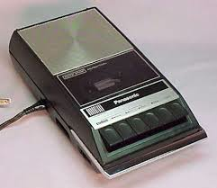
This time Mitch brought a tape recorder. He wanted to record what Morrie and him talked about. That why he would not forget Morrie after Morrie died.

Slide 62
Today Mitch and Morrie talked about how people look at how they are living.

Slide 63
Morrie told Mitch that it is important that people reflect on how they live their lives.

Slide 64
Morrie says that people need to see what they are missing from their lives. That way they can find whatever they are missing and be happy.

Slide 65
Mitch goes home.

Slide 66
The Audiovisual, Part Two

Slide 67
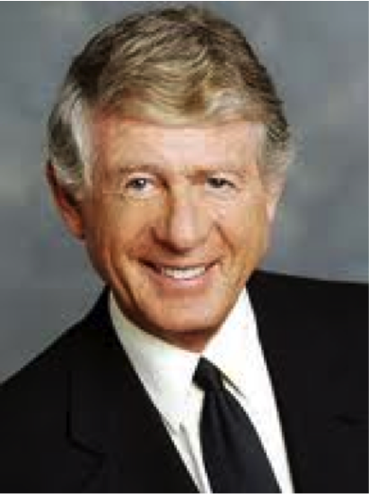
Ted Koppel interviews Morrie again.

Slide 68
Ted and Morrie are starting to become friends.

Slide 69
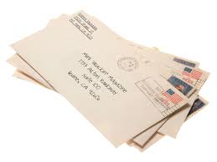
Since Morrie was on TV before he has gotten a lot of letters from people.

Slide 70
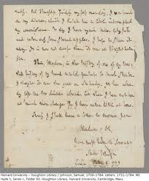
Ted and Morrie talked about a letter he received from a teacher. She had nine students who all had a parent died.

Slide 71
This letter reminded Morrie of when his mom died. This made Morrie very sad and he cried on TV.

Slide 72
The Professor

Slide 73
Morrie remembers when he was eight years old.

Slide 74
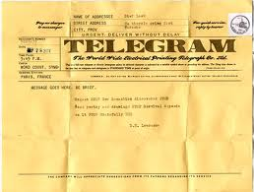
One night his father received a telegram. Since his father couldn’t read Morrie had to read what it said to him.

Slide 75
The telegram said his mother had died. This made Morrie very sad. Morrie cried.

Slide 76
Morrie had a younger brother named David.

Slide 77
David became sick one day and could not move his body. David had polio. This made Morrie sad.

Slide 78
Morrie’s dad married a women name Eva.

Slide 79
Eva loved Morrie and Morrie loved Eva. Eva made Morrie happy.

Slide 80
Morrie was not allowed to tell David about his mother. Morrie’s dad wanted David to think Eva was David’s mother. This made Morrie sad.

Slide 81
Many years passed.

Slide 82
Morrie’s father died of a heart attack. Morrie was not sad. Morrie did not like his father.

Slide 83
The Fourth Tuesday We Talked about Death

Slide 84
Mitch visits Morrie again. Mitch brings more food.

Slide 85
Morrie is starting to look sicker. He now needs a machine to help him breath.

Slide 86
Mitch and Morrie talk about how a person can prepare to die.

Slide 87
Morrie says you need to live like it is your last day.

Slide 88
Morrie points out to Mitch that a person truly knows how to live once they know how to die.

Slide 89
Mitch goes home.

Slide 90
The Fifth Tuesday We Talked about Family

Slide 91
Mitch visits Morrie again. Mitch brings more food.

Slide 92
Morrie looks sicker. This makes Mitch sad.

Slide 93
Mitch and Morrie talk about family.

Slide 94
Morrie tells Mitch that family is very important. Friends come and go but you will always have family.

Slide 95
Mitch tells Morrie that he is not sure if he wants to have children. Morrie does not tell Mitch if he should or should not have children. Instead Morrie tells Mitch “There is no experience like having children.”

Slide 96
This makes Mitch wonder how he would feel if he had no children and ended up being like Morrie one day.

Slide 97
Mitch goes home.

Slide 98
The Sixth Tuesday We Talk about Emotions

Slide 99
Mitch visits Morrie and brings more food with him.

Slide 100
When Mitch gets to the front door he is greeted my Charlotte, Morrie’s wife.

Slide 101
Mitch is surprised to see her. She is usual at work when Mitch visits Morrie.

Slide 102
Charlotte tells Mitch that Morrie is feeling sick today. Charlotte looks tired and worried.

Slide 103
Charlotte tells Mitch that Morrie can no longer eat the food Mitch is bringing, Mitch feels bad about bringing the food.

Slide 104
When Mitch sees Morrie, Morrie is coughing a lot and is having trouble breathing.

Slide 105
When Morrie stops coughing he tells Mitch that is he trying not to think about the coughing and his trouble breathing. He explains thinking about it makes him scared.

Slide 106
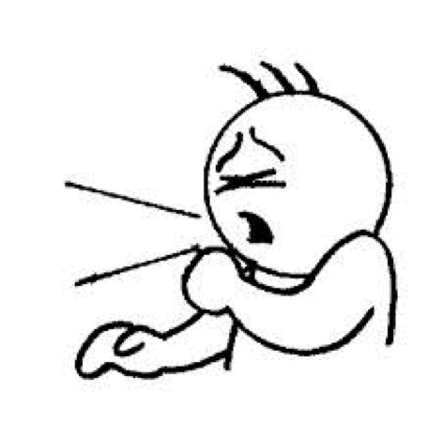
Morrie starts to cough again. Mitch tries to help Morrie by slapping him on the back.

Slide 107
After the coughing stops Morrie tells Mitch that he doesn’t want to die when he is coughing and having trouble breathing.

Slide 108
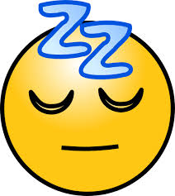
Morrie wants to die peacefully in his sleep, so he won’t feel any pain.

Slide 109
Mitch goes home.

Slide 110
The Seventh Tuesday We Talk about the Fear of Aging

Slide 111
Mitch visits Morrie again. Mitch stills bring food because even though Morrie can’t eat it, Mitch still wants to help Morrie in someway.

Slide 112
Today Mitch asks Morrie if is jealous of people younger than him. Morrie says no. He explains that he already was young once and it is other people’s turn to be young.

Slide 113
Mitch goes home.

Slide 114
The Eighth Tuesday We Talk about Money

Slide 115
Mitch visits Morrie again and brings food.

Slide 116
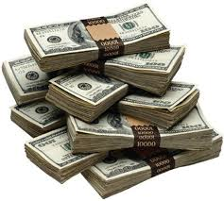
Today Morrie explains to Mitch that money does not make you or other people happy.

Slide 117
Morrie explains that giving people your time is better than giving money. He tells Mitch that he could volunteer and love people more.

Slide 118
Mitch goes home.

Slide 119
The Ninth Tuesday We Talk about How Loves Goes On

Slide 120
Mitch visits Morrie again.

Slide 121
When Mitch sees Morrie, Morrie looks very sick.

Slide 122
Morrie tells Mitch that he was wondering if people would forget about him when he died. But Morrie said that he don’t think people will forget about him, since he has so many people who love him.

Slide 123
Morrie also tells Mitch what he wants written on his tombstone. He wants “A Teacher to the Last.”

Slide 124
Mitch goes home.

Slide 125
The Tenth Tuesday We Talk about Marriage

Slide 126
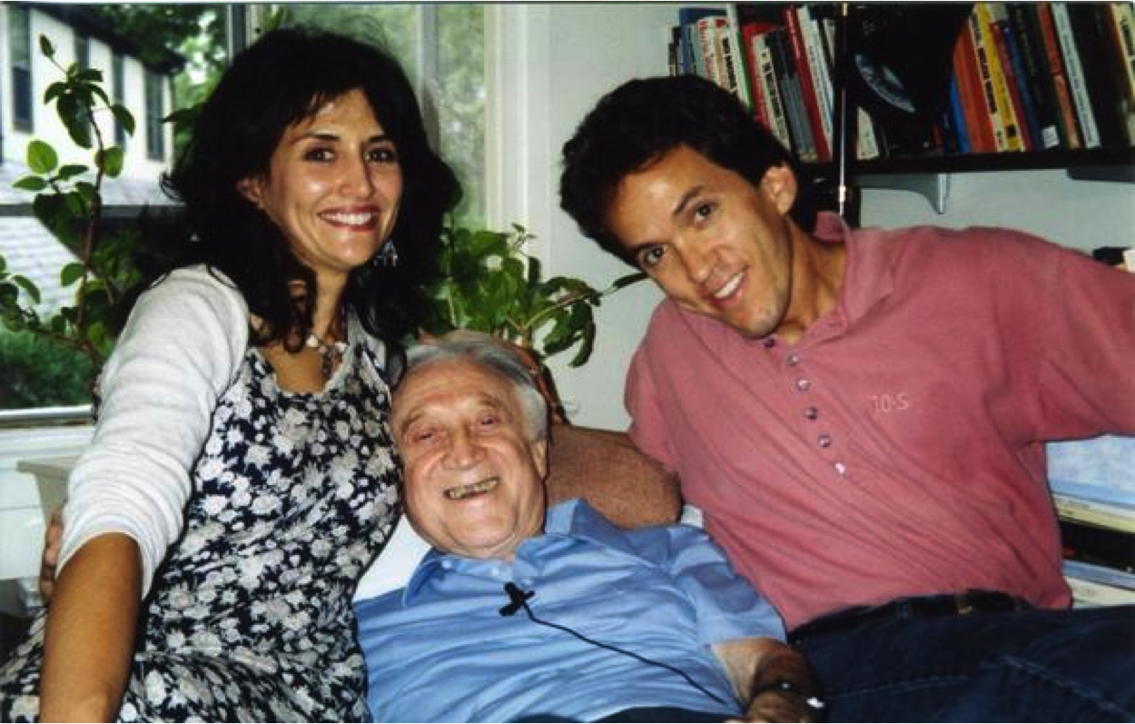
Mitch and his wife Janine go to visit Morrie. Mitch brings more food with them.

Slide 127
Morrie and Janine talk about their lives. Morrie knows that Janine is a singer. He asks Janine to sing a song for him.

Slide 128
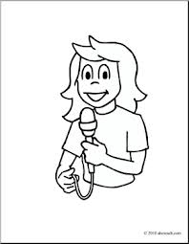
Usually Janine does not like to sing for people, but she sings a beautiful song for Morrie.

Slide 129
After the song Mitch, Morrie and Janine talk about marriage. Morrie says for a marriage to work you need to respect the other person. Learn how to compromise and you need to be truthful.

Slide 130
Morrie also stresses that people need to realize that marriage is important.

Slide 131
Morrie explains that people who do not get married will wish they did when they are older.

Slide 132
Mitch and Janine go home.

Slide 133
The Eleventh Tuesday We Talk about our Culture

Slide 134
Mitch visits Morrie again.

Slide 135
Morrie is getting very sick and is having a very hard time breathing. Morrie starts to cough very badly and Mitch has to hit in on the back to make him stop.

Slide 136
When Morrie stops coughing Mitch and him talk about the culture of America.

Slide 137
Mitch feels that Americans are selfish and Morrie explains to him that to fix this we need to invest in people.

Slide 138
Mitch goes home.

Slide 139
The Audiovisual, Part Three

Slide 140
Ted Koppel interviews Morrie again.

Slide 141
Ted and Morrie are friends now.

Slide 142
During the interview Morrie tells Ted that he is ready to die and that he admires other people who have ALS.

Slide 143
At the end of the interview Morrie tells Ted he has been talking to God.

Slide 144
The interview is over and Ted goes home.

Slide 145
The Twelfth Tuesday We Talk about Forgiveness

Slide 146
Mitch visits Morrie again.

Slide 147
Morrie talks to Mitch about forgiveness.

Slide 148
Morrie stresses that everyone needs to forgive themselves and then forgive everyone else.

Slide 149
Morrie explains to Mitch you should never not forgive someone. Morrie had a friend Norman. Norman made Morrie mad one day and Morrie never forgave him.

Slide 150
Norman died and Morrie is very sad that he never forgave him.

Slide 151
Later on in the day Morrie tells Mitch that if he could have another son he would pick Mitch. This made Mitch happy.

Slide 152
Morrie then tells Mitch he picked a spot to be buried. He wants to be buried on a hill under a tree by a pond.

Slide 153
Morrie asks Mitch if he will visit his grave. Mitch says he will, he also tells Morrie is will visit on a Tuesday.

Slide 154
Mitch went home.

Slide 155
The Thirteenth Tuesday We Talk about the Perfect Day

Slide 156
Mitch visits Morrie again.

Slide 157
When Mitch sees Morrie, Morrie is very sick and using the machine to breath.

Slide 158
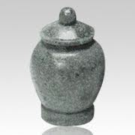
Morrie tells Mitch that he wants to be cremated.

Slide 159
Mitch asks Morrie what Morrie would do if he was healthy again for one day.

Slide 160
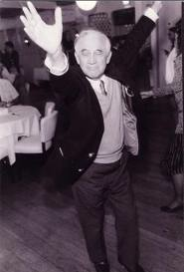
Morrie answers that he would exercise, go out to lunch with friends, take a walk in the evening, enjoy a good dinner, and dance for the rest of the night.

Slide 161
Mitch realizes that Morrie used to do that everyday. Thus Mitch realizes that Morrie is telling Mitch that everyday is a perfect day.

Slide 162
Then Mitch went home.

Slide 163
The Fourteenth Tuesday We Say Good-Bye

Slide 164
Mitch visits Morrie again.

Slide 165
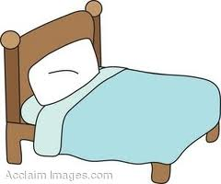
When Mitch sees Morrie he is lying in his bed. Morrie is closed to dying.

Slide 166
Morrie is barely able to speak to Mitch. Morrie and Mitch tell each other that they love one another.

Slide 167
Mitch tells Morrie he will see him next Tuesday but Mitch knows Morrie is going to die before then.

Slide 168
Mitch kisses Morrie on the head and then cries.

Slide 169
Mitch goes home.

Slide 170
Graduation

Slide 171
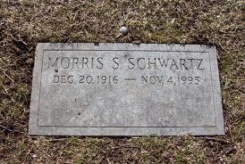
Morrie dies that Saturday in the morning.

Slide 172
The funeral for Morrie was small and everyone was sad.

Slide 173
Mitch talked to Morrie in his head during the funeral. Even though Morrie could not respond to Mitch, this made Mitch feel better.

Slide 174
Conclusion

Slide 175
Mitch turned all of his talks with Morrie into the book you just read.

Slide 176
Morrie and Mitch came up with the title together.

