Slide 1
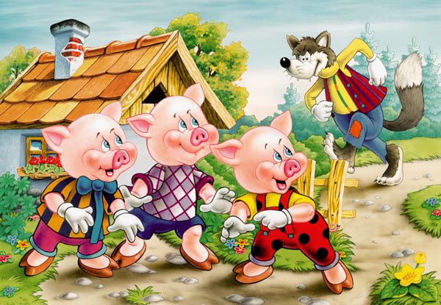
Three Little Pigs
By Walt Disney

Slide 2
Picture Key
Three Bad
Little Wolf
Pigs Story
One Mom

Slide 3
Home/House Hill
Alone Move
Build Straw
Strong Not
Watches Second
First Third

Slide 4
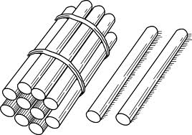
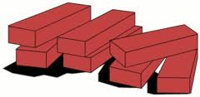
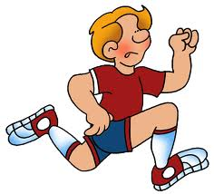
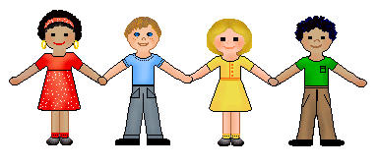
Sticks Bricks
Ask Inside
Huffs/Puffs Blows
Down Runs
Gives up Cries
Happy Together

Slide 5
This is the story of the three
little pigs and one bad wolf.

Slide 6
The three little pigs live with
their mom at home.

Slide 7
The bad wolf lives on top
of a hill alone.

Slide 8
The mom wants the three
little pigs to move out.

Slide 9
Each of the three little pigs
leave home to build a house.

Slide 10
The first little pig builds a
house made of straw.

Slide 11
The house of straw is not
A very strong house.

Slide 12
As the little pig builds his
house the wolf watches.

Slide 13
The second little pig builds
a house made of sticks.

Slide 14
The house of sticks is not
a very strong house.

Slide 15
As the little pig builds his
house the wolf watches.

Slide 16
The third little pig builds a
house made of bricks.

Slide 17
The house of bricks is a
very strong house.

Slide 18
As the little pig builds his
house the wolf watches.

Slide 19
The wolf runs to the first
little pigs house of straw.

Slide 20
The wolf asks to come inside
and the little pig says NO!

Slide 21
The wolf huffs and he puffs
and blows the house down!

Slide 22
The little pig runs to second
little pig’s house of sticks.

Slide 23
The wolf runs to the second
little pigs house of sticks.

Slide 24
The wolf asks to come inside
and the little pigs say NO!

Slide 25
The wolf huffs and he puffs
and blows the house down!

Slide 26
The little pigs run to third
little pig’s house of bricks.

Slide 27
The wolf runs to the third
little pigs house of bricks.

Slide 28
The wolf asks to come inside
and the little pigs say NO!

Slide 29
The wolf huffs and he puffs,
the house does not move!

Slide 30
The wolf huffs and puffs again
and the house does not move!

Slide 31
The wolf gives up and cries
all the way back to his house.

Slide 32
The wolf never bothers the
three little pigs ever again!

Slide 33
The pigs stay in the house of
bricks to stay safe from the wolf.

Slide 34
The three little pigs live
happily ever after together!

