Slide 1


The Giver
By Lois Lowry

Slide 2
Setting
A society on earth in the far future
Takes place many years in future
It is very strict with many rules and orders on how to do things

Slide 3

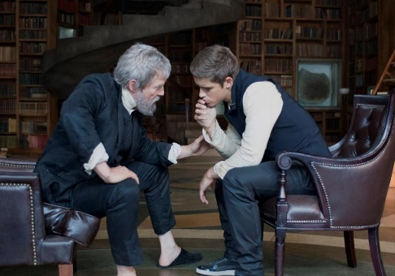
Characters
Jonas- the main character. He is 11 years old, smart, and kind.
The Giver- man that hold’s the communities memories and their wisdom
Jonas’s Mom- a serious, nice lady with an important job
Jonas’s Dad- a very nice man who works with babies
Lily- Jonas’s 7 year old younger sister

Slide 4
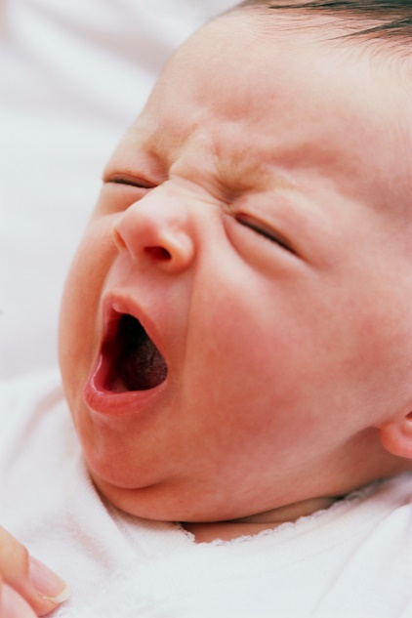
Characters (continued)
Gabriel- the new baby Jonas takes care of at night so Gabriel can sleep
Asher- Jonas’s best friend who is very fun
Fiona- Jonas’s friend who is very nice and takes care of old people
Larissa- an old man that lives in a home with lots of other old people that Jonas becomes friendly with
The Chief Elder- the lady in charge of the community who is very thoughtful

Slide 5

Chapter 1
Jonas is 11 years old. He will be turning 12 soon. He lives with his family. At dinner his family talks about the rules in the community they live in. One rule is that each family should have one boy and one girl.

Slide 6

Chapter 2
Jonas, his mom, dad and sister Lily talk about how Lily came to be a part of the family. Jonas is nervous for a special day called the Ceremony of Twelves. He will learn his job and how to be an adult

Slide 7
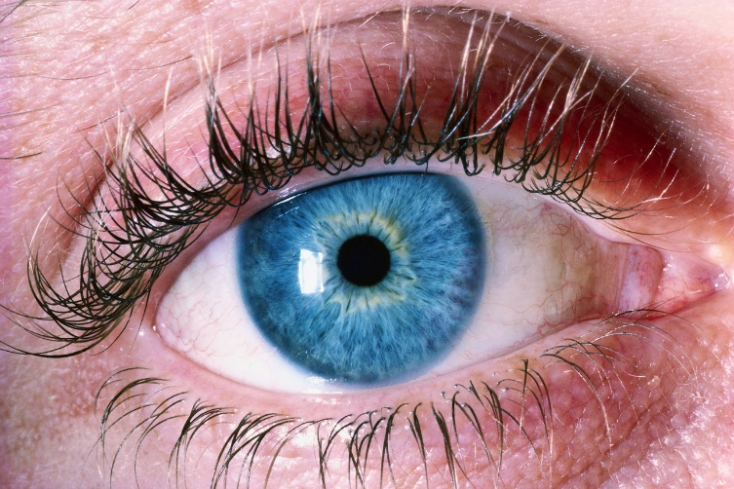
Chapter 3
Lily wants to be a Mom when she grows up. Jonas thinks she should be a speaker. Jonas’s dad brings home a little baby named Gabriel. Gabriel and Jonas have the same eye color.

Slide 8
Chapter 4
Jonas meets his friends, Asher and Fiona. The 3 of them work together at the House of the Old, where the old people live. Jonas helps an old man named Larissa. Larissa tells Jonas about his friend that was released. Jonas does not know what releasing is.

Slide 9
Chapter 5
One night Jonas has a dream about a girl. It was a happy dream. Jonas tells his dad about the dream he had.

Slide 10

Chapter 6
Today is the Ceremony of Twelves. Everyone is going to the party. Jonas has to wait to go. Waiting makes Jonas sad.

Slide 11

Chapter 7
The ceremony starts. All the children who are 11 and turning 12 get their jobs. The Chief Elder does not tell Jonas about his job.

Slide 12

Chapter 8
The Chief Elder tells Jonas he is sorry for making him wait to learn about his job. She tells Jonas that he is the new Receiver of Memory. The Receiver of Memory must be brave, smart, and truthful. Everyone in the community is happy that Jonas is the Receiver of Memory.

Slide 13
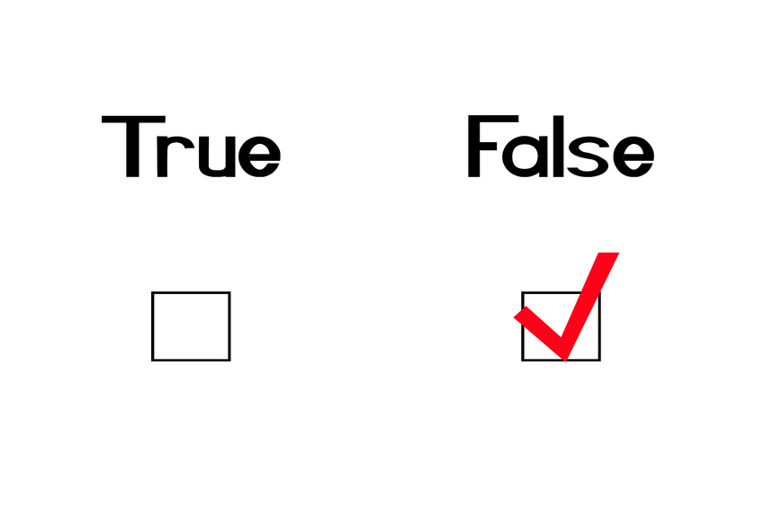
Chapter 9
Jonas learns about his new job. There is a lot to learn. Jonas is surprised because now he will be able to lie.

Slide 14
Chapter 10
Jonas meets with the old Receiver of Memory. He learns that he must keep all the memories of the world. The old receiver gives Jonas the memory of sledding in the snow.

Slide 15

Chapter 11
Jonas learns about weather. He gets a happy memory of sledding and a sad memory of sunburn. The old receiver tells Jonas that he should call him the Giver.

Slide 16

Chapter 12
Jonas has a dream in color. Most people do not see color. Jonas can see his friend Fiona’s red hair. Jonas lies to his parents about his dreams and his new talent. Jonas is happy he can now see colors.

Slide 17
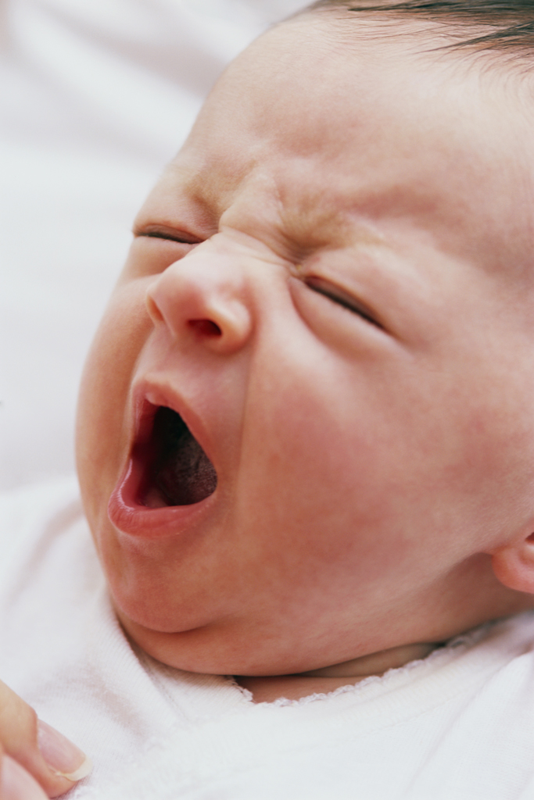
Chapter 13
The Giver tells Jonas about falling off a sled and getting hurt. Jonas is sad and wants medicine. The Giver says that Jonas needs to remember being hurt so he can tell other people. Gabriel, the baby that Jonas’s dad brought home, cries at night. Jonas is afraid Gabriel will be taken away so Jonas tells Gabriel a happy story so he will stop crying.

Slide 18

Chapter 14
Jonas tells his friends that he can see in color. His friends are confused because they only see in grey.

Slide 19
Chapter 15
The Giver shows Jonas pictures of war. Jonas feels pain from this and the Giver feels bad for Jonas.

Slide 20
Chapter 16
The Giver shows Jonas happy memories. Jonas wants a family with grandparents and love. Jonas feels sad so he takes medicine so he is more relaxed. Jonas decides not to take his medicine any more so he can feel pain and love.

Slide 21
Chapter 17
Jonas plays a war game with his friends and he is sad. His friends do not understand why. Jonas’s dad goes to work. His job is to kill sick babies. Jonas is afraid that he will kill Gabriel.

Slide 22
Chapter 18
The Giver tells Jonas about Rosemary. Rosemary was sad when she got memories and asked to be released. Jonas asks the Giver what would happen if he went away. The Giver says the community would be okay.

Slide 23
Chapter 19
The Giver shows Jonas a video of his dad releasing a baby. Jonas’s dad poisons the baby and puts him in a box and in the garbage. Jonas is very, very sad.

Slide 24
Chapter 20
Jonas learns that release means to kill. Jonas wants to run away. The Giver will take care of the community.

Slide 25
Chapter 21
Dad tells the family that Gabriel will be released because he did not sleep. Jonas decides to run away with Gabriel. Jonas will use the memory of the cold to hide him and Gabriel. This way the planes can not find them.

Slide 26

Chapter 22
Jonas and Gabriel are hiding in the woods with animals. They are hungry. They do not have food. Jonas hopes they will find food soon.

Slide 27
Chapter 23
Jonas and Gabriel go outside. It is snowing. Jonas and Gabriel are sledding down a hill. Jonas hears music in his head and has a special memory about love and family.

