Slide 1
The Sisterhood of the Traveling Pants
By: Ann Brashares

Slide 2
Background Information
This book is about four girls whom met even before they were born
Bridget’s mom passed away from depression, Tibby’s parents had more kids, Carmen’s parents got divorced, and Lena seems to have a perfect life.
The four girls continued to remain close and be there for one another when times were tough.
Each of them have different body types

Slide 3
Background Information
They each try on a pair of jeans and miraculously, it fits them all
While getting ready to embark on their different journeys, the girls agree to share the pants throughout the summer because they are convinced they are good luck.
The jeans are with the girls whenever they need them most and make this a summer filled with memories – good and bad.
The girls realize how much value their friendship has & no matter what they will be there for one another.

Slide 4
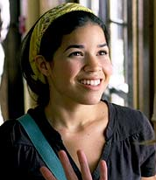
Character Information
Carmen – brown hair, brown eyes; going to visit her dad for the summer; her parents are divorced and she learns her dad is about to get remarried
Tibby – brown hair with some blue, brown eyes; staying home to work at Wallman’s; she will meet people this summer who will change her perspective on how precious life really is
Lena – brown hair, hazel eyes; going to Greece to visit her grandparents; she will learn what it is like to fall in love for the first time
Bridget – blonde hair, blue eyes; going to soccer camp; she brings the girls together even after a summer of crazy adventures for them all which proves how close they all remain

Slide 5
Chapter 1 “Luck never gives: it only lends.” – Ancient Chinese Proverb
Tibby finds a pair of jeans in Carmen’s room and asks to borrow them.
Carmen
didn’t believe they would
fit her because she has
a different body shape.

Slide 6
Chapter 1 “Luck never gives: it only lends.” – Ancient Chinese Proverb
Strangely enough, they fit Tibby. As well as Lena, and then Bridget.
Four girls with completely different builds so the girls came to one conclusion: these pants are magic.

Slide 7
Chapter 1 “Luck never gives: it only lends.” – Ancient Chinese Proverb
Before they go their separate ways, they agreed to meet up where their mom’s first met before they were born, Gilda’s
They each agreed to send the pants to one another throughout the summer.

Slide 8
Chapter 1 “Luck never gives: it only lends.” – Ancient Chinese Proverb
6. Upon our reunion, you must follow the proper procedures for documenting your time in the Pants:
On the left leg of the Pants, write the most exciting place you have been while wearing the pants
On the right leg of the Pants, write the most important thing that has happened to you while wearing the Pants. (For example, “I hooked up with my second cousin, Ivan, while wearing the Traveling Pants.”)
7. You must write to you sisters throughout the summer, no matter how much fun you are having without them.
8. You must pass the Pants along to your Sisters according to the specifications set down by the Sisterhood. Failure to comply will result in a sever spanking upon our reunion.
9. You must not wear the Pants with a tucked-in shirt and belt. See rule #2.
10. Remember: Pants = love. Love your pals. Love yourself.
The girls make a set of rules for wearing the pants:
1. You must never wash the Pants.
2. You must never double-cuff the pants. It’s tacky. There will never be a time when this will not be tacky.
3. You much never say the word “phat” while wearing the Pants. You must also never think to yourself, “I am fat” while wearing the Pants.
4. You must never let a boy take off the Pants (although you may take them off yourself in his presence).
5. You must not pick your nose while wearing the Pants. You may, however, scratch casually at your nostril while really kind of picking.

Slide 9
Chapter 2 “Today is the tomorrow we worried about yesterday.” – Anonymous
Tibby had her first day at Wallman’s where she runs into her crush and avoids him because she is embarrassed
She writes to Bridget and includes a piece of her smock.

Slide 10
Chapter 2 “Today is the tomorrow we worried about yesterday.” – Anonymous
Bridget is at soccer and is feeling happy to be there. She meets some other girls, Diana and Jo, from her cabin and the three of them slept on the beach.

Slide 11
Chapter 2 “Today is the tomorrow we worried about yesterday.” – Anonymous
Carmen is on her plane ride on her way to see her dad
She is thinking of all the activities they will do together and cannot wait to be there already
She also keeps thinking about her friends and what they would be doing if they were with her.
She writes to Tibby:
Tibby, you are with me, even though you aren’t. I love everything about this trip but being apart and knowing your sad about being home. I don’t feel right being happy knowing that. I feel so weird without you guys. Without you here being Tibby, I’m being a little bit Tibby – doing it badly compared to you, though
Infinite X’s and O’s,
Carma

Slide 12
Chapter 3 “Can you make yourself love? Can you make yourself be loved?” – Lena Kaligaris
Lena and her sister, Effie, arrive in Greece.
They are both jet-lagged and their first impression of their grandparents bright blue house with a yellow front door is you would be thought of as a drug-addict if you did that where they live.

Slide 13
Chapter 3 “Can you make yourself love? Can you make yourself be loved?” – Lena Kaligaris
Tibby has orientation at work where she meets her boss, Duncan Howe.
She found someone to be the star in her “suckumentary”, a.k.a. documentary.
While working, Duncan calls her to his office and accuses her of stealing but allows her to have a second chance.

Slide 14
Chapter 3 “Can you make yourself love? Can you make yourself be loved?” – Lena Kaligaris
Lena writes to Carmen
In the letter, she describes her grandparents and explains how they are not what she imagined them to be like and is having a hard time loving them right now because she does not know them even though they are her grandparents.
She mentions, “I feel like I should just love them right away. But how do you do that? You can’t make yourself love someone, can you?”

Slide 15
Chapter 4 “There is no such thing as fun for the whole family.” – Jerry Seinfeld
Lena tries to paint the sunset but when she cannot capture it she comes inside.
Her sister and grandma are cooking dinner before a party they are all going to.

Slide 16
Chapter 4 “There is no such thing as fun for the whole family.” – Jerry Seinfeld
Her grandma mentions how Lena should dress nicely because there is a “nice boy” named Kostos who will be there whom her & her grandfather want Lena to get to know.

Slide 17
Chapter 4 “There is no such thing as fun for the whole family.” – Jerry Seinfeld
Carmen gets off of the plane and ran to her dad as he called her.
He asks about her mom to be polite and then asks about her friends
Carmen explains how they are all doing different things this summer

Slide 18
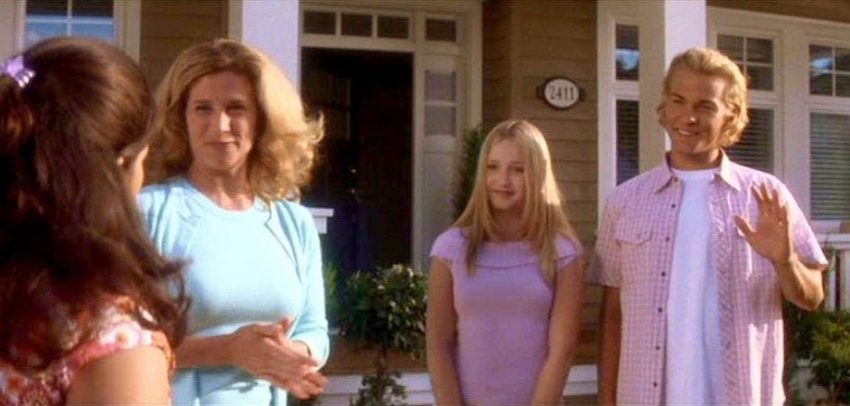
Chapter 4 “There is no such thing as fun for the whole family.” – Jerry Seinfeld
While they were catching up, Carmen notices how they are pulling up to a house and not his usual apartment
He fills Carmen in with how he moved out recently and he brings her inside to meet his fiancée, Lydia, and future stepchildren, Paul and Krista.
Carmen is upset that this was a surprise and she was not warned about it.
To vent, she writes to Bridget to tell her that her summer is going to be different than she expected mentioning, “I’m a guest in the guest room of a family that will never be mine.”

Slide 19
Chapter 5 “Love is like war: easy to begin, hard to end.” – Proverb
Meanwhile, Bridget has a crush on one of the coaches at her camp, Eric, who is a sophomore at Columbia University.
She writes to Carmen gushing about how much she likes him
Even though Lena does not want to meet Kostos, she agrees but is still a bit hesitant.

Slide 20
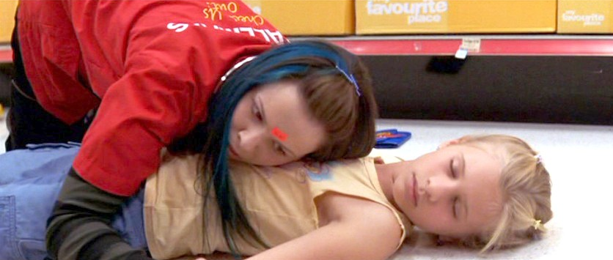
Chapter 6 “Rule #1: The customer is always right. Rule #2: If the customer is wrong, please refer to rule #1.” – Duncan Howe
She looks through her wallet to find some sort of ID but when she gives it to the EMS guy he thinks she stole it
She explained why she had it and after that he treats her like he would anyone else.
She goes in the ambulance with the girl so she is not alone.
Tibby is bored out of her mind while working when she hears a crash in the other aisle.
She rushes over and sees a young girl passed out on the ground.
Immediately she screams for help and stays with her until someone comes.

Slide 21
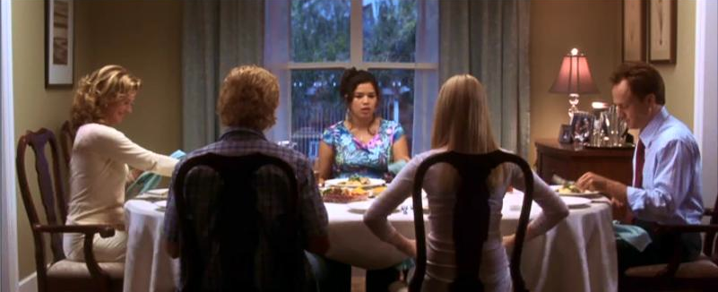
Chapter 6 “Rule #1: The customer is always right. Rule #2: If the customer is wrong, please refer to rule #1.” – Duncan Howe
Carmen has dinner with her father and soon to be stepfamily.
They say grace beforehand which startled her because her father was so against it when he was with her mother.

Slide 22
Chapter 6 “Rule #1: The customer is always right. Rule #2: If the customer is wrong, please refer to rule #1.” – Duncan Howe
Carmen gets more annoyed than she already is so when Krista says how she does not look how she imagined her to so Carmen asked if it was because she was Puerto Rican making Krista uncomfortable because that is not what she meant.
She leaves to call her mom and vent to her. Her mom asks if she’s mad at her dad and not everyone else but Carmen says no which is not true.

Slide 23
Chapter 6 “Rule #1: The customer is always right. Rule #2: If the customer is wrong, please refer to rule #1.” – Duncan Howe
When Eric asks about her mom, she tell him she died which she normally does not do.
When they are finished with their run, she ran into the water where he followed.
In order for Eric to notice her more, Bridget goes for a six mile run which he is in charge of.
She sprints up to the front and starts talking with him. They talk about their parents a little bit and their background.

Slide 24
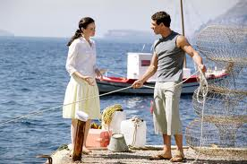
Chapter 7 “When life hands you a lemon, say, ‘Oh yeah. I like lemons. What else ya got?’” – Henry Rollins
Lena has breakfast silently with her grandfather because neither of them would be able to understand each other very well.
After she eats a little bit, she goes outside to paint.
She runs into Kostos but is quickly trying to get away

Slide 25
Chapter 7 “When life hands you a lemon, say, ‘Oh yeah. I like lemons. What else ya got?’” – Henry Rollins
Bridget writes to Tibby saying how great it is there but she’s “glad my real life is not like this, full of people like me, ‘cause the I wouldn’t have you, would I?”
She also fills her in with how she is in love with Eric

Slide 26
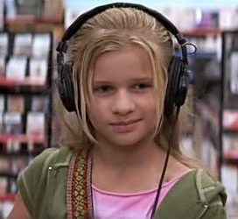
Chapter 7 “When life hands you a lemon, say, ‘Oh yeah. I like lemons. What else ya got?’” – Henry Rollins
Tibby realizes she forgot to return the little girls wallet.
She finds her library card and sees that her name is Bailey Graffman. She grabs the phonebook, looks up her name, and goes over to give it back.
Bailey’s mom opens the door and invites Tibby in to give it to Bailey herself.

Slide 27
Chapter 7 “When life hands you a lemon, say, ‘Oh yeah. I like lemons. What else ya got?’” – Henry Rollins
Right as Tibby goes upstairs to hand her wallet back, Bailey starts to test her.
Her mom calls up saying it is time for her medicine. Tibby goes downstairs to get it for her where her mom tells her that Bailey has leukemia.

Slide 28
Chapter 7 “When life hands you a lemon, say, ‘Oh yeah. I like lemons. What else ya got?’” – Henry Rollins
When she got back upstairs, Bailey knew her mom had said something because Tibby started acting differently.
She becomes angry, asks Tibby to leave & she does just that.

Slide 29
Chapter 7 “When life hands you a lemon, say, ‘Oh yeah. I like lemons. What else ya got?’” – Henry Rollins
Lena writes to Carmen, mentioning Kostos, but also making it clear she does not intend to date him no matter her grandmothers wishes.
Carmen goes to a party to make her dad happy.
There, she meets Paul’s girlfriend and causes trouble by saying she lives with him making it sound worse than it actually was.

Slide 30
Chapter 8 “I have seen the future and it’s like the present, only longer.” – Dan Quisenberry
Tibby helps her mom feed her younger siblings and remembers what it was like before they were born.
She wanted to bring up Bailey but realized things were just too hectic at the moment.
Bridget is being very flirtatious towards Eric and does whatever she can to talk to him or get his attention.
She writes to Carmen explaining how mischievous she is being as well as sharing some sight-seeing she has done.

Slide 31
Chapter 8 “I have seen the future and it’s like the present, only longer.” – Dan Quisenberry
It is Lena’s last day with the pants.
She goes to paint but it starts to get very hot.
She starts to take off her clothes and goes into the water.
She hears someone there and sees Kostos standing there not knowing what to do.
He apologizes but she thinks he did it on purpose.
She rushes home and tells her grandmother that Kostos is not the nice boy that she thinks he is.

Slide 32
Chapter 9 “Sometimes you’re the windshield: sometimes you’re the bug.” – Mark Knopfler
Krista is having difficulty with her geometry homework which Carmen is really good at but she does not offer to help.
Instead she goes with her dad to play tennis.
She writes to Bridget calling Paul’s girlfriend, “Skeletor” and claims that Paul does not like her because she caused problems between him and his girlfriend..

Slide 33
Chapter 9 “Sometimes you’re the windshield: sometimes you’re the bug.” – Mark Knopfler
Bailey visits Tibby at Wallman’s and they go at it again.
Bailey asks her to go out for ice cream when she gets off of work.
When they go, Tibby learns that Bailey’s ground rules are:
1. Don’t lie
2. Don’t ask her how she’s feeling.

Slide 34
Chapter 9 “Sometimes you’re the windshield: sometimes you’re the bug.” – Mark Knopfler
She learns how Bailey is actually interested in her documentary
Tibby also sees her crush again who she has been avoiding.

Slide 35
Chapter 9 “Sometimes you’re the windshield: sometimes you’re the bug.” – Mark Knopfler
Bridget sees if her friends want to go to a bar near by where the coaches hang out.
Some of them agree to go. Once they got there, Bridget starts to dance immediately. She knows Eric is there and watching her.
Eric and the other coaches join Bridget and her friends in dancing.
Eventually, her and Eric dance for a little but only briefly until Eric says they cannot do this.
Bridget writes to her dad asking him to send nice clothes, telling him everything is going well, and to say hi to her brother.

Slide 36
Chapter 9 “Sometimes you’re the windshield: sometimes you’re the bug.” – Mark Knopfler
Lena hears her grandfather yelling downstairs.
She rushes there only to follow her grandparents who are headed to Kostos’s grandfather’s house.
Both grandfather’s begin yelling at each other until Lena’s grandfather punches Kostos’s grandfather in the face.
Kostos breaks up the fight and Lena is mortified.

Slide 37
Chapter 10 “If you feel like you’re under control, you’re just not going fast enough.” – Mario Andretti
Carmen and her dad are on their way to play tennis.
They talk about the wedding in the car and her dad gives Carmen some background information on Lydia’s life and her first husband.
He was an alcoholic and after hearing that, she feels bad. She promised herself she would be nicer to them all.
Her dad asks if they can go and see Paul’s soccer game and Carmen starts to feel upset again.

Slide 38
Chapter 10 “If you feel like you’re under control, you’re just not going fast enough.” – Mario Andretti
Bridget is not able to sleep so she goes swimming instead.
She decides that she is going to show off her skills a bit at the scrimmage.
She was doing well but was hogging the ball and not playing like a team player so her coach took her out.

Slide 39
Chapter 10 “If you feel like you’re under control, you’re just not going fast enough.” – Mario Andretti
Carmen writes to Tibby about some of the wedding preparations and how that is all they talk about.
When they are watching Paul play soccer, she sees how her dad acts so proud of Paul and it makes her jealous.
Lydia shows up to the game upset because the reception hall overbooked so now they don’t have a place to have the wedding.
Carmen’s dad cancels their tennis plans and tells her that Paul will drive her home.
He does, but before that, he offers to go and play tennis with her which they did.

Slide 40
Chapter 11 “The problem is not the problem. The problem is your attitude about the problem. Got that?” – Coach Brevin
Lena’s grandfather had to get four stitches on his cheek while Kostos’s grandfather just complained of his nose hurting.
There was a drop of blood left on the pants.
She says to herself how she will clear things up with what actually happened later.

Slide 41
Chapter 11 “The problem is not the problem. The problem is your attitude about the problem. Got that?” – Coach Brevin
Bridget writes to Lena how she played too hard and needs to calm down.
She also explains how much she wants Eric, jokingly saying how Lena may be mature enough to handle her hormones but others, like herself, are unable to do so.

Slide 42
Chapter 11 “The problem is not the problem. The problem is your attitude about the problem. Got that?” – Coach Brevin
Bailey surprises Tibby by coming over.
She came over to tell her that she wants to help with the documentary but Tibby says no because she hasn’t started yet.
Bailey holds Mimi, Tibby’s guniea pig, and asks Tibby questions she never even thought about.
Then, she makes Tibby feel guilty until she lets her help out with the documentary.
Bailey asks about her younger siblings and mentions that they are really young. They both agree that Tibby was like their experiment child.

Slide 43
Chapter 11 “The problem is not the problem. The problem is your attitude about the problem. Got that?” – Coach Brevin
Lena writes to Tibby filling her in with what happened with Kostos. From him seeing her skinny-dipping, to the fight, and how she has no idea what to do now.
Now it is Tibby’s turn to have the pants.

Slide 44
Chapter 11 “The problem is not the problem. The problem is your attitude about the problem. Got that?” – Coach Brevin
Carmen was trying to find something to do because everyone was busy. She sees Krista’s homework on the table and completes the rest of it.
Paul saw her complete it but the next day when Krista asked him, he did not tell who it was.
Paul leaves to go and visit his dad but Krista stays home. She does not have contact with him.
Lydia tells Carmen how the reception will now be in the backyard expecting her to be somewhat excited but she does not act thrilled.
Her and her dad go to the tennis courts to play a little.
She finds out that Krista doesn’t go to see her dad because it upsets her but Carmen takes it as she is ashamed of him commenting, “You can’t just abandon your family.

Slide 45
Chapter 11 “The problem is not the problem. The problem is your attitude about the problem. Got that?” – Coach Brevin
Bailey informs Tibby how she found someone to interview for the documentary.
She says it is the kid who plays arcade games in the 7/11 across from Wallman’s

Slide 46
Chapter 12 “If you don’t find it in the index, look very carefully throughout the entire catalog.” – Sears, Roebuck catalog
Tibby and Bailey go over to interview Brian and Tibby is actually interested in filming him.
She was also surprised at how she did not need to help Bailey set up the video equipment, she did it herself.

Slide 47
Chapter 12 “If you don’t find it in the index, look very carefully throughout the entire catalog.” – Sears, Roebuck catalog
Eric held another run early in the morning which Bridget went to.
While they were running, Eric told her how she is a really good player but she admitted that she was showing off for him.
He asks her to not push anything because it is against the rules and even though she said she doesn’t care about the rules, he said he does not have a choice.

Slide 48
Chapter 12 “If you don’t find it in the index, look very carefully throughout the entire catalog.” – Sears, Roebuck catalog
Lena has breakfast with her grandpa, Bapi, again.
She was about to tell him just what happened with Kostos but ends up keeping quiet.
Bridget writes to Carmen about some of the sights she has seen. She throws in there how she wishes she were there with her.

Slide 49
Chapter 13 “Before you criticize someone, you should walk a mile in their shoes. That way, when you criticize them, you are a mile away from them, and you have their shoes.” – Frieda Norris
Carmen, Lydia, and Krista have an appointment with a dressmaker for the wedding.
The dressmaker acted surprised that she was related to her dad which got her annoyed so she responded that her mother was Puerto Rican with some other wise cracks.
The dress does not fit Carmen and the comments being made by the dressmaker only spark her anger.
She storms out of the store, making a comment about how Lydia’s dress looks in the process.

Slide 50
Chapter 13 “Before you criticize someone, you should walk a mile in their shoes. That way, when you criticize them, you are a mile away from them, and you have their shoes.” – Frieda Norris
Tibby is wearing the pants to work right when she gets them from Lena
Bailey tells her they fit her perfectly.
Now, Bailey is asking if anything good has happened with them yet, getting to know about all the other girls while she’s asking.
Tibby sees her crush again and gets mad when Bailey is snippy to him.
This time, they both interview Margret who works at a movie theater in town.
Bailey asks her if they could all watch a movie together and Margret seemed surprised but agreed.
Tibby was curious if Margret ever watched the movies with other people or just by herself.

Slide 51
Chapter 13 “Before you criticize someone, you should walk a mile in their shoes. That way, when you criticize them, you are a mile away from them, and you have their shoes.” – Frieda Norris
Bridget cannot sleep and goes for a walk.
She walks outside Eric’s room and wakes him up.
He tells her she cannot be there and is half asleep.
He tells her to leave after she touches his head and chest because he cannot handle her right now but she took this as words of encouragement rather than to stay away.

Slide 52
Chapter 14 “Time tells the truth.” – Fortune Cookie
Bailey asks Tibby if she can wear the pants.
She lets her and then Bailey wants her to interview her.
So she asks Bailey what she is afraid of and Baily replies with, “I’m afraid of not having enough time. Not enough time to understand people, how they really are, or to be understood myself.”
Tibby writes to Carmen to send her the pants. She said she cannot figure out what the pants mean to her just yet.

Slide 53
Chapter 14 “Time tells the truth.” – Fortune Cookie
Kostos’s family is now ignoring Lena’s grandmother.
Effie feels bad for Kostos but Lena is embarrassed to tell her grandparents what actually happened.
Bridget tries to call Tibby but Tibby’s housekeeper answered the phone and the connection was not good.

Slide 54
Chapter 14 “Time tells the truth.” – Fortune Cookie
Carmen went downstairs and was expecting Krista or Lydia to bring up the dressmakers.
When they pretend it did not happen, Carmen feels invisible. She gets mad, walks out of the house, and slams the door.

Slide 55
Chapter 15 “Of the thirty-six ways of avoiding disaster, running away is the best.” - Anonymous
Carmen thinks her dad may be worried so she heads back to the house.
When she gets there, she sees them through the window sitting down ready to eat.
To retaliate, she picked up a rock and threw it at the window and then ran away.
Bridget writes to Tibby explaining how much she loves the outdoors.

Slide 56
Chapter 15 “Of the thirty-six ways of avoiding disaster, running away is the best.” - Anonymous
Carmen goes back to the house to get her stuff.
After that, she goes to find a bus to go home.
She writes to Bridget sending her the pants, saying how she did not behave decently with them and she hopes she does better with them.
Rather than courage, energy, and love, she sends them to Bridget with “good sense”.
Lena tries to go and find Kostos.
She finds him but when she calls his name, he does not see her.

Slide 57
Chapter 16 “Life is so…whatever.” – Kelly Marquette, aka Skeletor
Bridget is thinking about being intimate with Eric.
She believes it is going to be a good night because she just got the pants in the mail.
Later in the day, she played well in her game in front of Eric. He even gave her a thumbs up.
Right when she comes back, Carmen rushes into Tibby’s room and starts to cry.
When she is able to speak, she says how she hates Lydia, Krista, and Paul but cannot explain why she does.
Tibby asks if she is mad at her dad but Carmen says no and gets angry.
She is confused as to where the old Tibby who hated the world went when Tibby told her that there are things that could be worse.
After that, Carmen leaves Tibby’s room, now upset with her.

Slide 58
Chapter 16 “Life is so…whatever.” – Kelly Marquette, aka Skeletor
Tibby writes to Lena about the documentary and who is helping with what.
In addition to that she says who is in the documentary as well.
Bridget was told to play defense by her coach but when her coach told her to not pass the midfield, she listened at first.
Then when she saw the perfect opportunity, she went and score. Everyone cheered except for her coach.

Slide 59
Chapter 17 “You make all kinds of mistakes: but as long as you are generous and true and also fierce you cannot hurt the world or even seriously distress her.” – Winston Churchill
Lena tries to go and paint at the pond again.
While she is there, she hears a splash and sees Kostos swimming naked.
She then realizes that her favorite place was Kostos’s favorite place and that is why he was there.
She felt as if she were intruding.

Slide 60
Chapter 17 “You make all kinds of mistakes: but as long as you are generous and true and also fierce you cannot hurt the world or even seriously distress her.” – Winston Churchill
Bridget writes to Lena how she thinks it is going to be a big night for her.
She cannot sleep again and goes for a walk.
She sits at the ocean where she has memories of her and her brother but cannot think of her mom being there.
She goes and finds Eric at his cabin.
He comes outside and they kiss.
She goes back into her room to go to bed but is overwhelmed with emotion.
She cries from all of the emotion she has inside.

Slide 61
Chapter 17 “You make all kinds of mistakes: but as long as you are generous and true and also fierce you cannot hurt the world or even seriously distress her.” – Winston Churchill
Lena writes to Tibby how she found out it was Kostos’s spot and she feels silly.
She was glad to have Kostos look at her again though.
At the end, she asks Tibby if she has heard from Bridget.
Carmen is thinking why her dad has not called her yet but continues to make excuses for him.
She feels guilty about what happened even though he has not contacted her either.

Slide 62
Chapter 18 “Wish for what you want. Work for what you need.” – Carmen’s grandmother
Effie tells Lena how she made out with Andreas, a Greek waiter.
Lena asks about her boyfriend, Gavin, but Effie brushes it off.
Effie tells Lena how she could have made out with Kostos but lost her chance.
Lena starts to draw Kostos but doesn’t realize he walked behind her.

Slide 63
Chapter 18 “Wish for what you want. Work for what you need.” – Carmen’s grandmother
Bridget has stayed in bed the whole day after she was with Eric.
Everyone is concerned about her because she is normally so outgoing.
Carmen tries to write a letter to her dad apologizing, sending him the money for the window but decides it is best to just send the money because she cannot find the right words without being sarcastic.

Slide 64
Chapter 18 “Wish for what you want. Work for what you need.” – Carmen’s grandmother
Lena is worried about Bridget.
Her concern makes her curious about Kostos and why he lives with his grandparents.
Her grandma explains that his parents and baby brother died in a car accident so he was sent to Greece to live with his grandparents.
After hearing this she feels sad and does not understand how him and Bridget, “who had lost everything, were still open to love, and she who’d lost nothing, was not.”

Slide 65
Chapter 19 “My karma ran over my dogma.” – Bumper sticker
Bridget writes to Carmen but Eric comes up to see her.
He apologizes for the night before & she gets angry with him.
She writes to Carmen saying she wishes she had some good sense too.
Bailey helps Carmen realize it is okay to be angry with her dad.

Slide 66
Chapter 19 “My karma ran over my dogma.” – Bumper sticker
One day when Tibby’s shift is over, she goes to check on Bailey. A neighbor tells her that she is at the hospital. Bailey’s mom explains to Tibby that there is not much more she can do and things are not looking good. Her mom thanks her for being such a good friend to her.

Slide 67
Chapter 20 “You can take a road that gets you to the stars. I can take a road that will see me through.” – Nick Drake
Lena wants to paint Kostos an apology.
She also wants to learn some Greek so her and her grandfather can talk to each other at breakfast before she leaves.
Tibby calls out sick from work because she does not want to think about Bailey not coming to meet her afterwards.
She realizes her guinea pig isn’t moving and will not accept that is is dead.
She tries to write to one of her friends but realizes she has nothing to say.

Slide 68
Chapter 20 “You can take a road that gets you to the stars. I can take a road that will see me through.” – Nick Drake
Carmen finally admits to her mom that she is mad at her dad.
Bailey called Tibby but Tibby didn’t answer her.

Slide 69
Chapter 20 “You can take a road that gets you to the stars. I can take a road that will see me through.” – Nick Drake
Bridget gets up to play again but does not play with the same heart she normally does. Her coach yells at her to hustle but that just causes Bridget to get angry, yell back, and walk off the field.

Slide 70
Chapter 21 “What you do speaks so loudly that I cannot hear what you say.” – Ralph Waldo Emerson
Carmen finally called her dad and told him she was mad at him.
Not only that, she asked him questions she never did before, hitting them both hard with emotion.

Slide 71
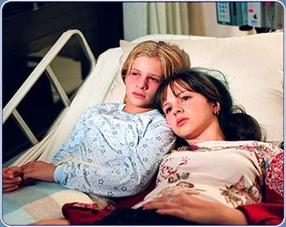
Chapter 21 “What you do speaks so loudly that I cannot hear what you say.” – Ralph Waldo Emerson
Tibby got a call from Bailey’s mom once again updating her with Bailey’s condition because she has not returned their phone calls.
Carmen tells Tibby to go over and see Bailey. She goes and when she gets to the hospital she sees a different Bailey. This Baily is tiny with tubes in her helping her stay alive.
Lena realizes she is like her Bapi – proud, silent, fearful. She thinks about how even with that, he gave a chance with love and she hoped she would do the same one day.

Slide 72
Chapter 22 “All Moanday. Tearday. Wailsday. Thumpsday. Frightday. Shatterday.” – James Joyce
Effie tells Lena she is in love with Kostos and tries to have her admit it.
She tells her that she has to be brave.
Tibby and Bailey wake up and talk. Tibby is wearing the pants because she need help and tells her that Mimi died,
Bailey said she knew she was here last night because she had good dreams.

Slide 73
Chapter 22 “All Moanday. Tearday. Wailsday. Thumpsday. Frightday. Shatterday.” – James Joyce
Eric asks Bridget to go on a walk where he comforts her.
He tells her how amazing she is but they cannot be together now because of the circumstances.
Carmen asks Tibby to borrow the pants because she is going to her dad’s wedding.

Slide 74
Chapter 23 “Is there world enough for me?” – Jane Frances
At the wedding, Carmen felt included with her new stepmom, stepbrother, and stepsister.
Her dad agreed to be honest with her like she was with him.
She sends the pants to Lena with good luck since both her and Tibby felt like they did something good in them.

Slide 75
Chapter 23 “Is there world enough for me?” – Jane Frances
Duncan asks Tibby where Bailey is. Everyone at her job knew about her. Tibby goes outside to take a breather and talks to her crush who asked her out but she realized she did not really want to be with him.
Her coworker came outside to talk to her and said how amazing she thought Bailey was.
Tibby realizes that Bailey always saw the good in people and never judged them. She wishes she did the same.

Slide 76
Chapter 23 “Is there world enough for me?” – Jane Frances
Lena finally met up with Kostos to apologize. He understood and accepted both her apology & painting.

Slide 77
Chapter 24 “In your eyes I am complete.” – Peter Gabriel
Tibby would be kicked out of the hospital after visiting hours were over. One night she went to visit Brian, the boy they interviewed at 7/11.
Lena had breakfast with Bapi for her last morning in Greece. At the end of their meal, he said to her, “You’re my girl.”

Slide 78
Chapter 24 “In your eyes I am complete.” – Peter Gabriel
Tibby knew Bailey was getting worse each day. She was able to tell by the nurses actions.
The next morning, she got a phone call from Bailey’s mom telling her the news she had been dreading.

Slide 79
Chapter 24 “In your eyes I am complete.” – Peter Gabriel
Lena got Bridget’s letters late but was worried by them. They said how she was scared and she was strange to herself. Instead of going home, Lena goes to get Bridget.
Once Lena got there, Bridget felt better knowing she was not alone. She also brought the pants with her which gave Bridget hope as well.

Slide 80
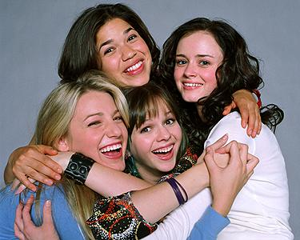
Epilogue “We will go. Nowhere we know. We don’t have to talk at all.” - Beck
The girls met up at Gilda’s as their normal tradition. This time, they brought the pants with them.
They each knew about each others summers which even though they were apart, they were spent together as well.
“Still, the pants promised us there was time. Nothing would be lost. There was all year if we needed it. We had all the way until next summer, when we would take out the Traveling Pants and, together or apart, begin again.

