Slide 1
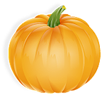
The Vanishing Pumpkin
By Tony Johnston
Pictures by Tomie DePaola

Slide 2
Book Summary
The Vanishing Pumpkin is a story about a 700 year old woman and an 800 year old man. One day while looking at the sun, this couple decided they wanted to pick a pumpkin. The sun made them think of the pumpkin, Halloween, and how they want pumpkin pie. When the old man went out to get the pumpkin, the pumpkin vanished. Someone took their pumpkin! The old woman checked everywhere but couldn’t find it. The couple then goes on a hunt to find their pumpkin. On their adventure, they encounter a ghoul, a rapscallion, a varmint, and a black cat. Whenever, the creatures do not have their pumpkin, the old couple does a trick on them. Their voyage finally leads them to a wizard. He had their pumpkin the whole time and turned it into a jack-o’-lantern. The wizard thought of the pumpkin and how he wanted pumpkin pie himself. He did magic and pumpkin pie appeared. In the end, everyone was happy and the old man, old woman, wizard, and the creatures enjoyed pumpkin pie.

Slide 3
Key
Old woman
Old man
Pumpkin

Slide 4

Key
Sun
Pumpkin pie
Halloween

Slide 5
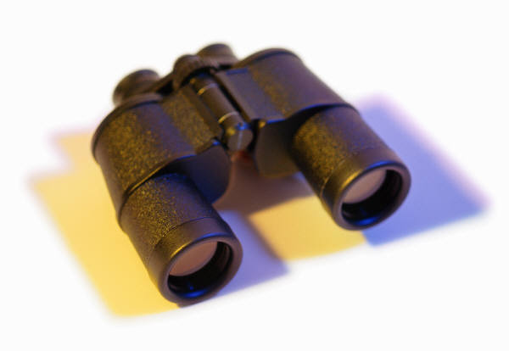
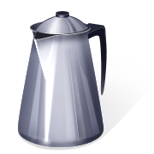
Key
Look
Coffeepot
Bed
Purse

Slide 6
Key
Ghoul
Rapscallion
Varmint

Slide 7

Key
Black Cat
Trick
Wizard

Slide 8
Key
Jack-O’-Lantern
Creature
Magic

Slide 9
There was a 700-year old woman and a 800- year old man.

Slide 10
They were looking at the sun.

Slide 11
The sun reminds the old woman of pumpkins.

Slide 12
Pumpkins remind the old man
and old woman of Halloween too.

Slide 13
The old man decided to pick a pumpkin.

Slide 14
They wanted to make
pumpkin pie.

Slide 15
But the pumpkin vanished!

Slide 16
She looked in the coffeepot, the bed, and the purse of magic powers.

Slide 17
But still no pumpkin.

Slide 18
The old woman and old man went to look for the pumpkin.

Slide 19
The old man and old woman asked a ghoul.

Slide 20
The ghoul looked but did not have the pumpkin.

Slide 21
Next, they ran into a rapscallion.
“Where is my pumpkin?” said the old man.

Slide 22
The rapscallion looked but did not find the pumpkin.

Slide 23
The old man and old woman ran
into a varmint and black cat.

Slide 24
The varmint and the black cat did not have their pumpkin.

Slide 25
The old man and old woman did
tricks on the creatures when they did not have their pumpkin.

Slide 26
The old man and old woman then met a 900 year old wizard.

Slide 27
The wizard had their pumpkin!

Slide 28
The pumpkin was turned into a jack-o’-lantern.

Slide 29
The wizard also likes pumpkin pie.

Slide 30
The wizard then did magic.

Slide 31
The wizard made pumpkin pie
from his magic!

Slide 32
The old woman, old man, the
creatures, and the wizard ate pumpkin pie.

Slide 33
The End

