Slide 1
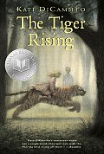
The Tiger Rising
By: Kate DiCamillo

Slide 2
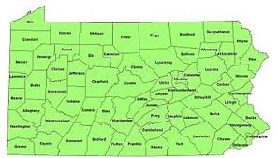
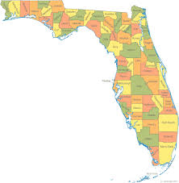
Chapter 1
Rob didn’t want to ever go to school so he went into the woods on a foggy, rainy, Florida day where he found a tiger.
It had been 6 months since he and his father had moved to Lister from Jacksonville

Slide 3
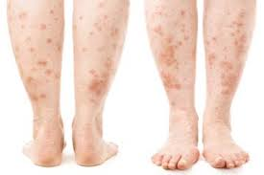
Chapter 2
Norton and Billy Threemonger bully Rob because the rash on his legs

Slide 4
Chapter 2 Cont.
The bus stops and picks up a new girl who is small and has blonde hair

Slide 5
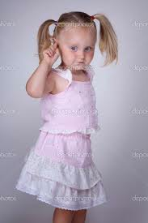
Chapter 3
The girl wore a pink, lacy dress
She talked very proper and was not scared of the Threemonger brothers

Slide 6
Chapter 3 Cont.
Rob’s mom passed away six months ago
Now he packs his emotions away like a suitcase read to burst
Rob and his dad moved from Kentucky

Slide 7
Chapter 4
In 6th grade homeroom the girl, Sistine introduces herself
She tells the class people from the South are ignorant and she wants to return to Philadelphia

Slide 8
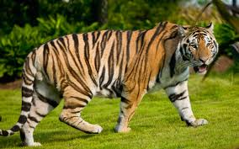
Chapter 4 Cont.
While Sistine spoke, Rob drew a tiger
He wished to whittle it using wood as his mother has taught him

Slide 9
Chapter 4 Cont.
Rob gets called down to the principal’s office
He trips, is made fun of and then is given a mean look by Sistine

Slide 10
Chapter 5
The principal, Mr. Phelmer tells Rob he is worried about the rash on his legs being contagious

Slide 11
Chapter 5 Cont.
Mr. Phelmer asks Rob if he has been using his medicine
Rob says yes but the principal still tells him to stay home until the rash clears
Rob knows the rash will never ever heal

Slide 12
Chapter 6
Rob did not go into the cafeteria during lunch because Norton and Billy were in there and the food was not as good

Slide 13
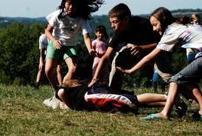
Chapter 6 Cont.
Sistine gets hit in the head with an apple
A fight breaks out

Slide 14
Chapter 6 Cont.
Rob yells for everyone to stop
They all start to chase Rob instead of Sistine

Slide 15
Chapter 6 Cont.
Rob saves Sistine by outrunning everyone but looses his tiger drawing from his pocket and is late for English

Slide 16
Chapter 7
Sistine sits next to Rob on the bus ride home
She says it’s the only open seats and complains that all the people in town are hicks and don’t even know where the Sistine Chapel is

Slide 17
Chapter 7 Cont.
Rob tells Sistine he doesn’t have to go back to school because of his legs
She puts her hand on the rash and prays that she will get it so she can miss school too

Slide 18
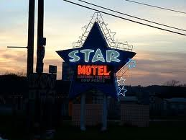
Chapter 7 Cont.
Rob tells her it is not contagious but she doesn’t listen
He tells her about living in the Kentucky Star until his family gets back on their feet

Slide 19
Chapter 7 Cont.
Rob felt surprised how much he spoke to her because he tries to never talk
Norton came up to start beating on him again and Rob was happy he wouldn’t have to speak anymore

Slide 20
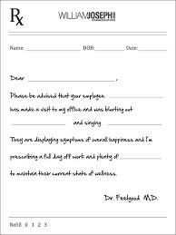
Chapter 8
Rob’s Dad reads the letter from the principal and tells Rob he can have a few days off
His Dad was getting a note from the doctor saying it is not contagious

Slide 21
Chapter 8 Cont
Rob would eventually have to face the bullies
Rob’s dad tells him the boss of the Motel, Mr. Beauchamp gave him too much work and he would need help

Slide 22
Chapter 8 Cont.
His dad made burned, soggy mac and cheese
Rob’s father didn’t eat even though Rob knew he was hungry

Slide 23
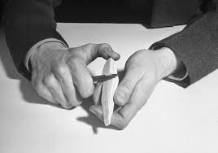
Chapter 8 Cont.
Rob began whittling a piece of maple into a tiger but later realized it looked more like Sistine
That night he dreamed Sistine was riding the tiger through the woods

Slide 24
Chapter 9
Rob’s dad woke him up in the morning at 5:30 for work
He saw the Kentucky star neon outside
It was his wishing star

Slide 25
Chapter 9 Cont.
He didn’t wish on it because he didn’t think he would be able to stop
He put his not-wishes in the suitcase too

Slide 26
Chapter 9 Cont.
Rob got coffee and sat with his dad on the front porch
He was glad it was muggy and rainy because he hated sunshine

Slide 27
Chapter 9 Cont.
The sun reminded him of his mother’s funeral
Then him and his dad left for the maintenance shed
His Dad was singing a song he used to sing to his wife

Slide 28
Chapter 9 Cont.
His dad quickly stopped
Rob slowed to give his father spaced and searched for glowing eyes or a flicking tail

Slide 29
Chapter 10
Rob saw Willie May in the laundry room
He told her he was not in school because his leg rash
She said the rash was caused by sadness

Slide 30
Chapter 10 Cont.
Willie May told Rob he has to let the sadness rise to his heart where it belonged as she lit a cigarette and gave him some gum

Slide 31
Chapter 11
The bus drove by the next morning with Norton and Billy yelling out the window that Rob was a leper.

Slide 32
Chapter 11 Cont.
Sistine walked up to him to give him his homework
She was wearing a torn green dress and her knuckles were bloody

Slide 33
Chapter 11 Cont.
He didn’t want to talk, but finally told her that he had seen a tiger.
She merely asked him, “Where?”

Slide 34
Chapter 12
Rob tells Sistine they have to go through the woods so she asks to borrow some clothes

Slide 35
Chapter 12 Cont.
Sistine finds Rob has whittled a blue jay, pine tree, his dad’s foot and Sistine herself

Slide 36
Chapter 13
Sistine tells of her mom living in Lister when she was young
She said if she ever left, she would not come back, but Sistine’s father had an affair with his secretary
Her mom left her dad and moved back to Lister.
He dad will be here soon to take Sistine back to Pennsylvania

Slide 37
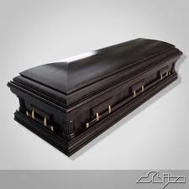
Chatper 13 Cont.
Sistine then asks about Rob’s mom.
He won’t tell her so she stomps off telling him she didn’t want to see his tiger anyway.
Rob chases her back down and tells her about his mom dying

Slide 38
Chapter 14
They find the tiger in a rusty, chain-link cage, triple padlocked
The tiger is pacing back and forth

Slide 39
Chapter 14 Cont.
Sistine wants to set him free, sawing off the padlocks, but Rob said the tiger wasn’t his to save
They hear a car so Rob grabs Sistine’s hand and they begin to run

Slide 40
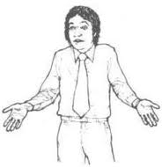
Chapter 14 Cont.
Sistine asks if someone was behind them and Rob shrugs his shoulders
Sistine gets upset because she hates it when he shrugs his shoulders

Slide 41
Chapter 14 Cont.
He remembers Willie May telling him he looks like a baby bird trying to fly and he begins to laugh, Sistine laughs too.
He feels a familiar, but elusive feeling rising in him. He realizes its happiness.

Slide 42
Chapter 15
Rob bursts out of the forest laughing. His dad sees him and calls to him asking if he has done all of his chores.
Rob says yes and that they just went into the forest.

Slide 43
Chapter 15 Cont.
His dad asks why the girl is in his clothes and he explains. He then tells Sistine that there is a pay phone in the laundry room.
Sistine asks for change to call her mom

Slide 44
Chapter 15 Cont.
She leaves and Rob goes inside noticing how dark it is now and how bright it used to be when his mom was alive – especially at Christmas when she would hand lights outside of their home.

Slide 45
Chapter 16
Mrs. Bailey comes to pick up Sistine.
She tries to usher Sistine into the car, but she doesn’t move, until her mom acknowledges Rob

Slide 46
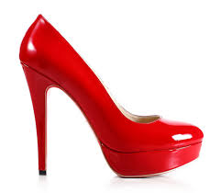
Chapter 16 Cont.
She’s wearing high heels and is acting a bit snooty. She obviously doesn’t belong in Lister
Sistine asks Rob for his mom’s name, and how she died

Slide 47
Chapter 16 Cont.
He tells her that his mom died of cancer, but nothing more. He stood quiet.
As she walks away, he whispers, “Caroline.” He loves the way his mom’s name sounds.

Slide 48
Chapter 17
The next day Robert was talking to Willie May and asking her if she had ever been to a zoo.
She said she had been once. He asked if it was right to keep animals locked up and she tells a story of a little green parakeet she had when she was a girl.

Slide 49
Chapter 17 Cont.
She talks of letting it go and her dad getting upset that she had just given a snake his supper.
Rob then tells her that he knows of something in a cage. She replies, with, “Who don’t know something in a cage?”

Slide 50
Chapter 18
As Rob was sweeping the front, red-headed Mr. Beauchamp drove up in his jeep.
He asked Rob if they were paying him to work

Slide 51
Chapter 18 Cont.
When he said no, he offered him a chance to help him with a wild animal.
He made rob get into the car and they headed deep into the woods with Beauchamp hooting and hollering the whole way.

Slide 52
Chapter 19
Beauchamp stopped in front of the cage and showed Rob how to feed the tiger.
He gave Rob the food door key and the other padlock keys to the cage, but told him not to use them. He said he would pay Rob $2.00 every time he fed the tiger. He needed to be fed 2 times a day. As Rob looked at the tiger he realized the tigers stare looked like Sistine’s eyes

Slide 53
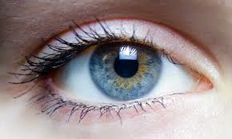
Chapter 19 Cont.
He said he would pay Rob $2.00 every time he fed the tiger. He needed to be fed 2 times a day.
As Rob looked at the tiger he realized the tigers stare looked like Sistine’s eyes

Slide 54
Chapter 19 Cont.
When asked, Beauchamp said the tiger didn’t have a name and that he was going to put him in front of the hotel to draw more customers or skin him to make a coat

Slide 55
Chapter 20
Sistine was pelted with dates as she got off the bus, as was Rob. She had already changed out of her dress and put Rob’s clothes back on.
They ran into the forest to see the tiger. She told Rob that tigers were endangered and that they were only dangerous when they were hungry

Slide 56
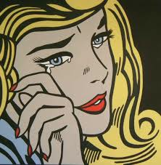
Chapter 20 Cont.
Sistine wanted her dad to come and get her now and help her free the tiger.
Finally, she started crying and Rob put his hand on her neck to comfort her the way his mom used to. She didn’t push away.

Slide 57
Chapter 21
As they walked back they went to the laundry room to call her mom. Willie May was there and stopped them to talk.
Willie tells Sistine that she has anger coming out of her like lightening

Slide 58
Chapter 21 Cont.
Sistine denies it so Willie calls her an angry liar.
She then gives her a piece of gum and offers some advice, “Ain’t nobody going to come and rescue you. You have to rescue yourself.”

Slide 59
Chapter 22
When Rob went inside his dad asked him if he had been hanging out with “that” girl.
He said yes. Then he pointed to the rotten meat under the bed and asked him where it came from

Slide 60
Chapter 22 Cont.
When he said Beauchamp, Rob’s dad was angered because he thought he was giving it to them out of charity. Rob never told him what it was really for
His dad went to the locked gun case, but never opened it.

Slide 61
Chapter 22 Cont.
Rob went out on the porch and whittled.
He was thinking about his mom and him laying out on a blanket talking about the original green.

Slide 62
Chapter 22 Cont.
Rob couldn’t feed the tiger tonight so he went back inside. His dad was asleep.
When he woke up he helped Rob with his ointment.

Slide 63
Chapter 23
The next morning he went looking for Willie May. He had her close her eyes as he gave her the carving of the bird.
She knew before she opened them that it was Cricket, her parakeet

Slide 64
Chapter 23 Cont.
She asked him where he learned to work with wood, he said his mama.
He didn’t have any chores until the afternoon so he helped Willie May clean rooms, dreading the time when Sistine would come home and want to let the tiger go

Slide 65
Chapter 24
When she got off the bus she was in a dress.
Her mom had found out how she was dressed at school and confiscated the clothing
She had gotten into another fight, had some scrapes and a black eye

Slide 66
Chapter 24 Cont.
Sistine wanted to go see Willie May. She then asked her if she had something beautiful in a cage if she would let it go.
Willie asked them what they had in a cage. Rob told her a tiger. Willie asked them to take her to the tiger

Slide 67
Chapter 25
As they came to the tiger, Willie couldn’t believe anyone would lock up a tiger.
She knew if anyone would it would be Beauchamp.

Slide 68
Chapter 25 Cont.
Sistine then tries to get Willie May to tell them that they need to release the tiger.
Willie then replies that they can’t do anything about it. Sistine says that it’s not right.

Slide 69
Chapter 25 Cont.
Willie says it has nothing to do with being right.
Sistine gets upset and says her dad will help her. Rob then tells her that he is never coming to get her.
It is a truth he feels inside

Slide 70
Chapter 25 Cont.
Sistine gets upset and tells Rob that he is a liar and that she hates him and everyone else hates him too
She then takes off. Rob starts scratching his legs like crazy. Willie tells Rob to stop and that Sistine didn’t mean anything that she just said. She then wishes the tiger would rise up out of the cage and eat Beauchamp

Slide 71
Chapter 26
After Rob walks back to the hotel he runs after Sistine. She stops, but tells him to leave her alone.
He tells Sistine that he wants to free the tiger too.

Slide 72
Chapter 26 Cont.
Beauchamp then drives up and tells Rob that he has something waiting back at the motel with Ida.
He also asks if he has kept the secret. Rob says yes

Slide 73
Chapter 26 Cont.
He introduces himself to Sistine. She introduces herself as Sissy.
Sistine then tells Rob they should go set the tiger free. She then tells him that she wants to let the tiger go now

Slide 74
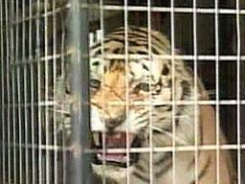
Chapter 27
They ran back and unlocked the cages locks. Rob was afraid they would get eaten, but Sistine thought otherwise.
The tiger ignored them and didn’t realize he was free. They both started shaking the cage, screaming for the tiger to leave

Slide 75
Chapter 27 Cont.
He finally took on step out and took off running.
They were struck with the beauty and speed of the tiger. Rob felt his own heart beating to the tigers strides.

Slide 76
Chapter 28
Rob’s dad suddenly called him and Willie scream. He heard a pop as Willie May found them.
There on the ground was the tiger dead on the ground and his dad standing over it with a gun. Rob yelled that his dad had killed the tiger

Slide 77
Chapter 28 Cont.
Rob ran to his dad and started punching.
He then opened his “suitcase” and began to yell to his dad that he wished it would have been his dad that had died and that he needed his mom. He told his dad to say his mom’s name. As he did, Rob began to cry and his dad just held him. Willie May held Sistine. They then got up and petted the tiger. They decided they should say a few words and bury him. Sistine recited the tiger poem.

Slide 78
Chapter 28 Cont.
As he did, Rob began to cry and his dad just held him.
Willie May held Sistine. They then got up and petted the tiger. Sistine recited the tiger poem

Slide 79
Chapter 29
Rob and his dad dug a huge, deep, dark whole.
Willie May lay her whittled bird on the grace. Rob and Sistine decided they would put fresh flowers on the grace everyday. Sistine grabbed his hand to hold it giving him great comfort as the sun started to shine again

Slide 80
Chapter 29 Cont.
Sistine grabbed his hand to hold it giving him great comfort as the sun started to shine again

Slide 81
Chapter 30
That night his dad sings him , “Mining For Gold.”
His dad tells him that he will tell Beauchamp that he shot the tiger, but Rob will have to tell him that he was the one that let him go

Slide 82
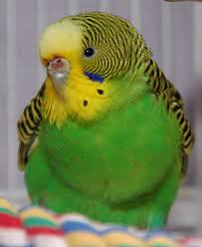
Chapter 30 Cont.
That night Rob has a dream that he and Sistine were standing at the grave when the green parakeet (which is the wooden bird) flies by.
They chased it laughing and bumping into each other

Slide 83
Chapter 30 Cont.
When the bird disappeared from getting so high up, he noticed he was looking at the Sistine chapel.
He wakes up and thinks about the tiger he will make for Sistine.

