Slide 1
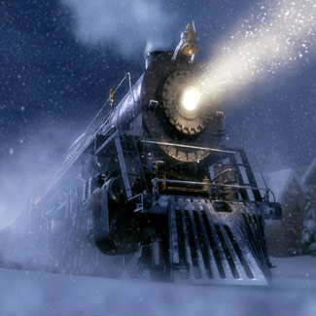
The Polar Express
Written and Illustrated by Chris Van Allsburg

Slide 2


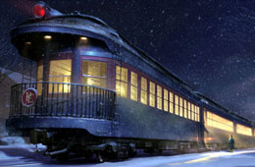
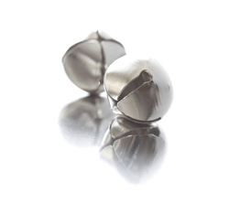


Key:
stop
Santa
Sleigh
Christmas
snow
bed
friend
conductor
quietly
hear
North Pole
listen
train
bell
window
kids

Slide 3






Key:
gifts
sad
look
songs
wave
Hot chocolate
reindeer
morning
Mountains
ask
sister
city
one
Mom
elves
home
Dad

Slide 4
On Christmas Eve, many years ago, I lay in my
bed quietly. I listened for the bells of Santa’s
Sleigh.

Slide 5
My friend said there was no Santa. I knew that
he was wrong. I did not hear bells, but I did
hear a train.

Slide 6
Outside of my window a train was stopped. It was
snowing. A conductor opened the train. “All
aboard,” the conductor yelled.

Slide 7
He said we were going to the North Pole. I got
on the train. There were lots of kids on the
train.

Slide 8
We sang Christmas songs and drank hot
chocolate. The train went up mountains and
through valleys. We ended up at the North Pole.

Slide 9
The North Pole was a huge city where all the
Christmas toys were made. The elves were
waiting for Santa to give the first gift.

Slide 10
“Look at the elves!” said one of the kids. We
stopped and got off of the train. We saw Santa’s
sleigh. The reindeer had bells on their harnesses.

Slide 11
The sound was magical. Santa Claus came. The
elves cheered. Santa chose me and asked me
what I wanted for Christmas.

Slide 12
I wanted one silver bell from Santa’s sleigh.
Santa gave me the first gift of Christmas. He
gave me a bell.

Slide 13
Santa flew away in his sleigh. We got back on the
train. The kids wanted to see the bell but I lost it.
The train left to go back home.

Slide 14
I was sad that I lost the bell. I got home and I
waved good-bye to the train. The conductor yelled,
“Merry Christmas!” The Polar Express sped away.

Slide 15
In the morning, my sister and I opened
presents. The last present was the silver bell!
There was a note from Santa.

Slide 16
I shook the bell. The sound was magical. My
sister and I heard it. My mom and dad could
not hear it.

Slide 17
Most people when they get old cannot hear the
bell. But I always can because I truly believe in
Santa Claus.

Slide 18
The End

