Slide 1
The Fault in Our Stars By John Green

Slide 2
Chapter 1

Slide 3
Hazel Grace is an average teenager except for the little fact that she has all sorts of cancer inside her body and her lungs don’t work very well.

Slide 4
Hazel Grace’s mom thinks Hazel Grace is Depressed.

Slide 5
Due to her supposed Depression, Hazel Graze has to attend a weekly Support Group, which is held in a church basement by an very enthusiastic group leader named Patrick. Hazel Grace does not like the Support Group.

Slide 6
This week at Support Group, there is a new boy named Augustus Waters.

Slide 7
Augustus finally introduces himself and says that he is seventeen and had some osteosarcoma a year and a half ago.

Slide 8
Hazel also introduces herself and says that she is 16 with thyroid cancer and mets in her lungs.

Slide 9
After the support group wraps up, Augustus makes his way over to Hazel to talk.

Slide 10
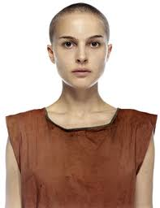
Augustus tells Hazel that she's beautiful and it's kind of awkward. But then he compares her to Natalie Portman in V for Vendetta. Hazel says that she has never seen that movie.

Slide 11
Augustus asks Hazel if she'll come over right now to watch a movie with him.

Slide 12
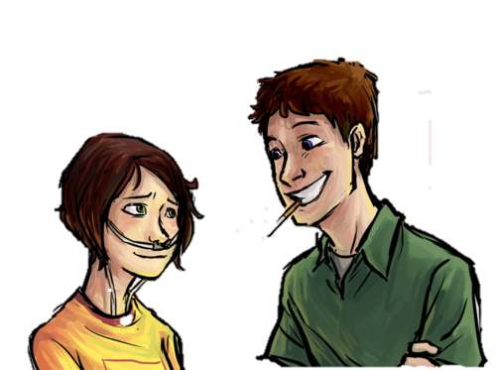
Hazel finds Augustus charming, but then he pulls out a cigarette and she is disgusted!

Slide 13
He explains himself and says that it's actually a metaphor, since he never ever lights the cigarette.

Slide 14
Hazel runs up to her mom's car and tells her that she will be watching a movie at Augustus Waters’ house tonight.

Slide 15
Chapter 2

Slide 16
Augustus drives Hazel to his house. He isn’t a very good driver. He drives very fast.

Slide 17
He tells Hazel that getting his driver’s license was probably a “Cancer Perk.”

Slide 18
Hazel tells Augustus her story about her disease and how everyone thought that she was going to die until she took Phalanxifor, which shrank her tumors. She mentions how she already got her GED and Augustus is impressed.

Slide 19
When Hazel walks into Augustus’ house, she notices a bunch of inspiring phrases sewn onto different things such a pillows or other fabrics. Augustus explains that his mom calls them “Encouragements.”

Slide 20
Hazel meets Augustus’ parents. Then, Augustus and Hazel go into the living room to watch a movie.

Slide 21
They start to get to know one another a talk for a while.

Slide 22
Hazel tells Augustus that she loves the novel An Imperial Affliction.

Slide 23
Augustus gives her his favorite book The Price of Dawn.

Slide 24
When Hazel is leaving, Augustus asks her if he can see her again. She says she will call him when she finishes The Price of Dawn.

Slide 25
Chapter 3

Slide 26
Hazel reads The Price of Dawn and liked it so much she immediately started reading the sequel.

Slide 27
Chapter 4

Slide 28
Hazel starts rereading An Imperial Affliction... Again. The book is about a girl named Anna who lives in California and gets this rare blood cancer. The story ends right in the middle of a sentence.

Slide 29
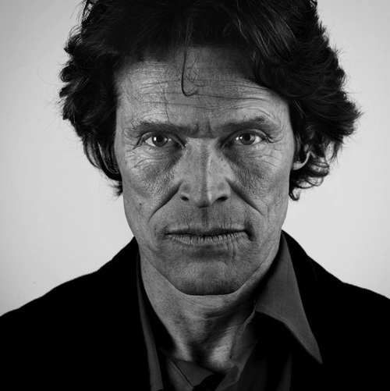
An Imperial Affliction is the only book that Peter Van Houten has written and he's extremely reclusive. However, Hazel wants to track him down to find out what happens after the end of the book.

Slide 30
Hazel calls Augustus to tell him that she's finished The Price of Dawn.

Slide 31
Augustus frantically asks her why An Imperial Affliction just ends in the middle of a sentence! Hazel tells him that she has tried to contact Van Houten to find out more about the ending.

Slide 32
Chapter 5

Slide 33
Hazel does not talk to Augustus for a whole week. She is very sad about it.

Slide 34
On Sunday night, Augustus finally calls and Hazel goes outside to talk to him. They talk about An Imperial Affliction and how they both love the book.

Slide 35
He also tells her that he has contact Peter Van Houten via email. Augustus gives Hazel the email address and she spends the next two hours writing an email to Van Houten begging him to answer her questions about the book's ending.

Slide 36
Then Hazel stays up talking to Augustus on the phone. They decide that their couple "thing" will be saying "okay" to each other.

Slide 37
On Monday, Van Houten finally responds to Hazel’s email. In his email, he writes if she ever finds herself in Amsterdam, he'd be happy to talk to her.

Slide 38
Hazel asks her parents if they can go to Amsterdam, but they say they can’t afford it. Hazel is very sad.

Slide 39
Hazel calls Augustus who suggests using her Wish from The Genie Foundation, the organization that grants sick kids one wish. Unfortunately, Hazel already used her wish on Disney World and Epcot when she was thirteen.

Slide 40
On Saturday, Augustus comes to Hazel’s house and asks her to go on a picnic with him.

Slide 41
They go to a park and eat a bunch of orange foods. Augustus says that orange is the national color of the Netherlands. He tells her that he hasn't used up his Wish yet and is going to use it in order to take them both to Amsterdam!

Slide 42
Chapter 6

Slide 43
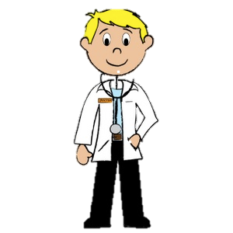
Hazel is so excited! She runs home to tell her parents. They say she has to ask her doctors to see if she can travel.

Slide 44
Hazel goes to sleep, but she wakes up in the middle of the night with a horrible pain in her head.

Slide 45
Chapter 7

Slide 46
Hazel is rushed to the hospital and passes out on the way.

Slide 47
Hazel wakes up in the ICU alone. She finds out that she does not have a brain tumor, but that her lungs had a bunch of fluid in them which made her head hurt. They had to drain this liquid.

Slide 48
She has to spend six days in the hospital before she can go home.

Slide 49
Augustus finally gets to see Hazel and tells her that he missed her. He also tells her that Peter Van Houten wrote him a letter. Hazel is very excited about this!

Slide 50
Chapter 8

Slide 51
Hazel has a meeting with her doctors and asks them if she can go to Amsterdam. One of them doesn’t think that it is a good idea.

Slide 52
Later that night, Augustus calls and she breaks the news to him that they might not be able to go to Amsterdam.

Slide 53
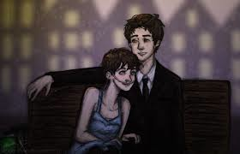
Hazel is very sad that she won’t be able to go to Amsterdam. Augustus keeps her company and tries to cheer her up.

Slide 54
When Hazel wakes up the next morning, she has an email from Van Houten's assistant Lidewij saying that everything is set for their trip the next week.

Slide 55
Hazel finds her mother and tells her that they have to tell the wish-granting genies to call the trip off. But to her surprise, her mom tells her that the doctors said that she can go! Hazel is so happy!

Slide 56
Chapter 9

Slide 57
The trip to Amsterdam has finally arrived! Her dad says goodbye, and she and her mother drive over to Augustus's house.

Slide 58
They pick up Augustus and drive to the airport.

Slide 59
Hazel, her mother, and Augustus fly to Amsterdam!

Slide 60
Augustus tells Hazel that he's in love with her. She is unsure of what she should say in return, so she says nothing.

Slide 61
Chapter 10

Slide 62
When they arrive in Amsterdam, they take a cab to the Hotel Filasoof where everything is very fancy.

Slide 63
That evening Hazel and Augustus go on a date at fancy restaurant called Oranjee where they have champagne and a delicious meal.

Slide 64
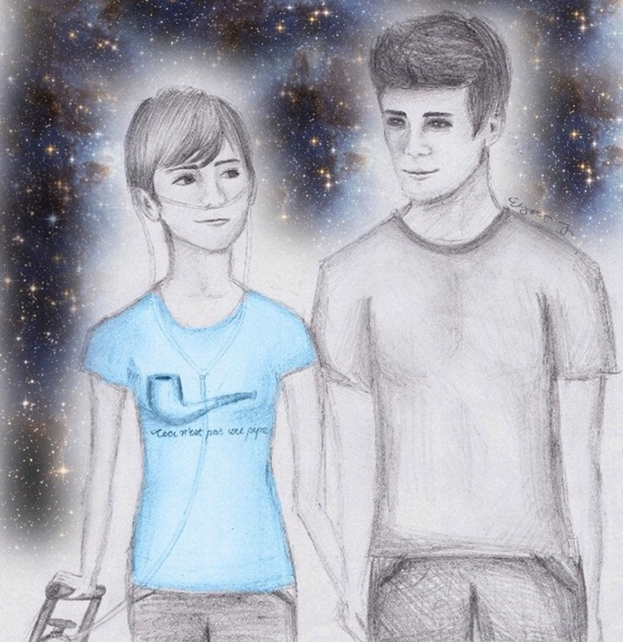
They go for a nice walk along the canal, but when Hazel leans against Augustus's body, he winces in pain. She doesn’t say anything about it though.

Slide 65
Chapter 11

Slide 66
The next morning, Hazel and Augustus go to Van Houten's house. They both are very excited!

Slide 67
They knock on the door, and an old guy, Van Houten opens it and then slams it in their faces. From inside, they can hear him talking to his assistant Lidewij, and telling her that she must tell them to leave because he doesn't want to meet them.

Slide 68
The door opens again, and Hazel and Augustus enter the house. Van Houten precedes to be a big drunken jerk to them. He refuses to answer any of Hazel’s questions. He says that he had only promised to tell her the ending because he thought that she wasn't well enough for travel and he never intended to tell her at all.

Slide 69
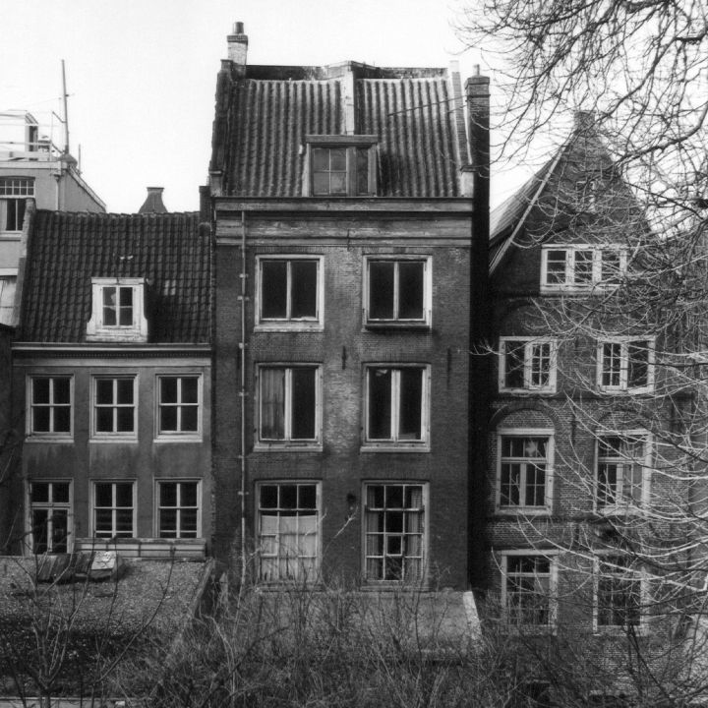
Lidewij quits her job. Hazel, Augustus, and Lidewij all leave. They decide to continue with plans to go visit Anne Frank's house.

Slide 70
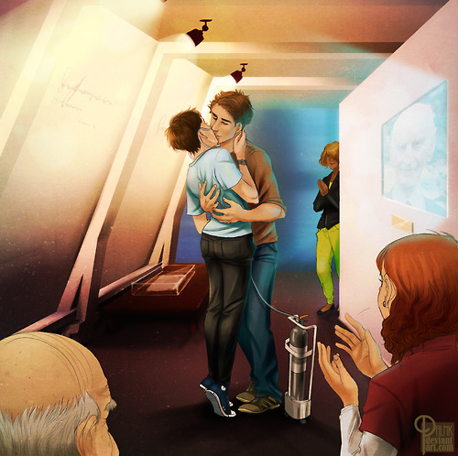
Hazel has trouble walking up the narrow, steep steps of the Anne Frank house with her oxygen tank. Eventually, she makes it all the way to the top, where she sees where the Franks lived. Augustus and Hazel finally kiss.

Slide 71
Chapter 12

Slide 72
The next day, Augustus tells her that he has something he needs to tell her. He recently went in for a PET scan… and it wasn't good. His cancer has returned. They are both very depressed. They cry together.

Slide 73
Hazel tells Augustus she loves him and they kiss.

Slide 74
Chapter 13

Slide 75
The next day, Hazel, her mother, and Augustus fly home. Augustus's chest starts hurting, so he has to take some pills and falls asleep.

Slide 76
When they arrive home, Hazel spends some time with her dad.

Slide 77
The next day, Hazel goes over to Augustus's house and hangs out with him while he's going through his cancer treatment.

Slide 78
Chapter 14

Slide 79
A few days later, Augustus, Hazel, and both of their parents all have dinner.

Slide 80
A week later, Augustus is rushed to the ER. Hazel goes to visit him.

Slide 81
Two weeks later, they go to the art park and drink champagne from Winnie-the-Pooh cups, pretending that they are back in Amsterdam.

Slide 82
Chapter 15

Slide 83
Hazel starts hanging out with Augustus every day. He tells her that he wants to write her a sequel to An Imperial Affliction, but that he's just so tired and can't find the time to do it.

Slide 84
They play video games, take naps and do all sorts of things together. They love each other very much and want to spend as much time together as they can.

Slide 85
Chapter 16

Slide 86
One day when Hazel goes over to Augustus's house, she discovers that he's wet him himself in the middle of the night. Augustus is embarrassed when he wakes up and realizes that Hazel was there to witness everything.

Slide 87
Augustus confides in Hazel that he had always hoped that he would have an exciting life and a special obituary. Hazel tells him that she wants him to write an obituary for her.

Slide 88
Chapter 17

Slide 89
A couple nights later, Hazel wakes up at 2 a.m. to see that her phone is ringing. She's immediately terrified that Augustus has died.

Slide 90
When she picks up, Augustus says he needs her help. He's at the gas station and something is wrong his G-tube, which similar to a feeding tube.

Slide 91
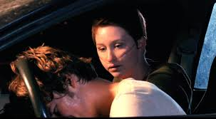
When she gets to the gas station, Hazel sees that Augustus is inside his car, that he has vomited, and that his G-tube looks infected.

Slide 92
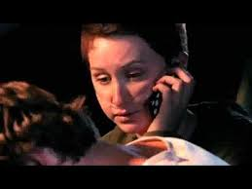
Hazel calls 911 and waits for an ambulance to arrive.

Slide 93
Chapter 18

Slide 94
Once Augustus comes home from the hospital, he basically has to stay in his bed all of the time.

Slide 95
Hazel spends lots of time over at Augustus’ house comforting him and getting to know his family, who have all come to spend his last days with him.

Slide 96
Chapter 19

Slide 97
On Augustus’ last good day, he calls Hazel and asks her if she'll prepare a eulogy for him and meet him at the Church that night.

Slide 98
When Hazel arrives at the Church that night, she sees Augustus in a wheelchair. He says he wanted to arrange a pre-funeral for himself.

Slide 99
Hazel gives her eulogy, and of course, cries. Her eulogy is about infinities and how she is glad that she and Augustus got to have their own infinities.

Slide 100
Chapter 20

Slide 101
When Augustus dies, Hazel isn’t there with him. She gets a phone call in the middle of the night from his mother and knows immediately that it's over.

Slide 102
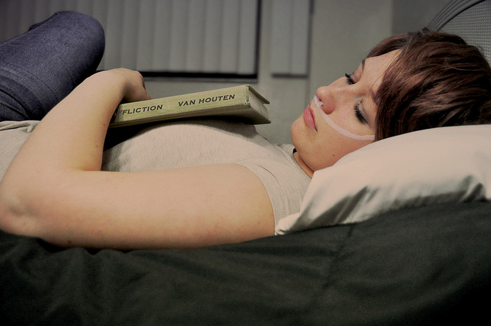
Hazel is, once again, depressed. Her parents do not know how to make her feel better.

Slide 103
Chapter 21

Slide 104
Hazel goes to Augustus’ funeral. She also goes to his coffin and kisses him on the cheek. She even sneaks him some smokes.

Slide 105
During the service, someone starts talking to Hazel. She realizes that Peter Van Houten is at the funeral.

Slide 106
Hazel gives her eulogy and then goes to the burial. After the burial, Peter Van Houten hitches a ride home with Hazel and her parents.

Slide 107
Hazel tells him that she doesn't want an explanation and that she thinks he's pathetic and an alcoholic.

Slide 108
When Hazel gets home, she goes into the bathroom and locks herself in there. Her dad comes in and tells her that even though the whole thing sucks, it was a privilege to know and love Gus. And that that's how he feels about her.

Slide 109
Chapter 22

Slide 110
Hazel called Augustus’ dad to see how him and Augustus’ mom were doing. He asks Hazel if Augustus ever gave her that thing he was writing for her. She says, “what thing?” But, Augustus’ dad is unsure of what it was. Hazel says she is coming over!

Slide 111
Hazel goes out to her car to drive over to Augustus's house when she realizes that Peter Van Houten is in her car. He says that she reminds him of Anna from An Imperial Affliction, even though she keeps telling him to get out of her car.

Slide 112
Van Houten says that he's sorry for ruining her trip and cries about Augustus. Then, she realizes that someone in his family must have died of cancer and that's why he's so sad.

Slide 113
Peter Van Houten says that he had a daughter who died, and he was the one who had to tell her that she was going to die. Then he leaves.

Slide 114
When Hazel gets to Augustus’ house, she goes into the basement to look for anything he's written, but can't find anything at all.

Slide 115
Chapter 23

Slide 116
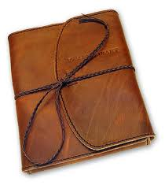
Augustus's dad tells Hazel that they found a notebook that he could have been writing in, but that there are a few pages that have been torn out of it.

Slide 117
Hazel looks everywhere for the missing pages, but can’t find them. She is sad.

Slide 118
Chapter 24

Slide 119
The next morning, Hazel realizes that Augustus may have sent the missing pages to Van Houten. She immediately emails Lidewij, and Lidewij writes back saying that she is will go over to his house to look for them.

Slide 120
Eventually, Lidewij emails Hazel back. The email has four attachments.

Slide 121
When she opens the attachments, she realizes that Augustus hadn't written the ending to An Imperial Affliction for her. He'd written her a eulogy.

Slide 122
The eulogy goes like this: in life, you don't get to choose whether or not you get hurt, but you do get to choose what hurts you. Augustus is happy with his choices, and he hopes Hazel is, too. Hazel realizes that she is happy with the choices she made and that she got to know and love Augustus.

Slide 123
The End
This Modified Book was written by Kristen VanBenschoten

