Slide 1
The Catcher in the Rye
By J. D. Salinger

Slide 2
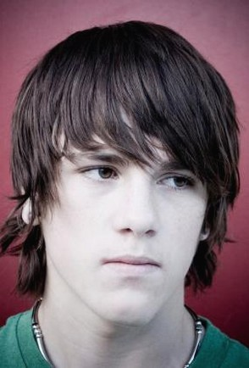
Chapter 1
This story is about a boy named Holden.

Slide 3
Chapter 1
Holden is a very heavy smoker.

Slide 4
Chapter 1
He is failing too many classes at his school and has been kicked out.

Slide 5
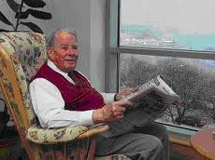
Chapter 1
Before Holden leaves the school for good, he visits his old history teacher, Mr. Spence.

Slide 6
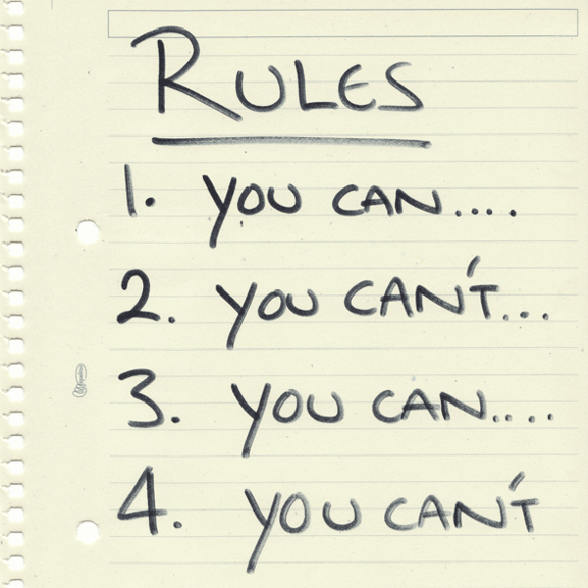
Chapter 2
Mr. Spence tells Holden that life is a game and to play by the rules.

Slide 7
Chapter 2
Holden did not want to listen to Mr. Spence talk about rules so he left.

Slide 8
Chapter 3
Holden puts on his red hunting hat.

Slide 9
Chapter 3
When he gets back to his room his roommate, Stradlater, tells Holden that he is going on a date.

Slide 10
Chapter 4
Holden is sad and upset when he finds out that Stradlater is going on a date with his friend Jane.

Slide 11
Chapter 4
Holden puts on his red hunting hat.

Slide 12
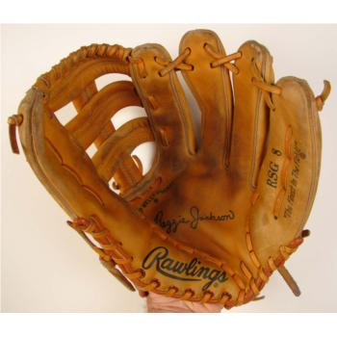
Chapter 5
Holden writes a paper about his younger brother, Allie, and Allie’s baseball mitt.

Slide 13
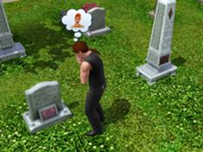
Chapter 5
Allie died and Holden misses him very much.

Slide 14
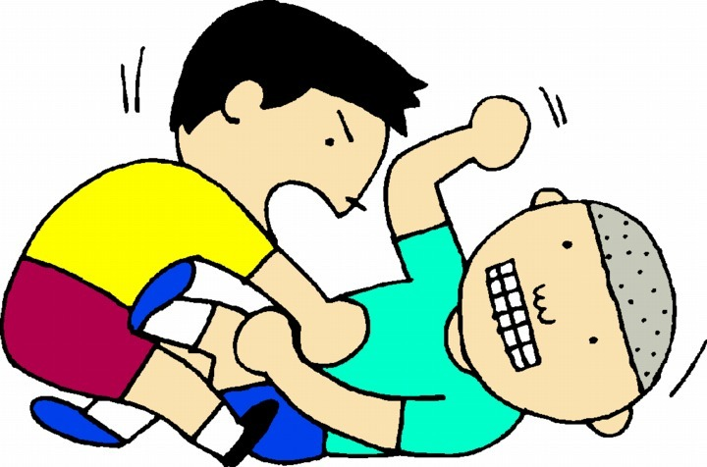
Chapter 6
Holden and Stradlater get into a fight and Holden goes to his friend’s room.

Slide 15
Chapter 6
Holden puts on his red hunting hat.

Slide 16
Chapter 7
Holden becomes upset with his friend, Ackley, and how “phony” he is.

Slide 17
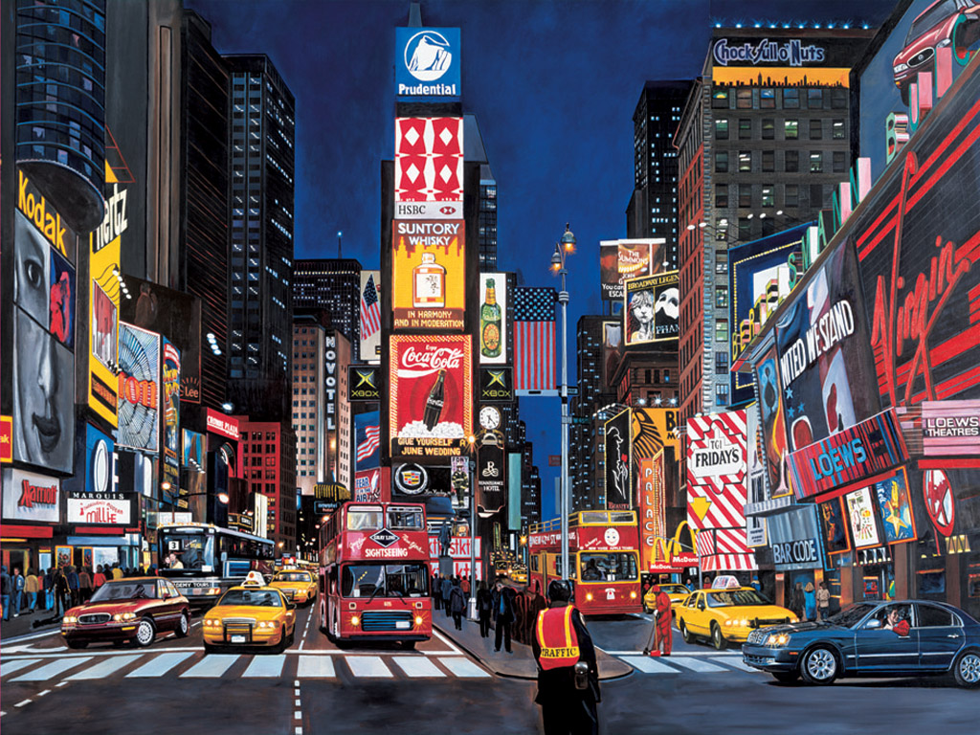
Chapter 7
Holden leaves for New York City for a few days where he plans to wait for his parents.

Slide 18
Chapter 7
And before he left, Holden put on his red hunting hat and began to cry.

Slide 19
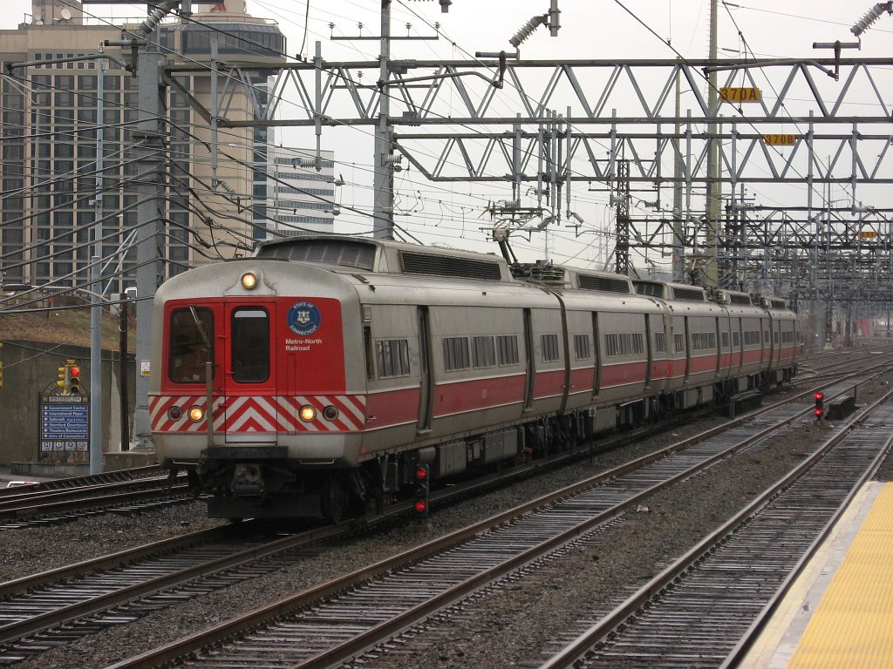
Chapter 8
On the train to New York City, Holden sits next to the mom of one of his classmates.

Slide 20
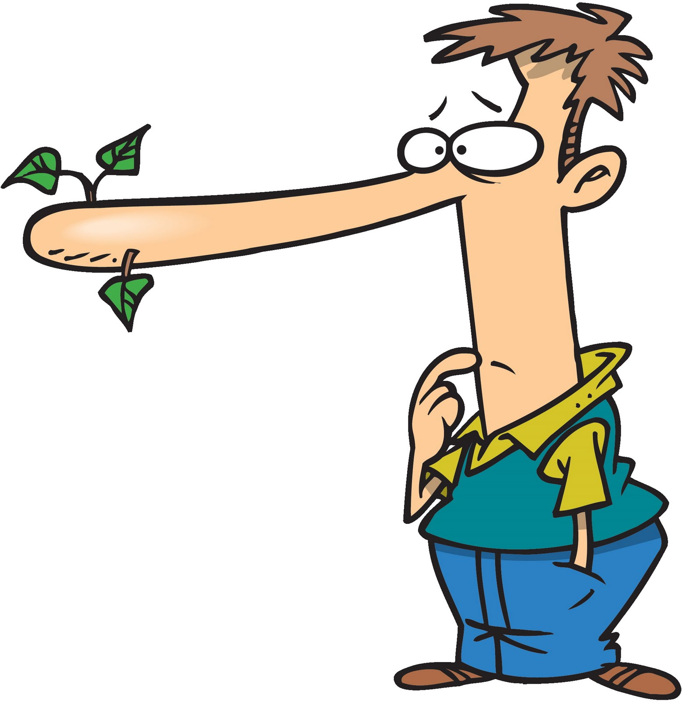
Chapter 8
He lies to her by saying her son is very popular and lies about his name to her.

Slide 21
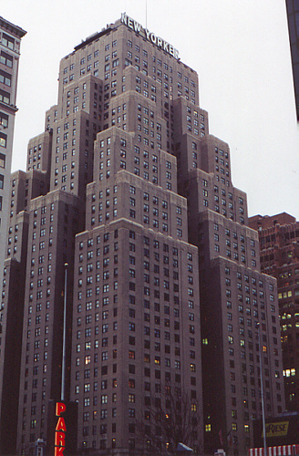
Chapter 9
Holden takes a cab to the Edmont Hotel and asks the driver where the ducks go in winter, but the driver doesn’t care.

Slide 22
Chapter 10
Holden considers calling Phoebe, his little sister who seems to be very much like Allie, but then Holden decides not to.

Slide 23
Chapter 11
Holden was reminiscing about his summer trips with Jane and misses how happy he was.

Slide 24
Chapter 11
He becomes very, very sad thinking about this so he takes a taxi to a nightclub.

Slide 25
Chapter 12
Holden asks this taxi driver about where the ducks in Central Park go in the winter, but this taxi driver became angry all of a sudden.

Slide 26
Chapter 12
At the nightclub, Holden found the people and their conversations depressing and phony so he leaves.

Slide 27
Chapter 13
Holden walks back to the hotel and decides to call a prostitute to his room.

Slide 28
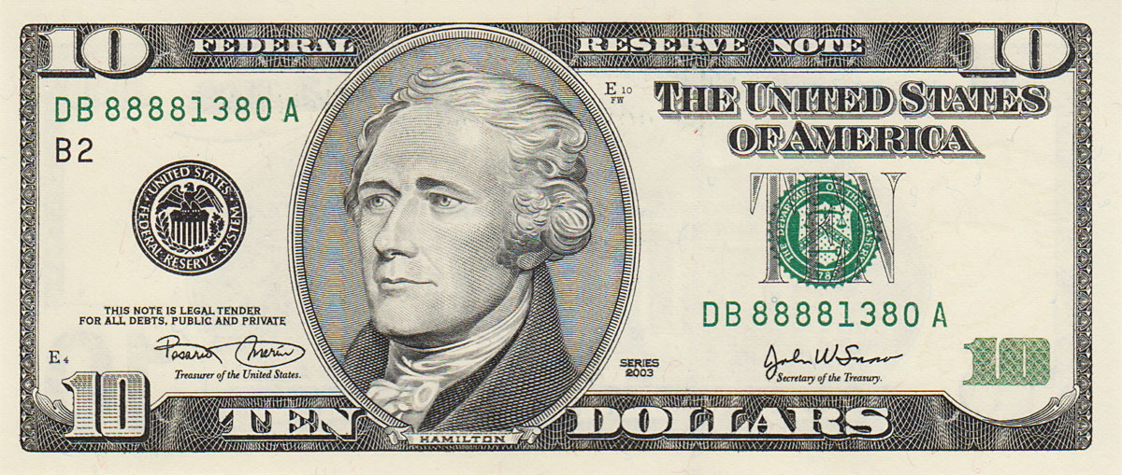
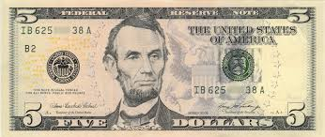
Chapter 13
The prostitute insists that Holden pay her $10 but he only gave her $5.

Slide 29
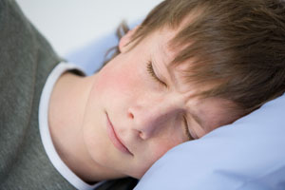
Chapter 14
Holden is still incredibly sad and upset and sits in his hotel room and smokes, then he goes to sleep.

Slide 30
Chapter 14
After he fell asleep, a knock on the door wakes up Holden and the prostitute her boss hurt Holden until he gives them the other $5 that the prostitute wanted.

Slide 31
Chapter 15
Holden goes to a diner for breakfast and talks with two nuns while he ate and gives them $10 as charity.

Slide 32
Chapter 16
Holden decides to walk to the park his sister usually goes to and meets a girl who knows that Phoebe had been at the Museum of Natural History the day before.

Slide 33
Chapter 16
Even though he knows Phoebe is not at the museum anymore, Holden goes to the museum anyway because he likes how constant and unchanging the museum artifacts are.

Slide 34
Chapter 17
Holden goes on a date with a friend named Sally Hayes, who is dressed very pretty.

Slide 35
Chapter 17
Holden takes Sally to see a play and then they go ice skating at Radio City Music Hall in Rockefeller Center.

Slide 36
Chapter 17
When they sit inside to take a break from skating Holden expresses to Sally how upset he is will all the phonies at his school and in New York City.

Slide 37
Chapter 17
When Sally says his dream of running away with her to escape the phonies is ridiculous, they argue, Sally cries, and Holden gets up to leave.

Slide 38
Chapter 18
Holden goes to see a movie but finds it extremely boring.

Slide 39
Chapter 18
After the movie Holden goes to the Wicker Bar where he meets his friend Luce.

Slide 40
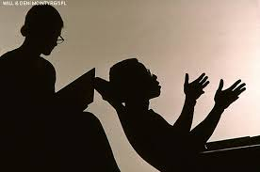
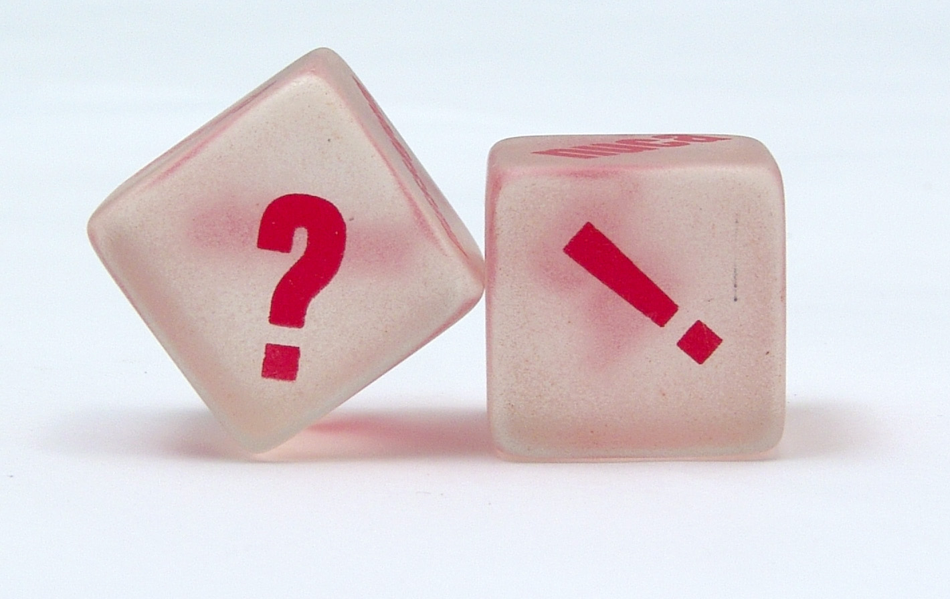
Chapter 19
Holden pesters Luce with questions he has about sex but Luce suggests Holden needs to see a psychoanalyst.

Slide 41
Chapter 19
When Holden continues to annoy Luce with childish questions, Luce leaves.

Slide 42
Chapter 20
Holden stays at the Wicker Bar and gets very drunk.

Slide 43
Chapter 20
He walks to Central Park and suddenly becomes very sad and misses Phoebe.

Slide 44
Chapter 20
Holden decides to sneak over to his home while his parents are asleep to say hello to her.

Slide 45
Chapter 21
Phoebe is ecstatic to see Holden and tells him all about school.

Slide 46
Chapter 21
She then realizes he is home two days before he is supposed to be from school and she tells him their dad will be especially mad at him.

Slide 47
Chapter 22
Holden tries to explain to Phoebe that he got kicked out of school because he hates school and she challenges him to name one thing in the world he doesn’t hate.

Slide 48
Chapter 22
He says he doesn’t hate Allie and Phoebe angrily reminds Holden that Allie is dead.

Slide 49
Chapter 22
Phoebe asks Holden what he wants to do with his life and Holden can only think of a little boy who was saying “If a body catch a body comin’ through the rye” and pictures himself catching children before falling off of a cliff while they play in an enormous field of rye.

Slide 50
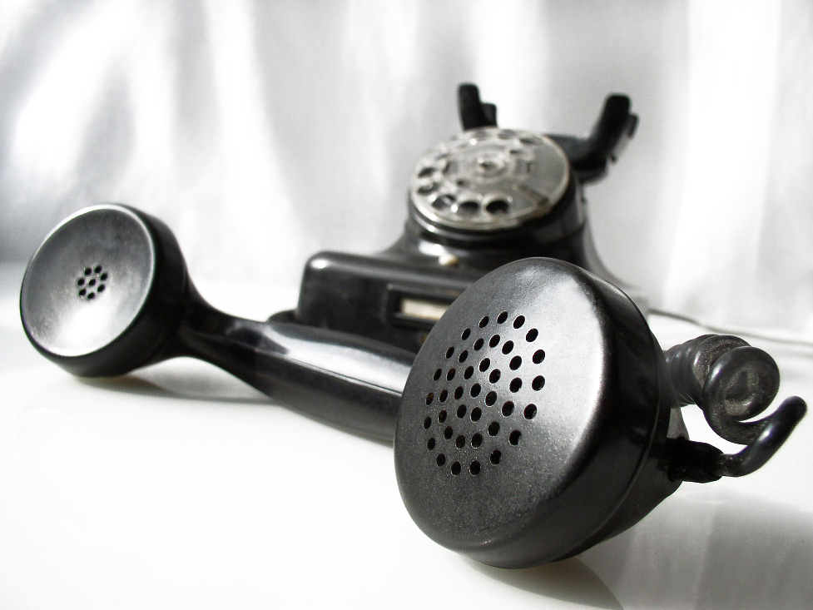
Chapter 23
Holden leaves Phoebe’s room to call his old English teacher, Mr. Antolini.

Slide 51
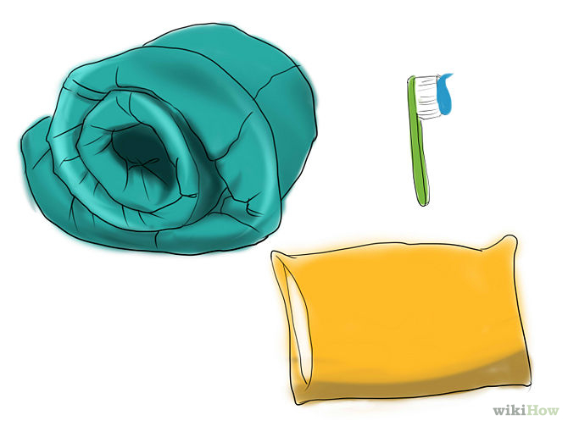
Chapter 23
After Holden mentions how he was kicked out of school Mr. Antolini offers Holden the option to stay with him for the night.

Slide 52
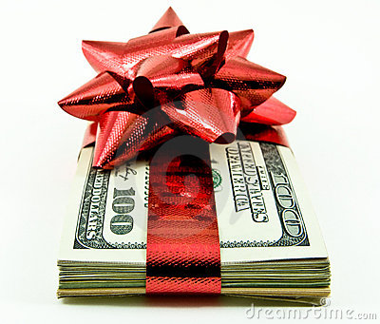
Chapter 23
Before Holden leaves, Phoebe gives him her Christmas money she had been saving up.

Slide 53
Chapter 23
Holden gives Phoebe his red hunting hat.

Slide 54
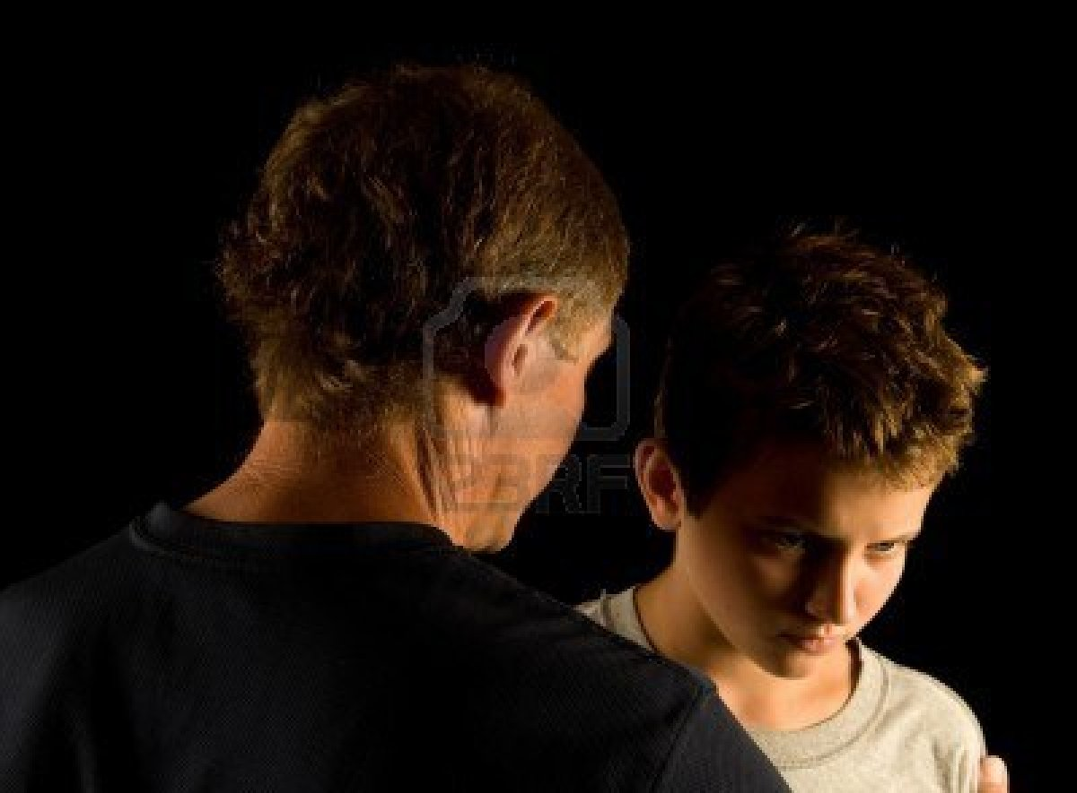
Chapter 24
When Holden arrives at Mr. Antolini’s, they sit down and have a serious talk and Mr. Antolini expresses how worried he is about Holden.

Slide 55
Chapter 24
After Holden was asleep for a while he wakes up to Mr. Antolini stroking his head, which makes Holden extremely uncomfortable so he decides to leave.

Slide 56
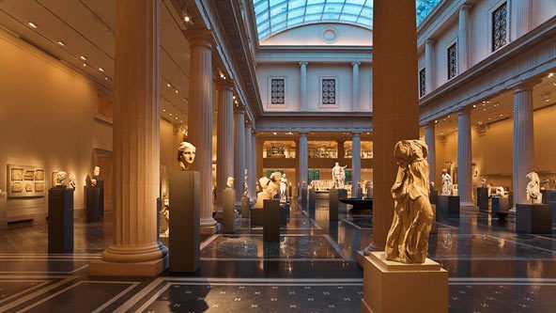
Chapter 25
Holden decides he wants to run away out west so he writes a note to Phoebe to meet him at the Museum of Art.

Slide 57
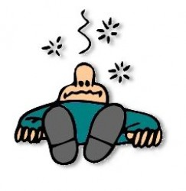
Chapter 25
While he waits for her, Holden ends up passing out in the bathroom but he claims he is fine.

Slide 58
Chapter 25
Phoebe arrives at the museum with her suitcase packed because she wants to go with Holden.

Slide 59
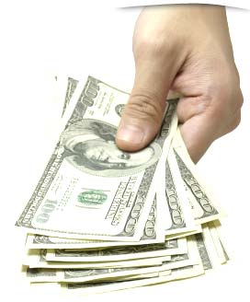
Chapter 25
Holden won’t let Phoebe go with him and gives back the money she gave him.

Slide 60
Chapter 25
Phoebe gives back his red hunting hat.

Slide 61
Chapter 25
They go to the zoo and Holden says he is so happy he might start to cry.

Slide 62
Chapter 26
At this point we find out that Holden was telling his story from a care home and refuses to say what happened next.

Slide 63
Chapter 26
All Holden says is that he went home, got sick, and his family sent him to the care home.

Slide 64
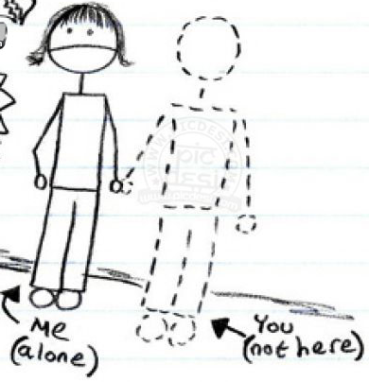
Chapter 26
He doesn’t want to talk anymore and says that talking about what happened to him during his story makes him miss everyone that he talked about.

Slide 65
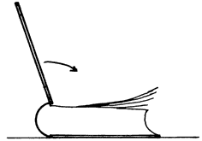
The End

