Slide 1
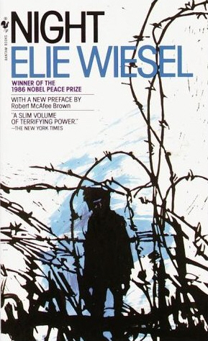
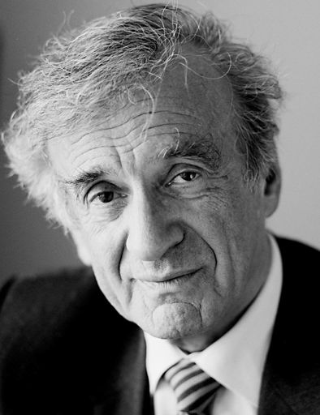
Night Ellie Wiesel

Slide 2
Part One
“Annihilate an entire people? Wipe out a population dispersed throughout so many nations? So many millions of people! By what means? In the middle of the twentieth century!” (Page 8)

Slide 3
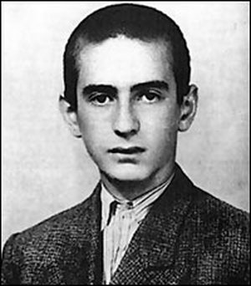
My name is Eliezer Wiesel, but you can call me Elie. I am a fifteen year old Jewish boy living in Sighet, Transylvania.

Slide 4
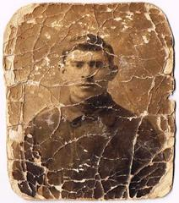
My friend Moishe and other Jews in my town were kidnapped by Nazis, men who hated us. Moishe, pictured below, escaped, but all the others were killed. He tried to warn us that the Nazis were going to exterminate the Jews and begged us to protect ourselves. But we didn’t believe him.

Slide 5
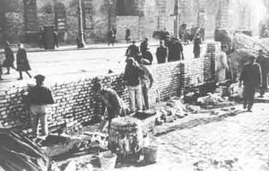
But just like Moishe warned, the Nazis came to our town. At first they were nice. But soon they became hostile, rounded up all the Jews including my family and me, and forced us to live in ghettos. We were imprisoned and isolated from the rest of the world.

Slide 6
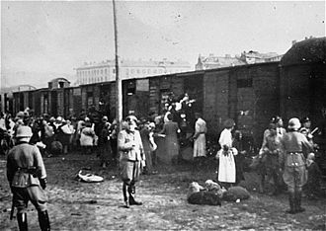
Soon they forced us into trains. We didn’t know where they were taking us.

Slide 7
Part Two
“’Jews, look! Look at the fire! Look at the flames!’ And as the train stopped, this time we saw flames rising from a tall chimney into a black sky.” (Page 28)

Slide 8
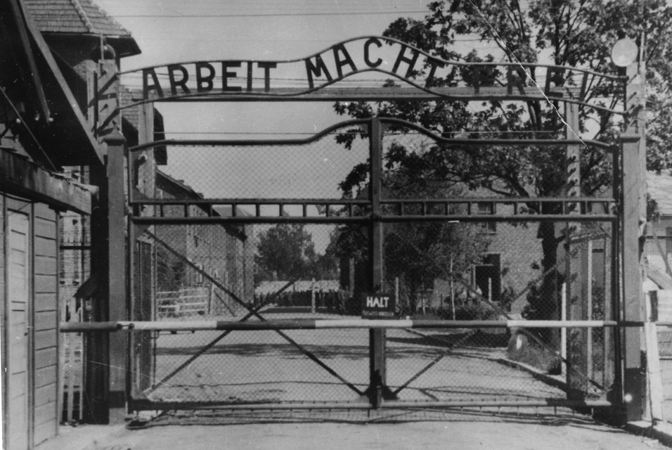
On the train, a woman kept screaming, “Fire! Fire!” We didn’t know what was wrong with her. Then we reached Auschwitz-Birkenau, a concentration camp, and knew why she was screaming. The Nazis were going to burn us alive.

Slide 9
Part Three
“Never shall I forget those moments that murdered my God and my soul and turned my dreams to ashes.” Page 34

Slide 10
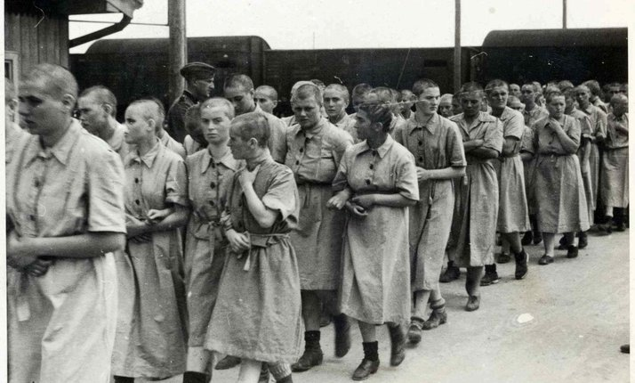
When we got off the train, we were separated into men and women. I looked at my mom reaching for my sister. That was the last time I ever saw them.

Slide 11
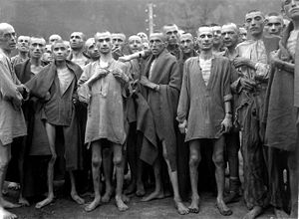
Although I was very sad to leave my mother, I did get to stay with my father. We were brought into the concentration camp. They stripped us down and shaved our hair. We all looked the same. They were preparing us for torture. We were not humans to the Nazi’s. they treated us like animals.

Slide 12
Part Four
“Where is God now?” And I heard a voice within me answer him: “Where is He? Here He is—He is hanging here on this gallows” 65

Slide 13
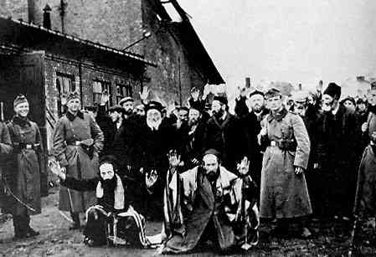
It was very strange. All of the Jewish men being tortured constantly prayed and thanked God. I did not understand why. I didn’t think we should be thankful.

Slide 14
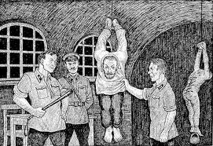
Whenever the Nazi’s wanted to, they could beat us. They abused us. They did not feed us. I had seen many people die from this awful treatment.

Slide 15
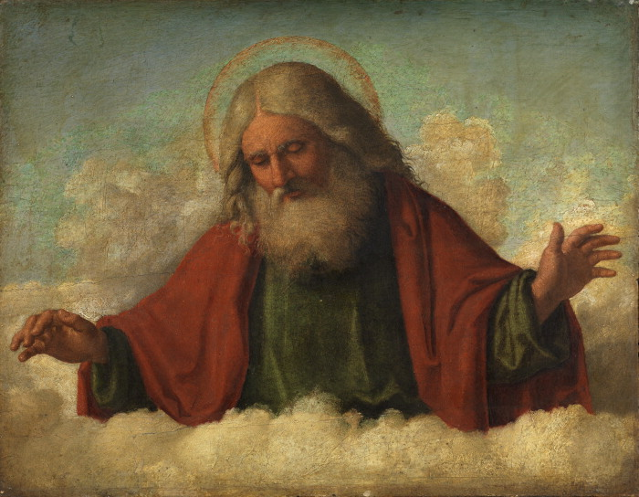
This was not a life. This is death, and God is dying with us. I no longer found reason to have faith. I felt that God had abandoned me.

Slide 16
Part Five
“I have more faith in Hitler than in anyone else. He alone has kept his promises, all his promises, to the Jewish People.” Page 81

Slide 17
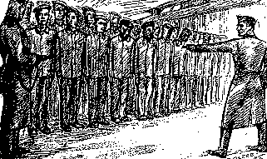
The Nazi’s forced us through another selection process. Who will live? Who will they murder?

Slide 18
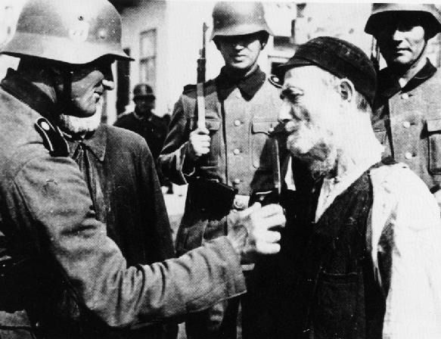
I made it through the selection but they said my father was too weak and he would be executed.

Slide 19
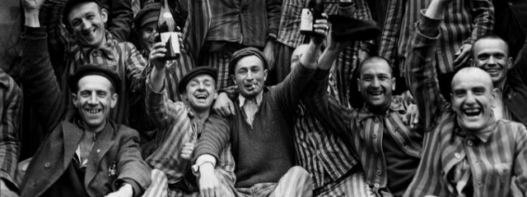
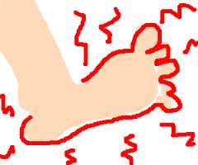
A miracle happened and my father survived.
I was happy my father was still alive. But, it was winter and we did not have warm clothes or food. It was awful.

Slide 20
Part Six and Seven
“This was it; the end of the road. A silent death, suffocation. No way to scream, to call for help.” Page 94

Slide 21
I ran for miles in the snow with my bleeding foot. I saw people abandon their loved ones. I saw herds of men wrestle over a few crumbs of bread. I saw people fight to the death for a coin. I saw people die. I was told to throw away their dead bodies.
This is the Holocaust.

Slide 22
Part 8
“I tightened my grip on my father’s hand. The old, familiar fear: not to lose him.” Page 104

Slide 23
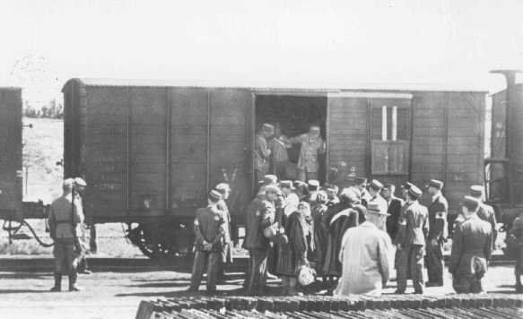
We were put on a train to Buchenwald, a different camp. My father was dying. I knew he would not survive.
I secretly wanted his food for myself because I had a much better chance of survival.

Slide 24
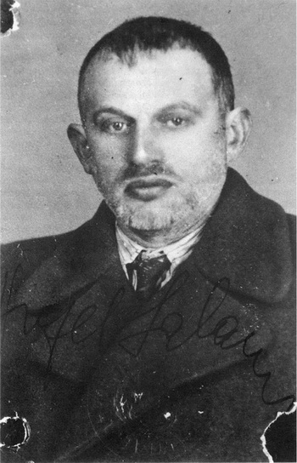
This was Shlomo Wiesel, my father.
I woke up one morning and found that my father had been taken away to be killed. He was too weak.
I did not cry. I felt free.

Slide 25
Part Nine
“I decided to look at myself in the mirror on the opposite wall. I had not seen myself since the ghetto. From the depths of the mirror, a corpse was contemplating me.” Page 115

Slide 26
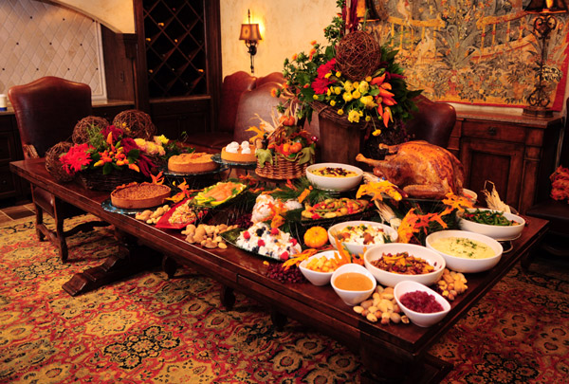
I stayed in Buchenwald. My life did not matter anymore. All I wanted was to eat.

Slide 27
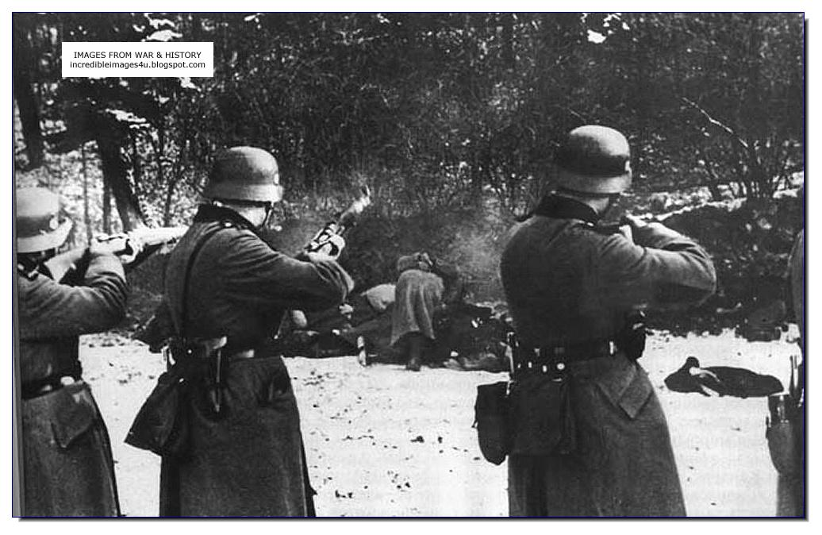
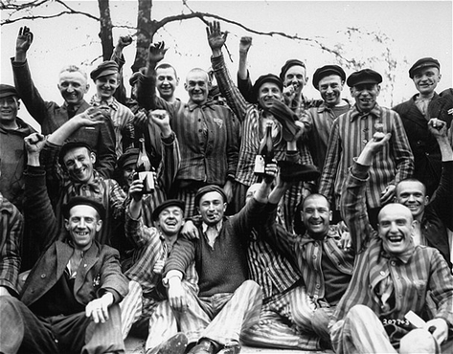
In April when the Russians came to save us, the Nazis tried to kill us before we could be saved. But the Russians won. We were finally free.

Slide 28
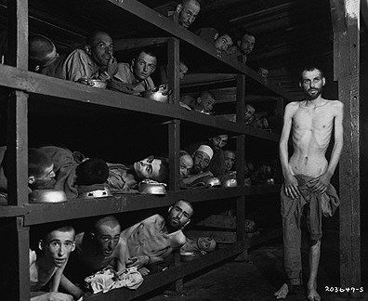
Even though I was free, I wasn’t even happy. All I cared about was food. I looked at myself in a mirror for the first time since I left my home. I did not look alive.

