Slide 1
Nate the Great By Marjorie Weinman Sharmat

Slide 2
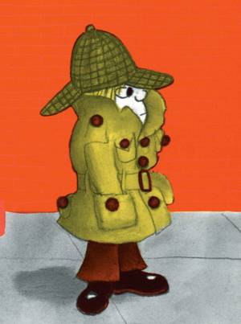
I am Nate the Great.

Slide 3
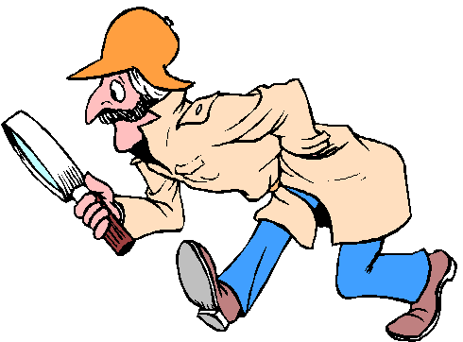
I am a detective.

Slide 4
I like to eat pancakes.

Slide 5
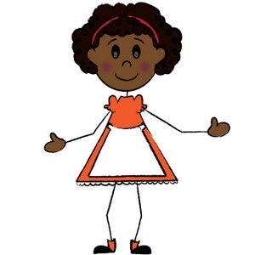
This is my neighbor Annie.

Slide 6
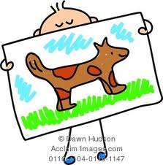
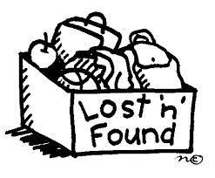
Annie lost her picture.

Slide 7
She called me to help her find her picture.

Slide 8
I went to Annie’s house to help.

Slide 9
I like Annie.

Slide 10
Annie was eating pancakes.

Slide 11
I like pancakes.

Slide 12
Annie painted a picture of her dog, Fang.

Slide 13
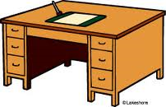
She put it on her desk to dry.

Slide 14
Now the picture is gone.

Slide 15
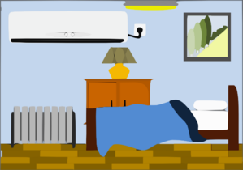
I went to look in Annie’s room.

Slide 16
I looked for the picture in the desk.

Slide 17
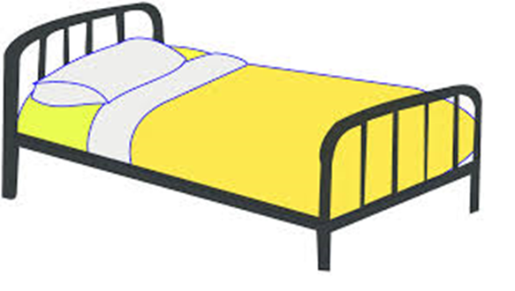
I looked for the picture under the bed.

Slide 18
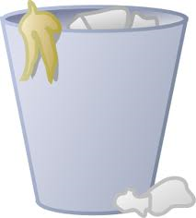
I looked for the picture in the garbage can.

Slide 19
I did not find the picture in Annie’s room.

Slide 20
This is Annie’s dog Fang.

Slide 21
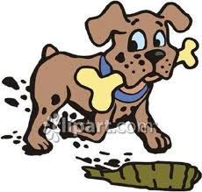
Fang likes to bury things.

Slide 22
I looked to see if Fang buried the picture.

Slide 23
The picture was not there.

Slide 24
After looking I was hungry.

Slide 25
Annie gave me pancakes.

Slide 26
I love pancakes.

Slide 27
Next we went to Rosamond’s house.

Slide 28
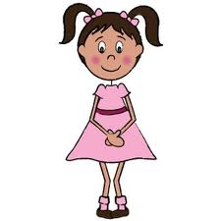
This is Rosamond.

Slide 29
Annie and Rosamond are friends.

Slide 30
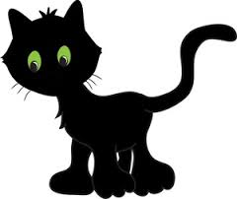
Rosamond lost her cat, Super Hex.

Slide 31
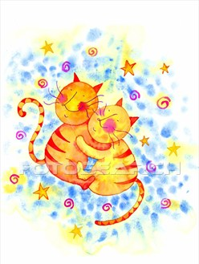
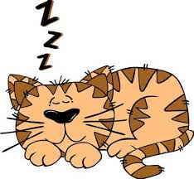
There were pictures of cats everywhere.

Slide 32
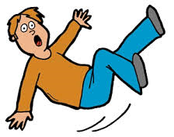
I tripped over something long and black.

Slide 33
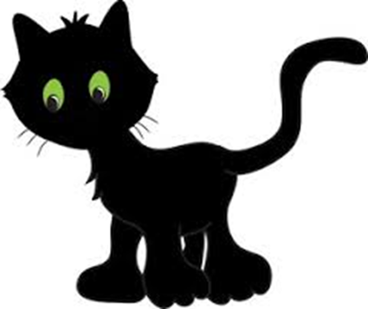
It was Super Hex’s tail.

Slide 34
I found Super Hex!

Slide 35
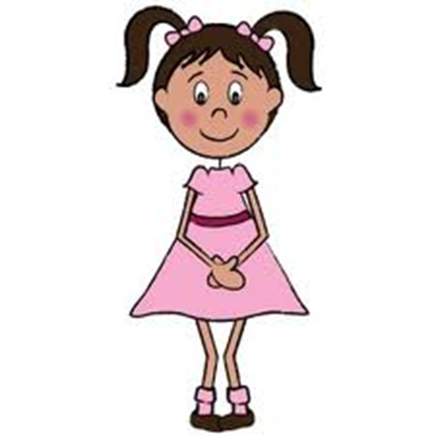
Rosamond only likes cats.

Slide 36
We left Rosamond’s house.

Slide 37
We went to Annie’s house.

Slide 38
I met Annie’s brother, Harry.

Slide 39
Harry likes to paint.

Slide 40
Harry liked to paint in red.

Slide 41
The painting of the monster was orange.

Slide 42
Annie’s picture was yellow.

Slide 43
Red and yellow make orange.

Slide 44
Harry painted over Annie’s picture.

Slide 45
I solved the case!

Slide 46
Annie gave me more pancakes.

Slide 47
I like pancakes.

Slide 48
Then I walked home.

