Slide 1
My Side of the Mountain
Written by: Jean George

Slide 2
Characters (people)
Sam Gribley → Main character. Sam ran away from home and is living in the Catskill Mountains.
Dad/ pa → Sam’s dad, he comes to visit on holidays.
Bando → A teacher who gets lost in the woods. Sam becomes friends with Bando, Bando visits on holidays.
Matt the reporter → A newspaper reporter who wants to write a story on Sam. Sam does not let him.

Slide 3
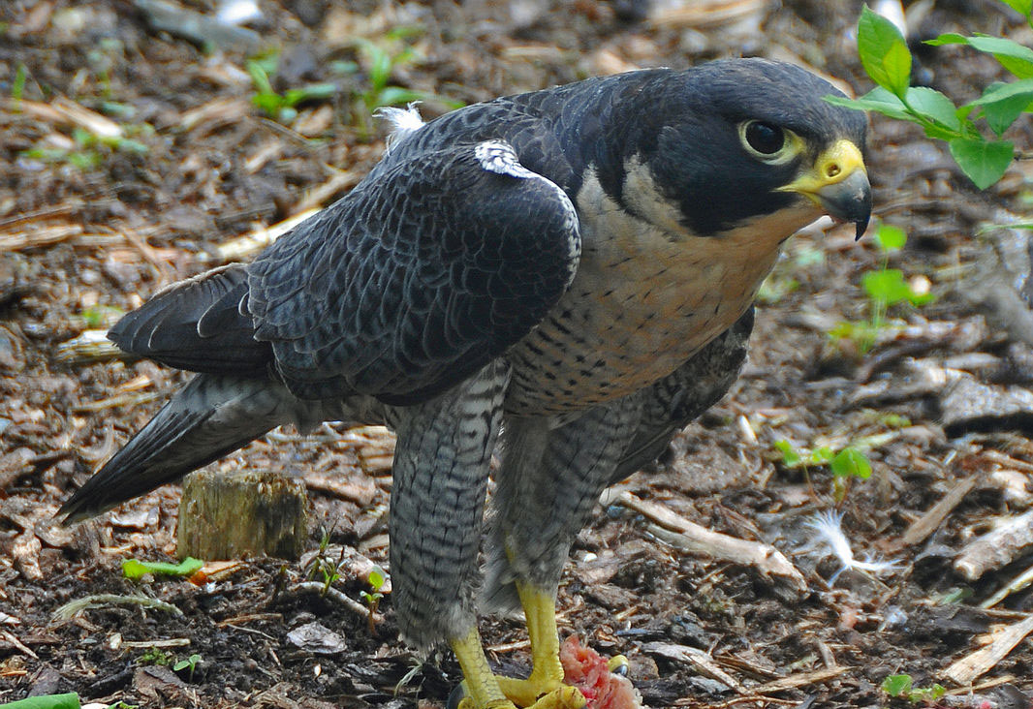
More Characters (animals)
Frightful → Sam’s pet falcon (bird).
Jeese Coon James → Racoon that Sam becomes friends with.
Baron Weasel → Weasel that Sam becomes friends with.

Slide 4
Background
Catskill Mountains are in Southeast New York
Sam P, you ski near there!
Sam lives in a hemlock tree, it is 6 feet wide
Big pine tree (like a giant Christmas tree)
Hemlocks can be 150 feet tall!
Sam has a pet falcon
A falcon is a big bird
They are great hunters

Slide 5
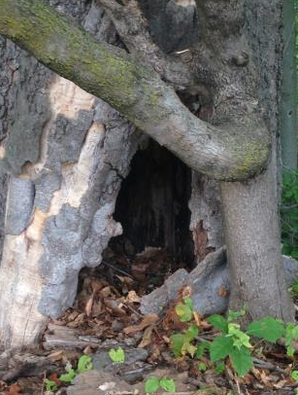
In which I Hole Up in a Snowstorm
Sam is writing in his journal, he talks about his tree house. It has a deer skin door, a bed, and a small fireplace.

Slide 6
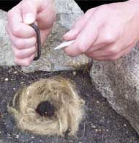
Chapter 1 Continued
It is the first big snow storm and Sam is very scared.
Sam talks about how he learned how to make fire, fish, and hunt.

Slide 7
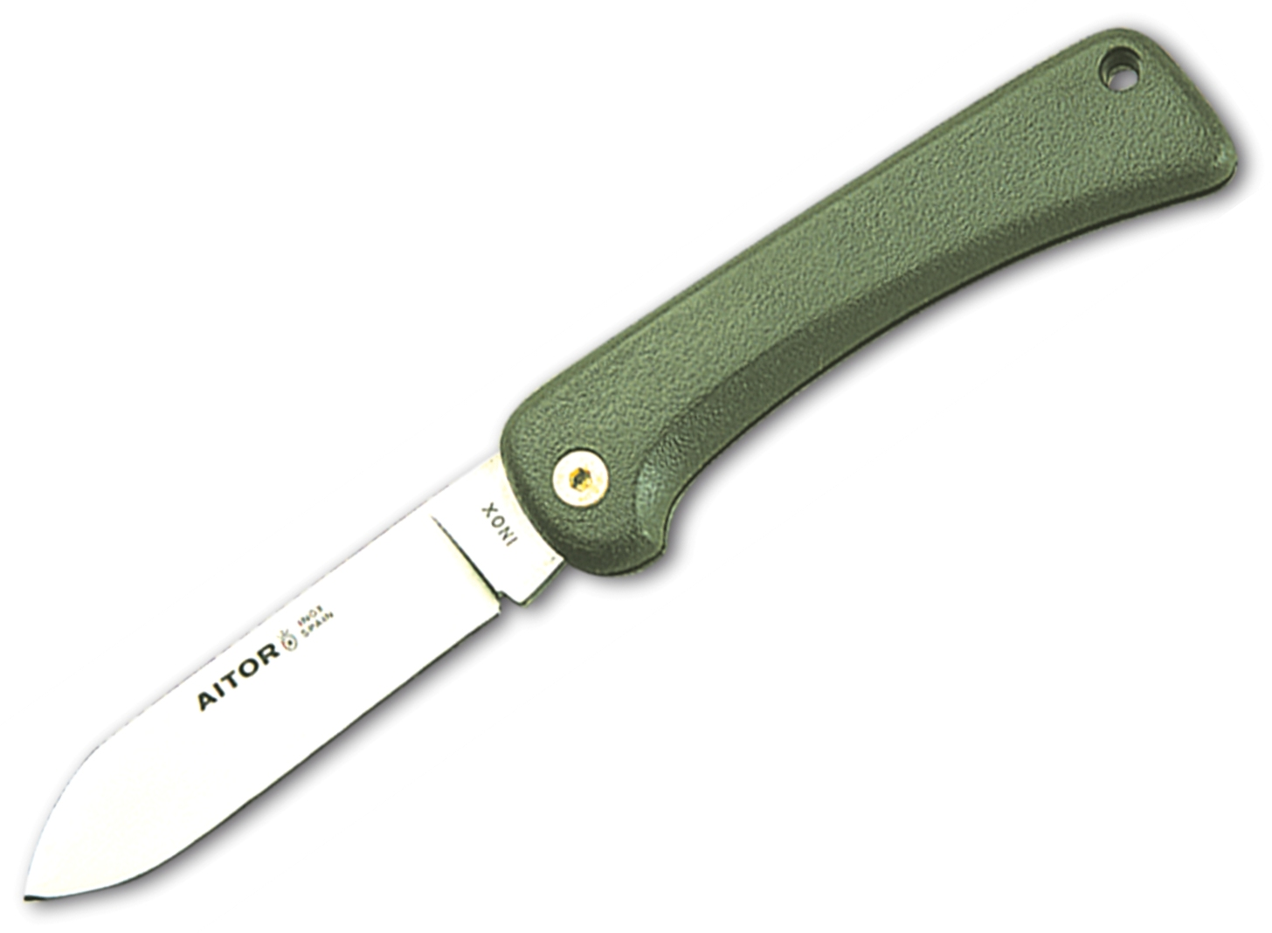
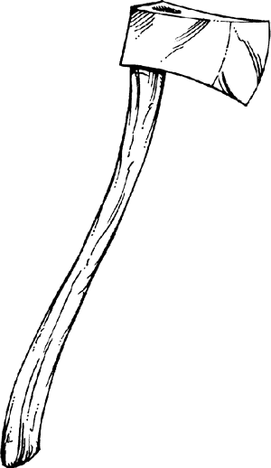
In which I Get Started on This Venture
Sam explains the start of his trip, he started with:
a penknife,
ball of cord (string), an ax,
$40, flint and steel to start fires.

Slide 8
Chapter 2 Continued
Sam ran away from home and spends his first night in the woods, he makes a tent with an old tree.

Slide 9
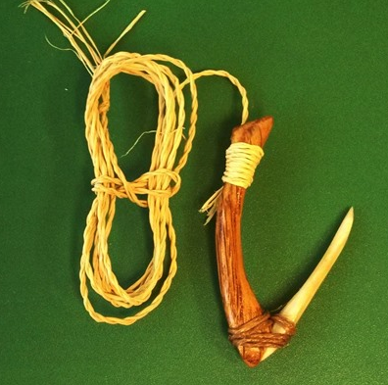
Chapter 2 Continued
Sam makes a hook to go fishing, he catches one fish.
He meets Bill, who teaches him how to make a fire.

Slide 10
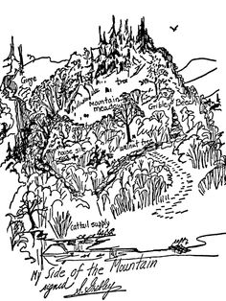
The manner in which I Find Gribley’s Farm
Sam goes to find his Great-grandfather’s farm. He goes to the library and gets a map of the land.

Slide 11
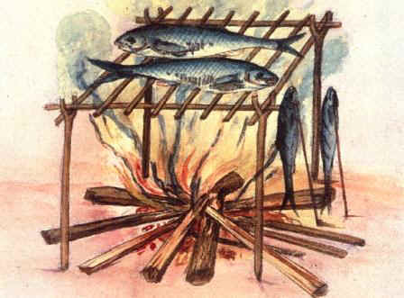
Chapter 3 Continued
He finds the Gribley’s tree and cannot believe he made it!
Sam catches himself a fish and makes a fire.

Slide 12
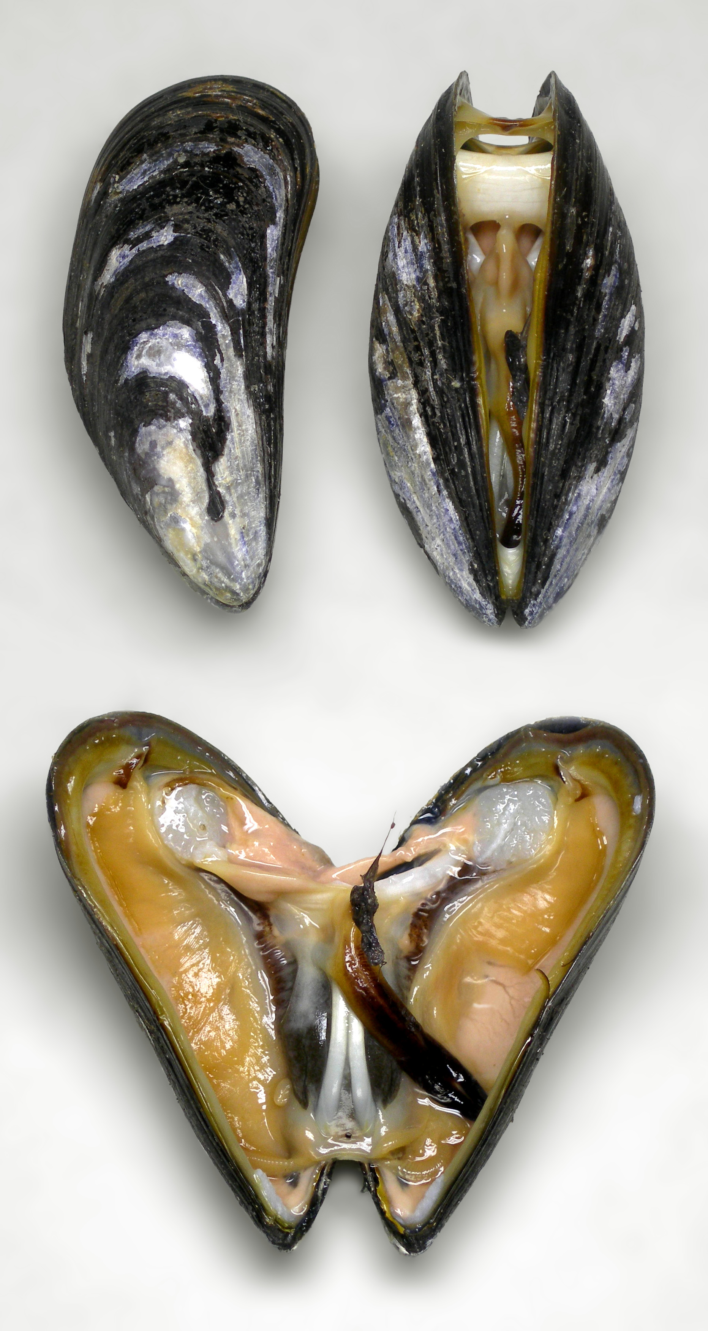
In which I Find Many Useful Plants
Sam tries to eat plants and berries, they taste bad.
He goes to the river and catches muscles (look at picture), he cooks them over the fire.

Slide 13
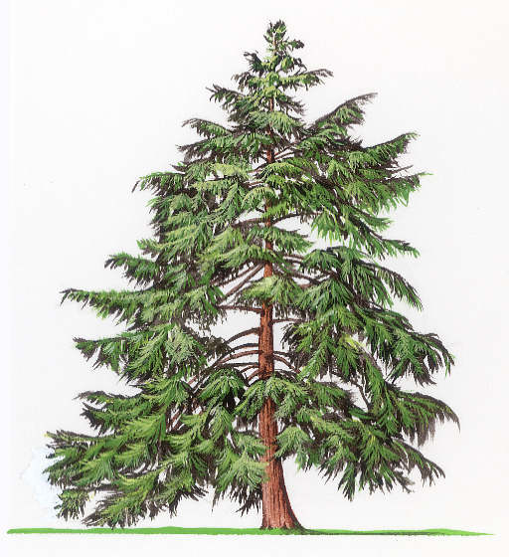
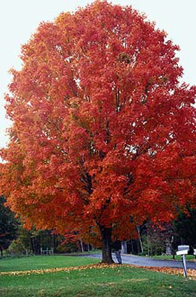
Chapter 4 Continued
Sam explores the land, he finds part of the old house, apple trees, hemlock trees, and maple trees.

Slide 14
This is about The Old, Old Tree
Sam finds a huge tree that he wants to make his home. It is a little rotten, all he has to do is dig out the inside, he uses fire to help him dig.

Slide 15
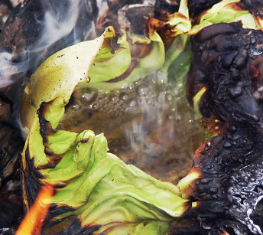
Chapter 5 Continued
Sam learns how to boil water in a leaf, he eats flower salad for lunch.
Sam find water near his new home, and he is very happy.

Slide 16
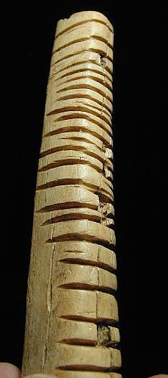
Chapter 5 Continued
Sam makes a calendar by putting marks in a stick. He counts his days on the mountain.

Slide 17
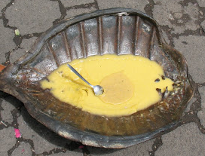
In which I Meet One of My Own Kind and Have a Terrible Time Getting Away
It is now June.
Sam learned how to cook frog legs and turtle for food. He set up hunting traps to catch rabbits.

Slide 18
Chapter 6 Continued
An old lady finds Sam in the woods, they pick strawberries.
She walks him back down to town to go home but Sam goes to the library.

Slide 19
The King’s Provider
At the library Sam learns about hawks (birds).
Miss Turner, the librarian, gave Sam a haircut.

Slide 20
Chapter 7 Continued
Sam catches a trout (fish) for lunch and watches birds.
He climbs a cliff and steals a baby hawk from a nest. He names the hawk Frightful.

Slide 21
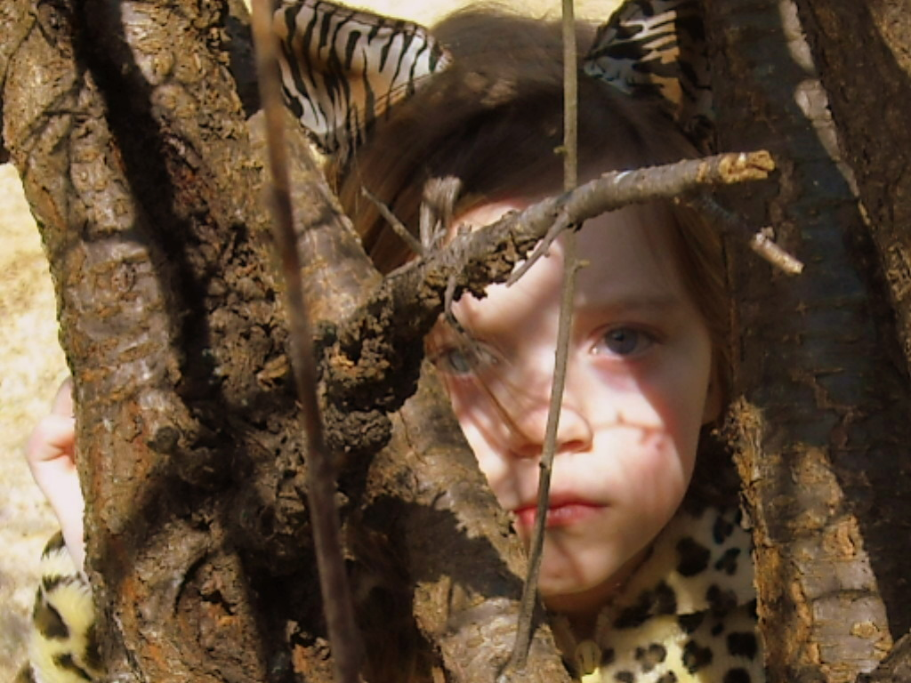
A Brief Account of What I Did About the First Man Who Was After Me
Sam spots a forest cop inspecting his home. He hides from the man, he does not want to go back to New York City yet.

Slide 22
Chapter 8 Continued
Sam catches a rabbit, makes a small fire by the river and eats dinner with Frightful.
Sam hopes to train Frightful soon.

Slide 23
In Which I Learn to Season My Food
The forest cop leaves so Sam goes back to his tree.
He caught a weasel but it attacked Sam, he named it The Baron.

Slide 24
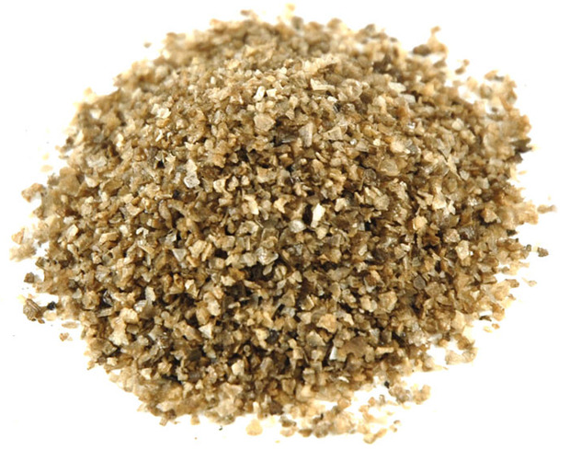
Chapter 9 Continued
Sam made salt by cooking sticks, he likes the salt.
Sam finished making a bed.
He decides he wants to catch a deer, so he makes a trap.

Slide 25
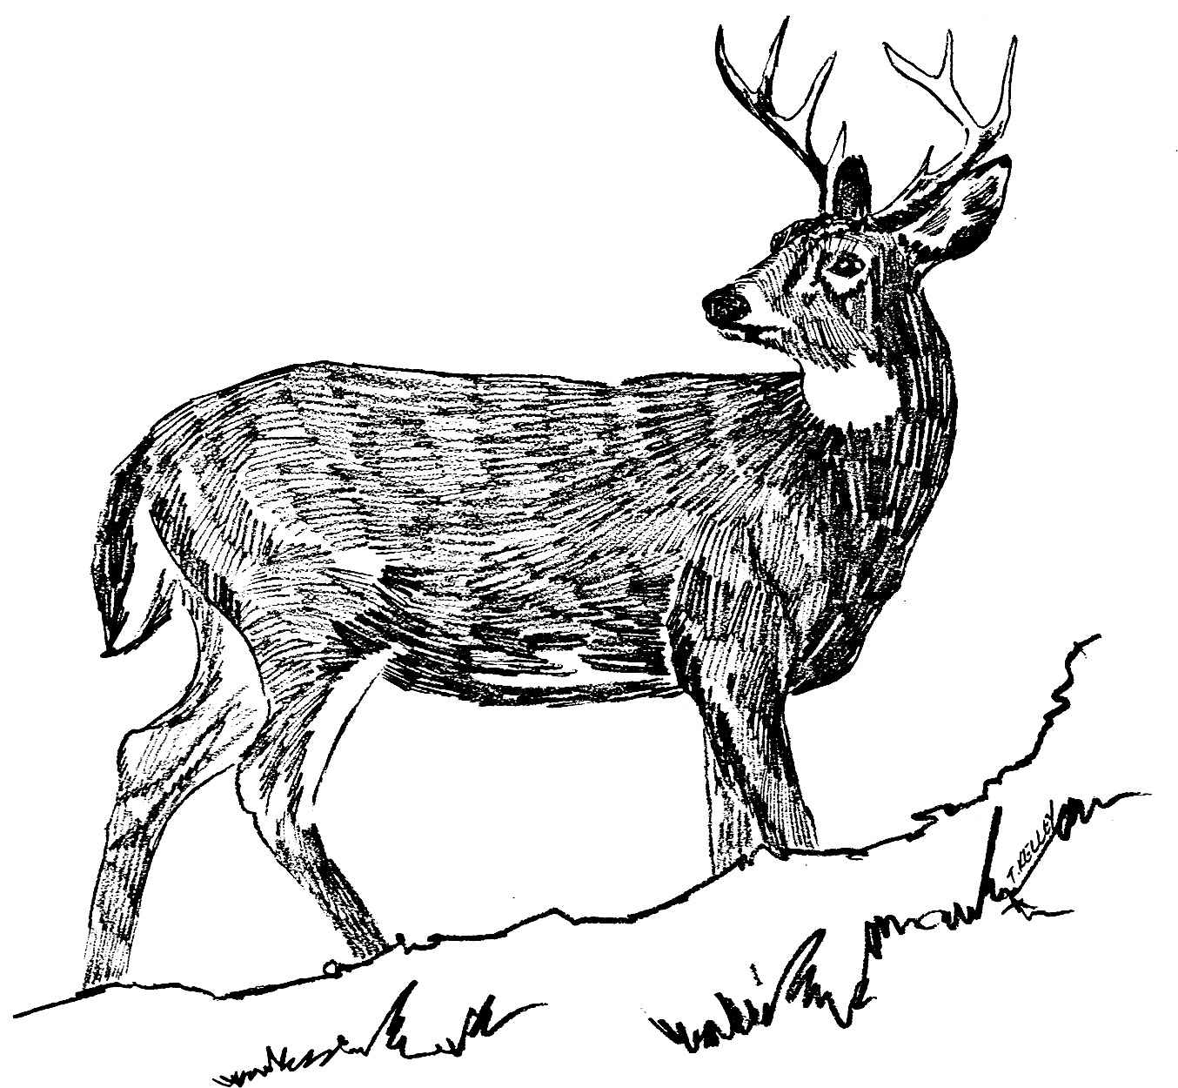
How a Door Came to Me
Sam hears a hunter shoot a deer, he runs out, steels the dead deer, and hides it.

Slide 26
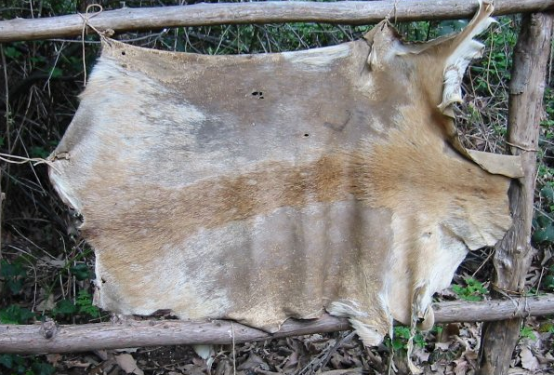
Chapter 10 continued
When the hunter left, Sam began to cut up the deer for his dinner.
He used the deer skin to make a door, and rope.

Slide 27
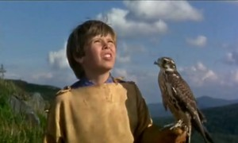
In Which Frightful Learns Her ABC’s
Sam teaches Frightful to fly to him when he whistles.
Frightful learns how to catch rabbits, and other birds in the sky.

Slide 28
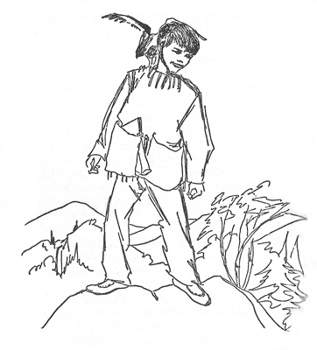
Chapter 11 Continued
Sam makes himself a pair of pants using deer skin.

Slide 29
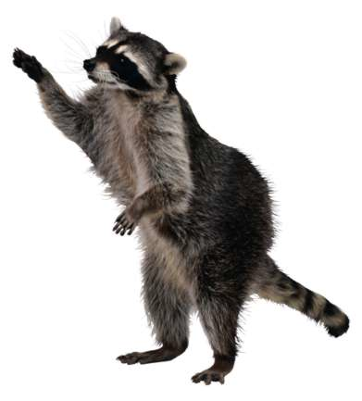
In Which I Find a Real Live Man
Sam was taking a bath in the river and made friends with Jessie C James Raccoon.
He spots a man by his fire, Sam thinks he is a bad guy. He names him Bando.

Slide 30
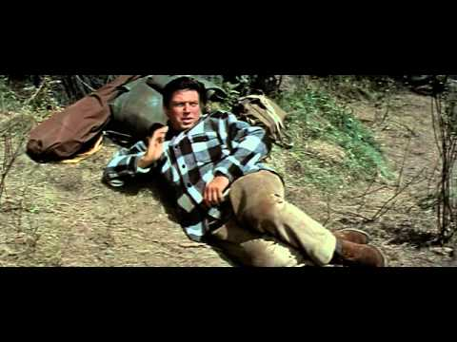
Chapter 12 Continued
Bando is a good guy. He stays for 10 days.
They fish, make a raft, and make blueberry jam together.

Slide 31
In Which The Autumn Provides Food and Loneliness
It is fall, becoming winter and Sam is scared.
He makes himself clothes with fur to stay warm.

Slide 32
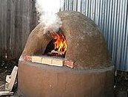
Chapter 13 Continued
Sam makes a fireplace with mud, he puts holes in the tree so he can get air.

Slide 33
In Which We All Learn About Halloween
It is Halloween, Sam has a party with the animals.
The animals sneak into his tree, make a mess, and eat a lot of his food.
Sam wakes up and scares all the animals away.

Slide 34
In Which I Find Out What to Do with Hunters
It is the first day of hunting season so Sam has to hide from the hunters.

Slide 35
Chapter 15 Continued
A hunter shoots a deer and looses it, Sam finds it.
He makes a blanket, and jacket from the deer skin.

Slide 36
In Which Trouble Begins
Sam goes to town to the drugstore to read comic books.
A boy comes up to him and makes fun of his clothes. Sam tells him to come to his farm one day.

Slide 37
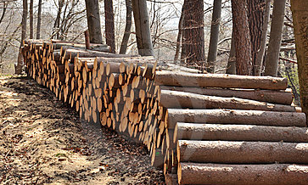
Chapter 16 Continued
As Sam walks home, he remembers he has to make a wood pile for the winter.
He is afraid he will not live all winter.

Slide 38
In Which I Pile Up Wood and Go On with Winter
Sam makes many wood piles for winter.
The first snow storm comes, winter has started.
Sam goes to the river and ice fishes, he makes fires in his home.

Slide 39
In Which I Learn About Birds and People
It is Christmas eve, Sam remembers that Bando will come visit for Christmas.
Bando tells him that people are trying to find Sam.

Slide 40
Chapter 18 Continued
The next day Sam hears a yell, it is his dad.
Sam, his dad, and Bando spend Christmas week together.

Slide 41
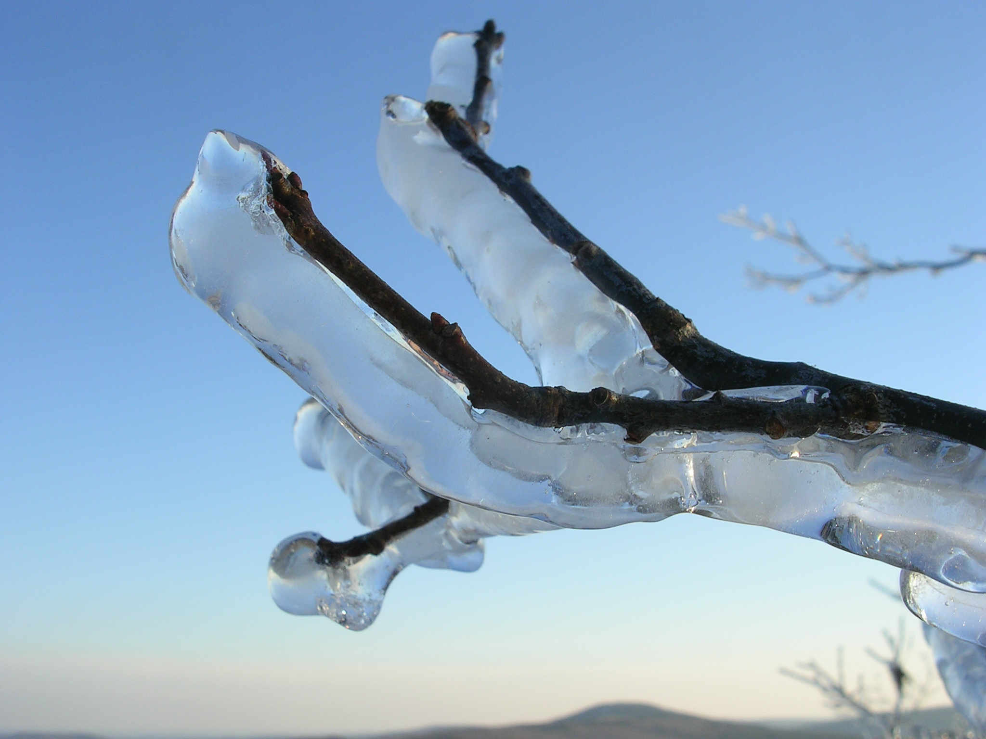
In Which I Have a Good Look at Winter and Find Spring in the Snow
Winter became very cold. One day Sam got iced in.
Sam is running out of food, he feels he is getting sick.

Slide 42
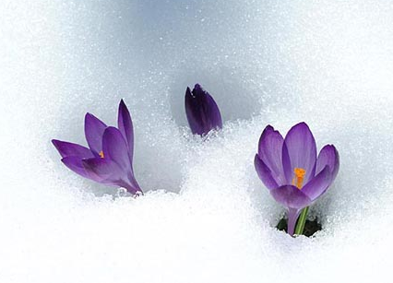
Chapter 19 Continued
Sam eats rabbit liver, he feels stronger.
Snow is starting to melt, spring is coming!

Slide 43
More About The Spring in the Winter and the Beginning of My Story’s End
A boy named Matt comes up and asks Sam if he has seen the “wild boy”.
Sam makes up a fake “wild boy” to tell Matt, the reporter.

Slide 44
Chapter 20 Continued
Matt knows Sam is the “wild boy” but won’t tell on him. Matt is going to visit later in the spring.

Slide 45
In Which I Co-operate with the Ending
Spring is finally here and Sam is eating plants, fish, and rabbits.
Matt the reporter, and Bando come to visit.
Sam does not want to leave the forest.

Slide 46
In Which The City Comes to Me
One day the forest was full of reporters taking pictures and asking for Sam’s story.

Slide 47
Chapter 22 Continued
He hears a voice yell, it is his dad! He runs down the mountain to see his dad and family.
His family lives with him and builds him a house.
THE END

Slide 48
Themes
Do you think a theme of the book is…
Run away from home
Do what makes you happy
Do you think a theme of the book is…
It is better to hurt the planet
It is better to live with nature
Do you think a theme of the book is…
Independence/ doing things by yourself
Needing help from others

