Slide 1
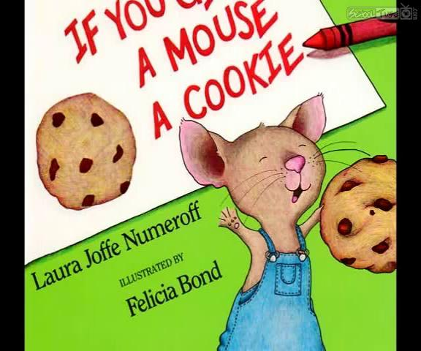
If You Give a Mouse a Cookie
By, Laura Numeroff

Slide 2
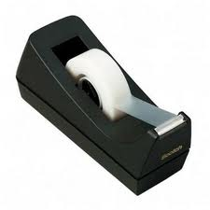
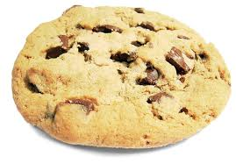
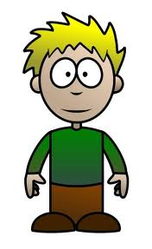
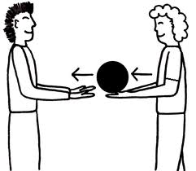
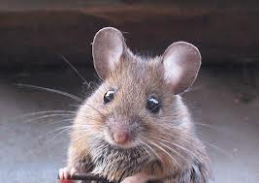
Words Used Throughout:
Tape→
Give→
Mouse→
Cookie→
He→
Ask→

Slide 3
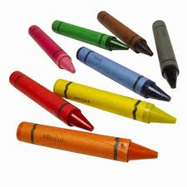
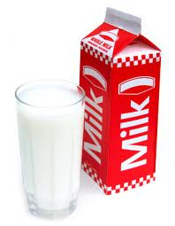
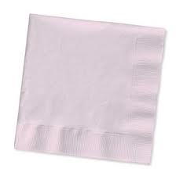
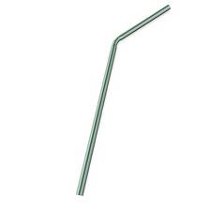
Crayons→
Milk→
Straw→
Finish→
Napkin→
Pen→

Slide 4
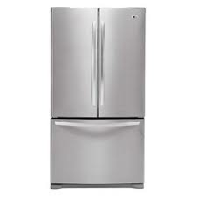
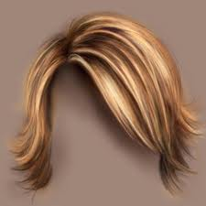
Mirror→
Mustache→
Hair→
Refrigerator→
Trim/Scissors→
Pair→

Slide 5
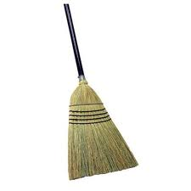
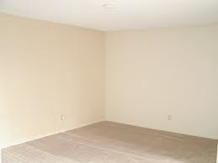
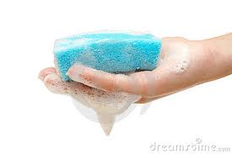
Broom→
Paper→
Start→
Room→
House→
Wash→

Slide 6
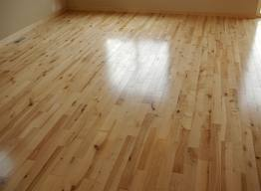
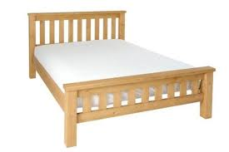
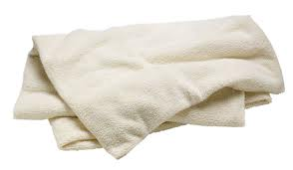
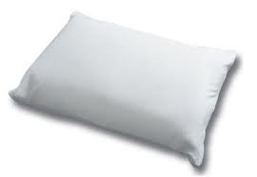
Floor→
Want →
Nap→
Bed→
Blanket→
Pillow→

Slide 7
Read→
Story →
Pictures→

Slide 8
Adapted Story…

Slide 9
If you give a mouse a cookie,
he’s going to ask for a glass of milk.

Slide 10
When you give him the milk,
he’ll probably ask you for a straw.

Slide 11
When he’s finished, he’ll
probably ask you for a napkin.

Slide 12
Then he’ll want to look in a mirror
to see if he has a milk mustache.

Slide 13
When he looks in the mirror, he may
see that his hair needs a trim.

Slide 14
So he’ll probably ask for a pair
of scissors.

Slide 15
When he’s finished giving himself
a trim, he’ll want a broom to sweep.

Slide 16
He’ll start sweeping. He might
Sweep every room in the house.

Slide 17
He might wash the floors!
Then, he’ll probably want to nap.

Slide 18
You’ll have to give him a bed
with a blanket and a pillow.

Slide 19
He’ll probably ask you to read
him a story.

Slide 20
You’ll read him a story and he
will ask to see the pictures.

Slide 21
When he looks at the pictures,
he’ll want to draw a picture.

Slide 22
He’ll ask for paper and crayons.
He’ll draw a picture.

Slide 23
When the picture is finished, he’ll
want to sign his name with a pen.

Slide 24
He’ll want to hang his picture
on your refrigerator.

Slide 25
He’ll want tape to hang it. He’ll
hang his picture and look at it.

Slide 26
Looking at the refrigerator will remind
him that he is thirsty.

Slide 27
So, he’ll ask you for a glass of milk.

Slide 28
And if he asks for a glass of milk,
he’s going to want a cookie to go with it.

Slide 29
THE END!

