Slide 1
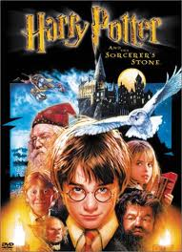
Harry Potter and the Sorcerer’s Stone

Slide 2
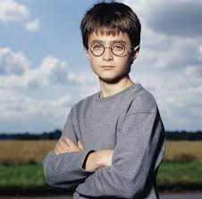
Harry Potter is a regular boy, but strange things seem to happen to him.

Slide 3
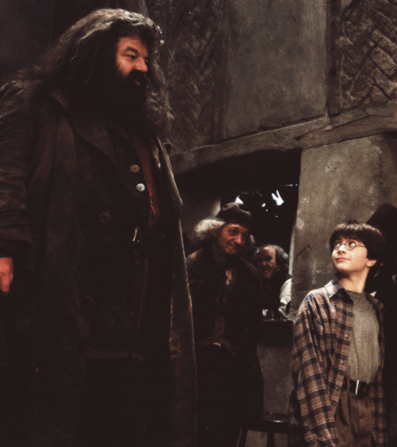
On Harry’s birthday a large man named Hagrid, comes to take him away.

Slide 4
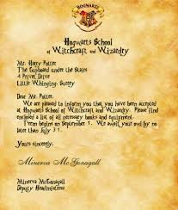
Hagrid tells Harry that he is a wizard and should attend wizard school.

Slide 5
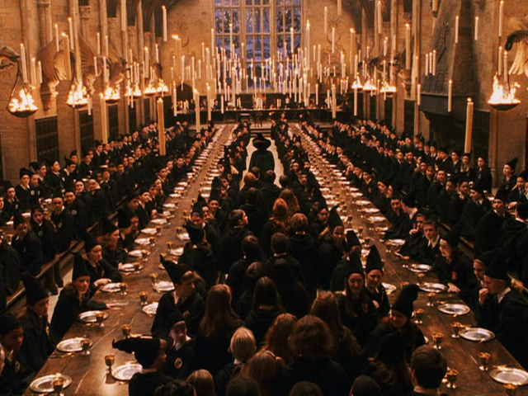
There are four teams at the Hogwarts School of Witch Craft and Wizardry.

Slide 6
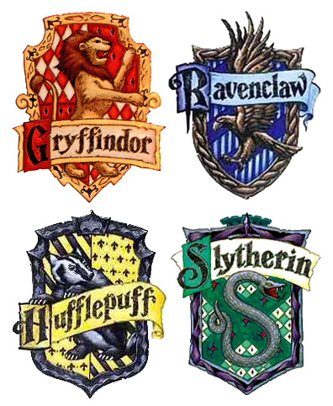
These teams are called houses. They are Gryffindor, Hufflepuff, Ravenclaw, and Slytherin.

Slide 7
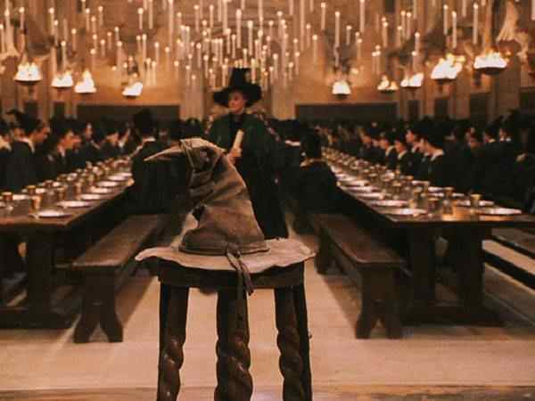
A magic talking hat sorts students onto each team.

Slide 8
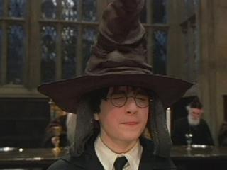
Harry gets sorted into Gryffindor by the magic talking hat.

Slide 9
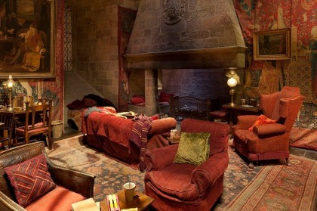
Gryffindor has very smart and nice wizards.

Slide 10
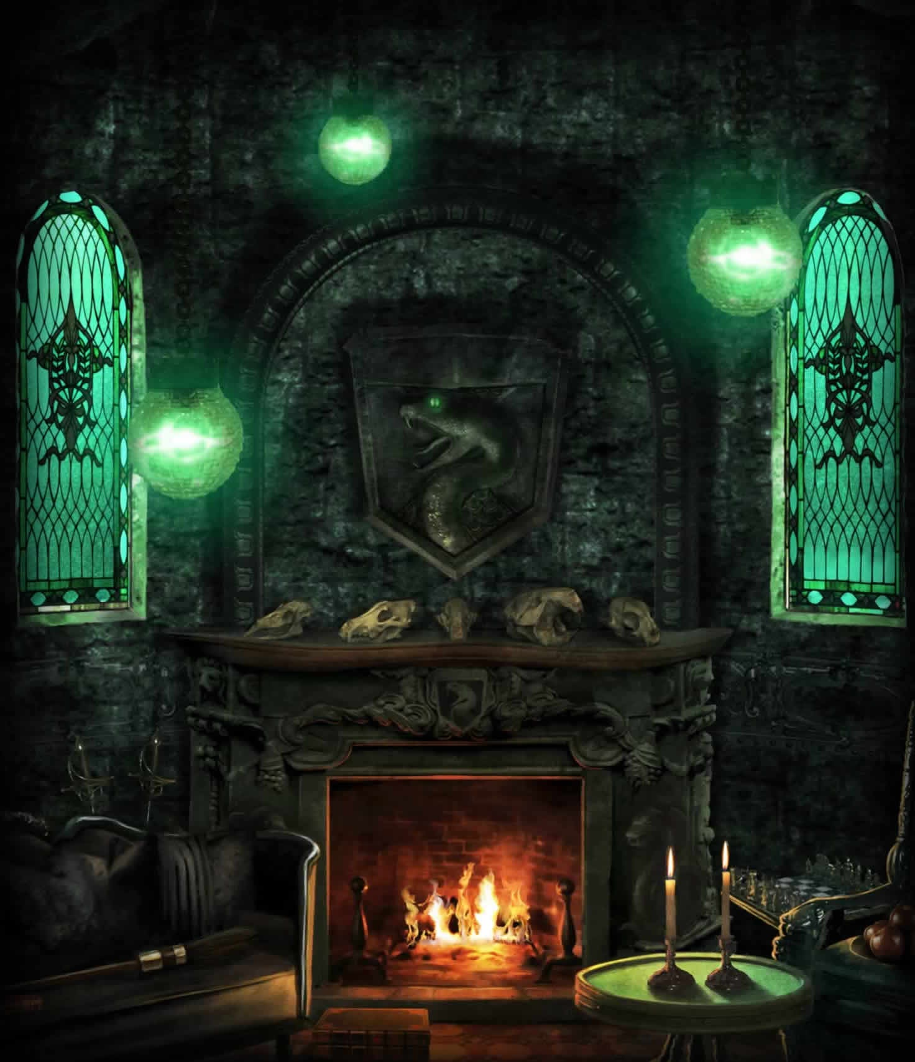
Slytherin has very smart but mean wizards.

Slide 11
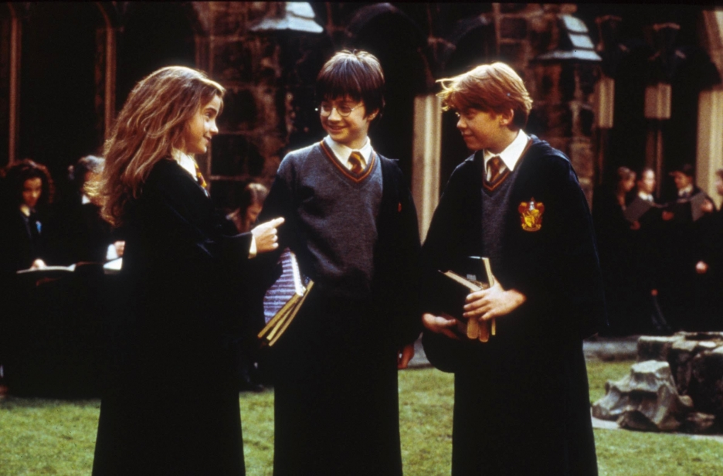
Harry makes friends with Ron and Hermoine at school, who are also in Gryffindor.

Slide 12
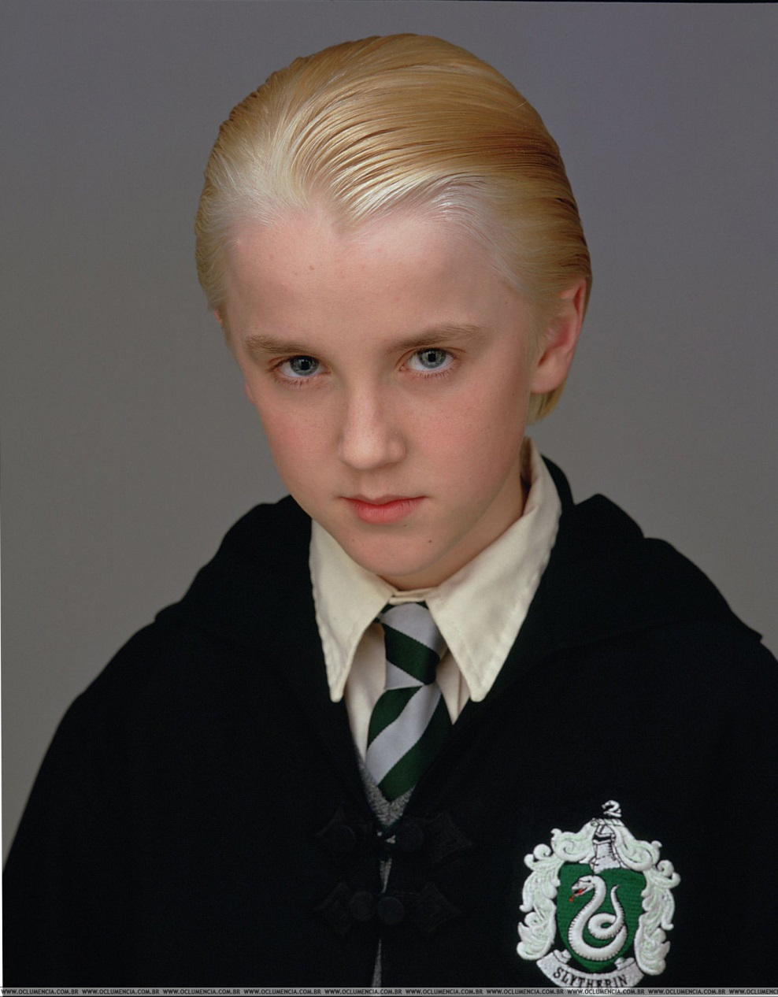
Harry does not get along with Malfoy because Malfoy is in Slytherin.

Slide 13
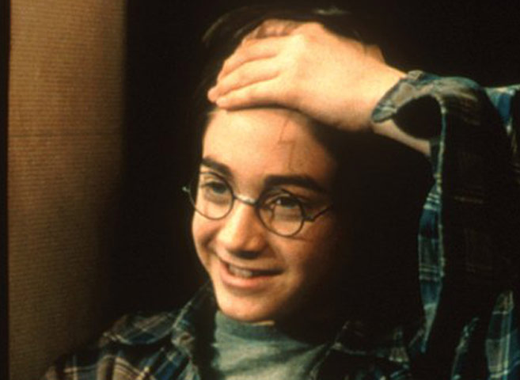
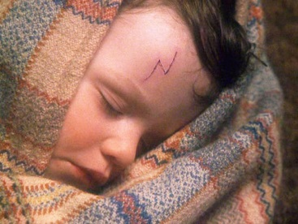
Harry has a unique scar on his head that burns sometimes. He has had this scar since he was a baby.

Slide 14
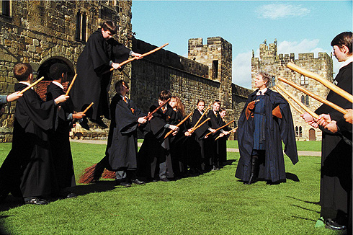
At school Harry learns about potions, spells, and how to fly.

Slide 15
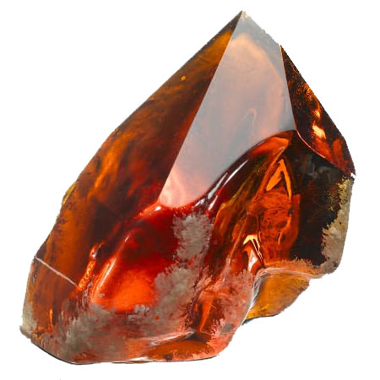
Harry learns that someone evil is trying to steal the sorcerer’s stone.

Slide 16
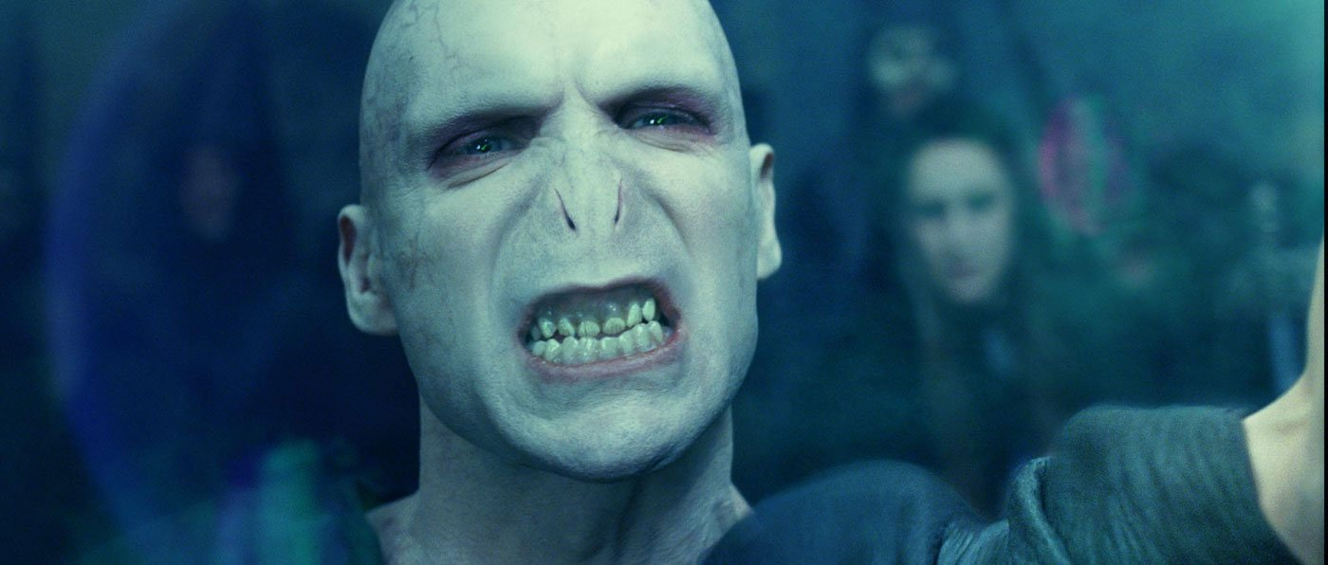
That evil person is named Voldemort. He is so evil people do not even speak his name.

Slide 17
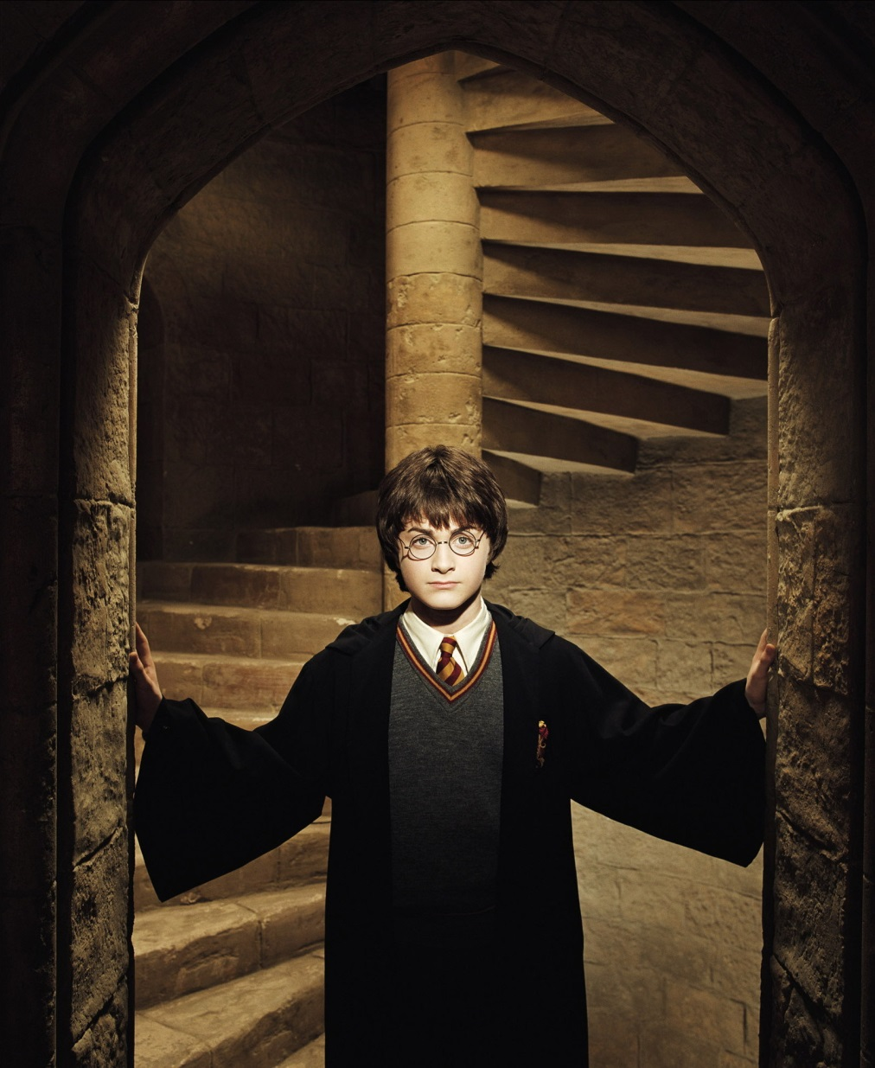
Harry decides he must find the stone before Voldemort does.

Slide 18
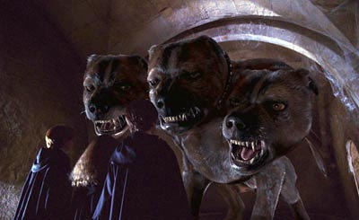
Harry and his friends get past the guard dog and perform many impressive acts as they get closer and closer to the stone.

Slide 19
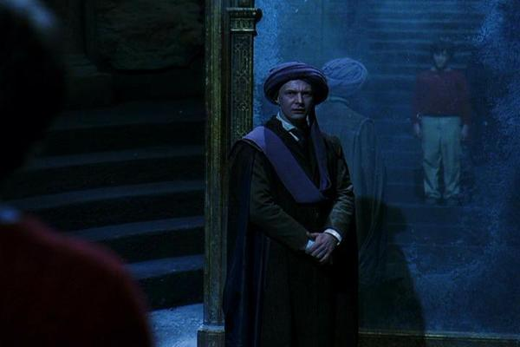
Harry meets one of his professors at the end of his journey to the dungeon.

Slide 20
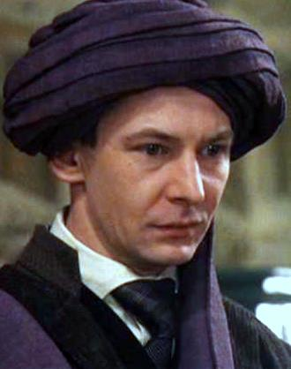
Harry’s professor is helping Voldemort find the sorcerer’s stone.

Slide 21
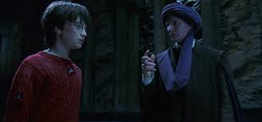
Harry is told to look into a mirror that shows him what he wants. He sees the stone in his pocket and when he touches his pocket the stone is actually there.

Slide 22
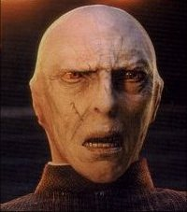
The professor takes off his hat and reveals Voldemort on the back of his head. At the sight of Voldemort, Harry’s scar starts to burn.

Slide 23
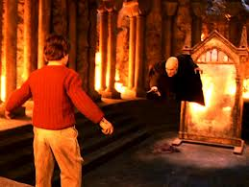
Voldemort tries to attack harry in the professors body.

Slide 24
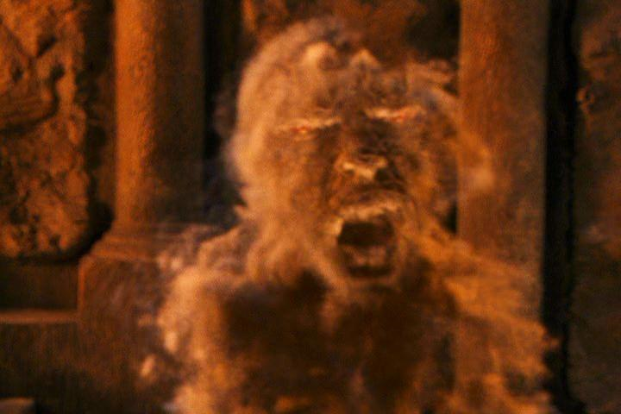
Harry’s skin burns the professor and the injured soul of Voldemort escapes.

Slide 25
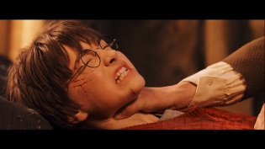
Harry passes out and is later found by his friends.

Slide 26
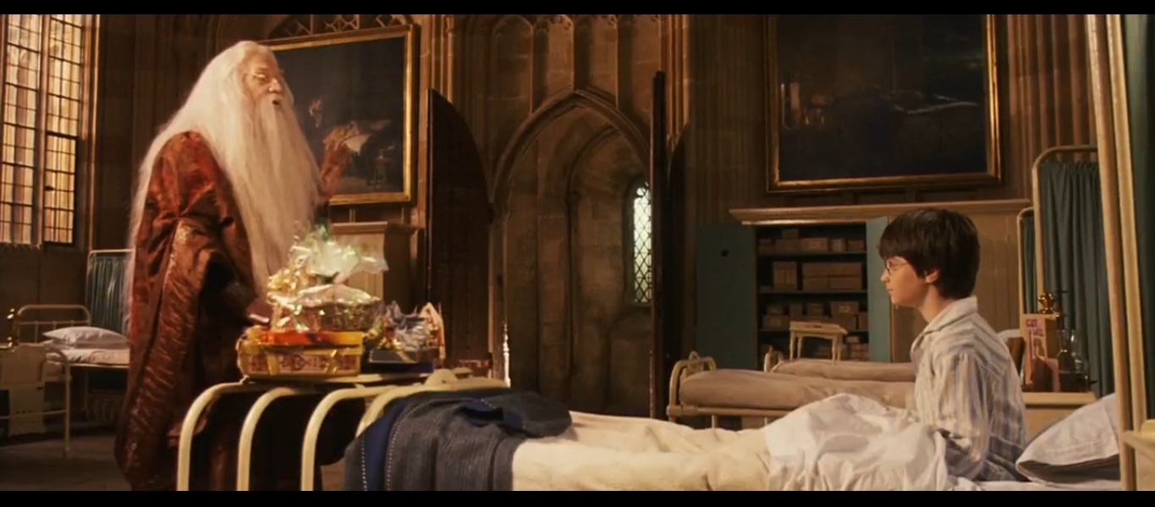
Harry wakes up in the hospital and the head of the school, Dumbledore, tells Harry that the stone has been destroyed.

Slide 27
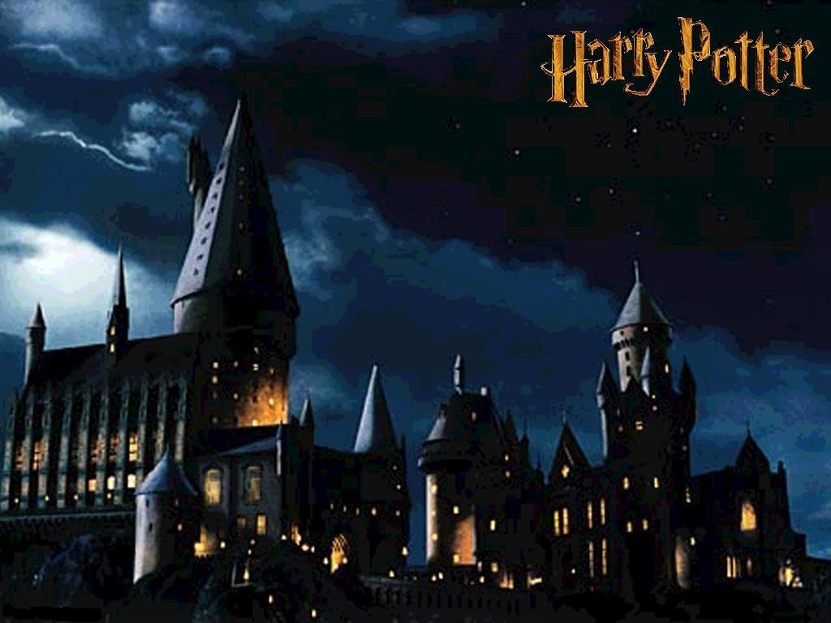
The End!

