Slide 1
Frindle By Andrew Clements

Slide 2
Character List
Nick Allen: main character, a 5th grader at Lincoln Elementary School
Miss Deaver: Nick’s 3rd grade teacher
Mrs. Avery: Nick’s 4th grade teacher
Mrs. Granger: Nick’s very strict 5th grade teacher
Mrs. Allen: Nick’s mother
James Allen: Nick’s older brother
Pete, John, Dave, and Chris: classmates of Nick
Mrs. Margaret Chatham: principal at Lincoln Elementary School
Tom Allen: Nick’s father
Judy Morgan: reporter for local newspaper
Mrs. Freed: secretary at Lincoln Elementary school
Alice Lunderson: television worker
Janet: friend and classmate of Nick’s

Slide 3
Vocabulary
Oasis: an area with water, plants, and life. Often in the middle of a desert.
Overwhelmed: to feel stressed
Prompts: asks someone to say something
Dismay: the feeling of shock and concern
Administration: the people in charge of a group
Frequency: amount of times
Scandal: an event that can be seen as wrong and dramatic
Skyrocketing: going up

Slide 4
Chapter 1
Nick Allen is a young boy who goes to Lincoln Elementary School. His classmates and teachers do not think that Nick is very smart, but he is very creative.

Slide 5
Chapter 1
In Nick’s 3rd grade class with Miss Deaver he transformed the classroom into a tropical oasis. Miss Deaver and Nick’s classmates were impressed with his creativity.

Slide 6
Chapter 1
When Nick was in 4th grade he watched a TV show about the red-winged blackbird. Nick learned about the high-pitched noise that these birds make. In his class Nick decided to let out a high-pitched squeal. His teacher, Mrs. Avery, blamed his classmate Janet for making the noise. Later Nick apologized to Janet for the confusion and they became friends.

Slide 7
oasis

Slide 8
Chapter 2
Nick is now ready to begin the 5th grade. When he finds out that his teacher will be Mrs. Granger he is very nervous. All of the students at Lincoln Elementary school know that Mrs. Granger is very strict. Some students even joke that she has x-ray vision.

Slide 9
Chapter 2
Mrs. Granger loves to teach Language Arts and gives her students a lot of vocabulary and spelling tests. She also loves dictionaries and makes the students learn 35 new words a week. Nick hates dictionaries and is very worried about 5th grade.

Slide 10
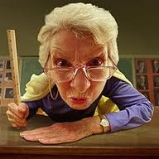
Mrs. Granger

Slide 11
Chapter 3
Nick’s first day of 5th grade is going very well. He is enjoying school until his Language Arts class with Mrs. Granger. When the students arrive at class Mrs. Granger gives them piles of handouts and assignments and even gives them a pretest. Nick feels overwhelmed but has a plan to slow down the pace of class.

Slide 12
Chapter 3
Nick typically asks teachers many questions during class to get them sidetracked. When Mrs. Granger is talking about all of the dictionaries in the classroom Nick raises his hand and asks her, “Where did all those words come from?”

Slide 13
Chapter 3
Mrs. Granger is amused by Nick’s question. In fact, she is so amused that she gives Nick the assignment to go home and research to find the answer. She then requests that Nick give an oral presentation to the class about what he finds. Nick is nervous that he now needs to complete this assignment along with all of the other work that she has given him.

Slide 14
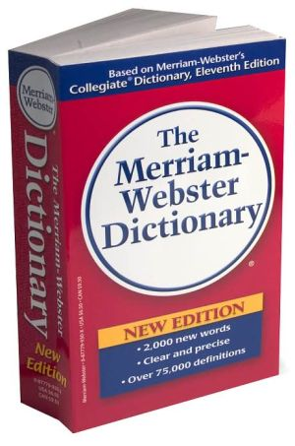
dictionary

Slide 15
Chapter 4
It is a beautiful day and of course, Nick needs to stay inside to complete his assignment for Mrs. Granger. He wishes to play with all of his friends outside but instead needs to research dictionaries and encyclopedias. Nick’s parents have a rule that he cannot go out and have fun until he finishes his homework. Although Nick does not like it, this rule helped out his older brother, James, who is now doing well in college.

Slide 16
Chapter 4
Nick realizes that he does not understand definitions and what he needs to create an oral report on. He spends a lot of time flipping through dictionaries and encyclopedias. He knows that this assignment will be very time-consuming. While preparing his report he pictures himself presenting and decides to make this presentation as much fun as possible!

Slide 17
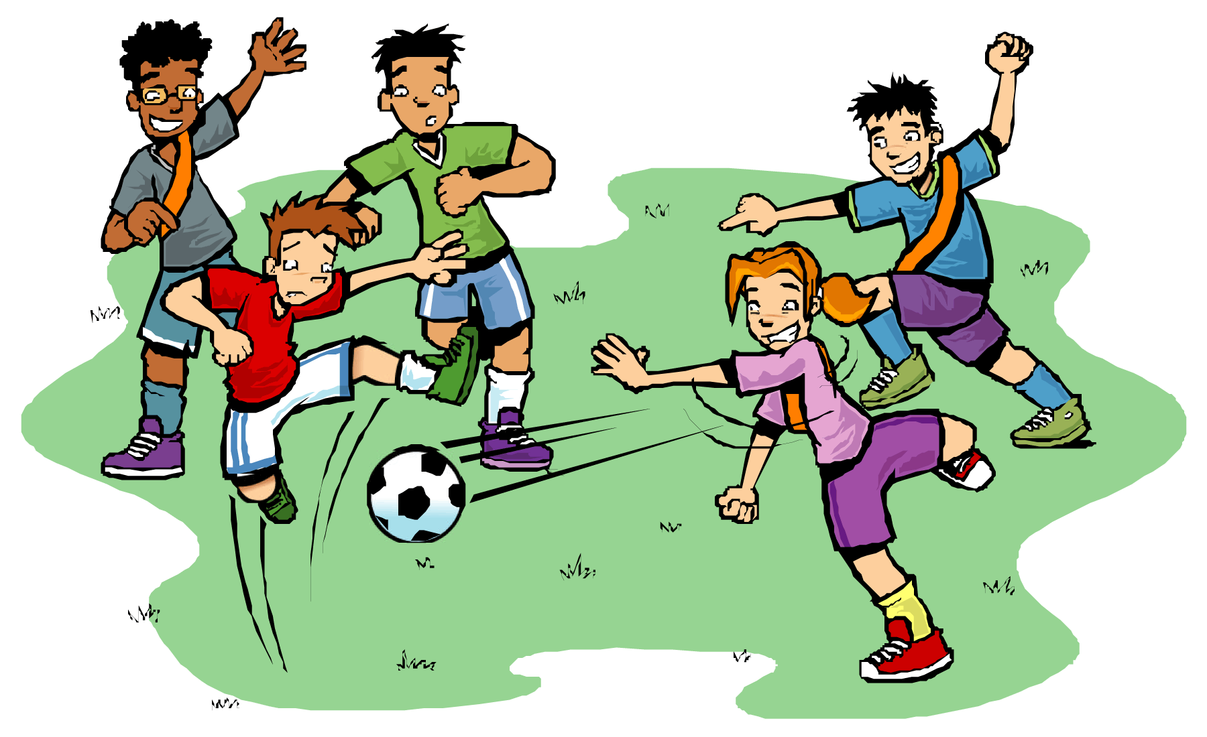
outside

Slide 18
Chapter 5
Throughout the day Nick is very nervous about his presentation. He prepared so much and had so much to talk about that it felt like all of his ideas were getting jumbled in his mind. Nick arrives in Mrs. Granger’s class, takes a deep breath, and immediately Mrs. Granger prompts him to present.

Slide 19
Chapter 5
Before Nick can get into his presentation Mrs. Granger interrupts him and asks what he has titled it. Nick is startled as he had not given a title to his presentation. He immediately thinks to name his presentation “The Dictionary”.

Slide 20
Chapter 5
Nick is on a roll with his presentation. He talks about the history of words and the dictionary for minutes upon minutes. Before he knows it class is almost over and he enters a conversation with Mrs. Granger about the meaning of words. Nick wonders, “what gives words meaning?” Mrs. Granger answers this question with the sharp response that “people give words meaning”. Nick is proud to have wasted so much time but to his dismay, Mrs. Granger just gives the class an extra homework assignment to catch them up on what they have missed.

Slide 21
Oral presentation

Slide 22
Chapter 6
Nick walks home from school that day with his friend, Janet. While walking the two of them play a game when they walk on the curb and make sure that they don’t fall off. When walking the two of them find a ballpoint pen on the ground.

Slide 23
Chapter 6
When Nick sees the pen he thinks about what Mrs. Granger said about words and how people give them meaning. He remembered when he was a kid and would call random things words that he made up on his own. He hands the pen over to Janet and says, “here is your frindle!” Nick decided to make up a new word for a pen and was excited to let all of his classmates know.

Slide 24
Ballpoint pen

Slide 25
Chapter 7
Nick is very excited to put his plan in action and to make his new word, frindle, popular. He tells some of his classmates what frindle means and devises a plan to cause a scene during Mrs. Granger’s class.

Slide 26
Chapter 7
As the bell rings Nick raises his hand and says, “Mrs. Granger, I forgot my frindle.” John, Nick’s classmate, responds telling Nick that he could borrow a frindle from him. The exchange lasts for several minutes and both boys make sure to repeat the new word over and over again. At the end of class Mrs. Granger pulls Nick aside and commands him to never disrupt her class again with his made up word. She then holds up a pen calling it the proper name and instructs Nick to leave.

Slide 27
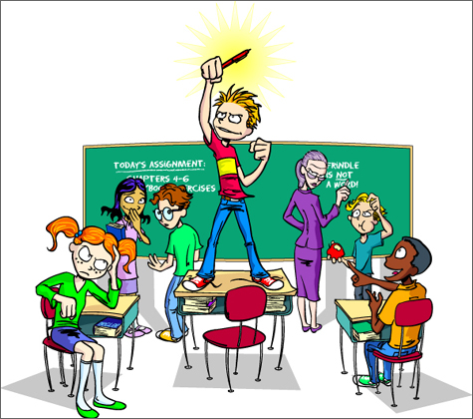
frindle

Slide 28
Chapter 8
Nick knows that he needs to do more so that his new word could gain more popularity. On picture day, instead of saying “cheese”, the 5th grade class all exclaims “frindle” and hold up frindles. The photographer runs out of film so this will have to be the photo to represent the 5th grade class. Teachers and administration are very upset– especially Mrs. Granger.

Slide 29
Chapter 8
Mrs. Granger begins to demand that all students who use the word “frindle” be held after class. However, this does not stop anyone because more and more students begin using the word with more and more frequency. Almost 200 students begin to stay after school everyday and parents are getting angry.

Slide 30
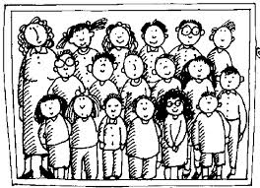
Class photo

Slide 31
Chapter 9
Because of the situation going on at Lincoln Elementary School, the principal, Mrs. Chatham, decides to visit Nick and his family. Mrs. Chatham is a very tall woman, as big as Nick’s father. She scares Nick a lot. Mrs. Chatham explains the situation to Mr. and Mrs. Allen and voices her disappointment. Nick could see that his mother is getting annoyed.

Slide 32
Chapter 9
Mrs. Allen tells Mrs. Chatham that she does not think that the frindle business is a big deal. However, Mrs. Chatham says that the students are being disrespectful, especially in regards to Mrs. Granger. Mr. and Mrs. Allen still do not agree so Mrs. Chatham leaves. Nick’s parents tell Nick that it is important that he is never disrespectful to his teacher and that it is probably in his best interest to stop using the word frindle. But, Nick assures his parents that it has come too far and he is not ready to stop now.

Slide 33
Mrs. Chatham

Slide 34
Chapter 10
A woman named Judy Morgan who works at the Westfield Gazette hears about the frindle situation going on at Lincoln Elementary School from a coworker. Judy is unclear on the story but is told that frindle might be a code word that the students are using. She sees this as a great opportunity for a story and decides to pay Lincoln Elementary School a visit.

Slide 35
Chapter 10
Judy Morgan first stops to see Mrs. Freed, the school secretary. Mrs. Freed clearly is not in the mood to talk about the frindle situation so she sends Judy to Mrs. Chatham. On her way to see Mrs. Chatham Judy takes a picture of a sign Mrs. Granger put up warning the students about using the word “frindle”.

Slide 36
Chapter 10
Mrs. Chatham gives Judy Morgan some of the general details about what is happening at Lincoln Elementary School and then suggests that she speaks with Mrs. Granger. When Judy talks to Mrs. Granger she spares few details, but does mention Nick Allen, the boy who started the use of the word frindle.

Slide 37
Chapter 10
Judy Morgan leaves Mrs. Granger’s room and asks a group of students about Nick. She gets a lot of information and even gets a photo of the 5th grade class sent to her in an unaddressed envelope. Interestingly enough the person giving Judy secret information about Nick Allen is Nick Allen himself!

Slide 38
Unaddressed envelope

Slide 39
Chapter 11
The next morning the article Judy Morgan wrote about frindle is on the front page of the Westfield Gazette. The paper even sells over 12,000 copies! The title of the article is “Move Over, Mr. Webster”. This suggests that the students of Lincoln Elementary School are making up their own meaning to a word and not listening to Webster’s Dictionary. The article makes the situation seem a lot more drama-filled than it truly is and leads to the questioning of many people involved in the frindle scandal.

Slide 40
Westfield Gazette

Slide 41
Chapter 12
Because of the news article the popularity of the word frindle expands. Now, the entire town is using the word frindle. Nick is noticed and recognized wherever he goes. This is incredibly weird for Nick’s parents who are not used to him getting so much attention.

Slide 42
Chapter 12
A local businessman sees this as an incredible business opportunity. He creates pens with the word “frindle” engraved on them and begins to sell them. As this is happening a reporter named Alice Lunderson presents a story on Nick and frindle to the entire nation. This sets the sales of the frindle pen skyrocketing.

Slide 43
Chapter 12
The businessman and Nick’s father create a deal so that they share the profits from the frindles sold. Nick’s father does not tell Nick about the deal and creates a college fund for Nick’s future.

Slide 44
Alice Lunderson

Slide 45
Chapter 13
Eventually the commotion in Westfield dies down. However, similar battles over the use of the word frindle spark in towns around the country. Frindle merchandise is becoming increasingly popular and Nick makes a lot of money. Mrs. Granger gives up on getting the word frindle banned from the school and even some teachers are picking up on the word. Students in her class continue to always misspell the same word on her spelling tests—”pen”.

Slide 46
Spelling Test

Slide 47
Chapter 14
Due to all of the excitement Nick’s inner-spark dims a bit. He was once so open to sharing his big ideas and now they frightened him. He thinks of a great idea on how to get better school lunches but is afraid of what could happen if he puts his plan into action.

Slide 48
Chapter 14
As summer comes Nick decides to visit Mrs. Granger to clear the air. Mrs. Granger tells Nick that he should not be so worried because he did not do anything wrong. Nick is now more comfortable to being himself and remains bold and creative throughout junior high and high school. Nick also gets to follow through with his school lunch idea and is able to get his town some of the best school lunch in the country. While this is happening the word frindle is still increasing in popularity.

Slide 49
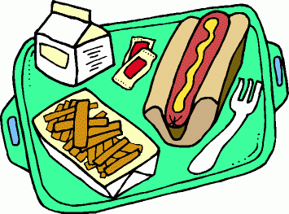
School Lunch

Slide 50
Chapter 15
Years passed by and Nick is now a junior in college. At this time he finds out about the fund his father set up for him with all of the money from the frindle merchandise sold. Nick does not know what to do with all of this money. He gives some money to his parents, some to his niece’s future college account, and he buys some things for himself.

Slide 51
Chapter 15
Something else exciting happened. Nick sees that he has received a package from Mrs. Granger. Inside the package is a note from her telling Nick to never stop growing and spreading new ideas. She also sent Nick a new dictionary that includes the word frindle. Along with these gifts Mrs. Granger sent Nick his favorite pen with a note attached reading “frindle”.

Slide 52
Chapter 15
Shortly after, Mrs. Granger notices that she has received a package. Inside the package there is a letter from administration saying that a scholarship has been set up in her name and it is starting at one million dollars. There is also a beautiful ballpoint pen with a note attached stating that she could call the writing utensil whatever she pleases.

Slide 53
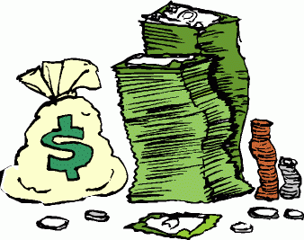
Money

