Slide 1
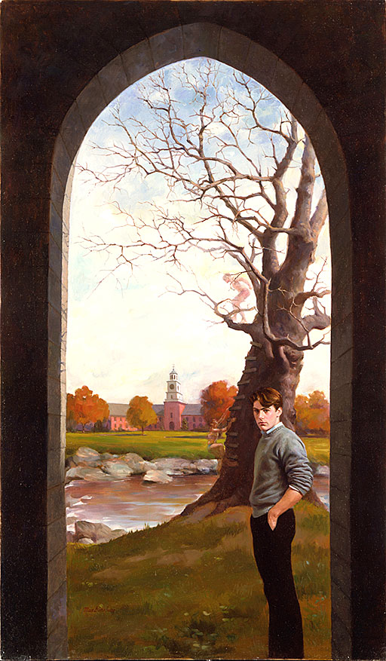
John Knowles’ A Separate Peace

Slide 2
Chapter One

Slide 3
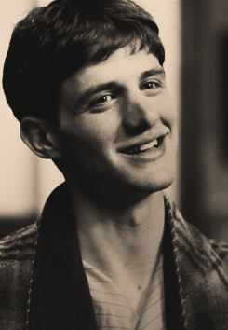
My name is Gene Forrester. When I was younger, I went away to study at The Devon School. Now, I am back visiting to see what has changed and what has stayed the same. What I really want to look at is the school’s big staircase and the tree I used to climb.

Slide 4
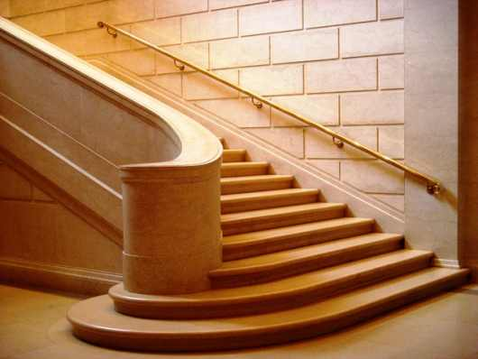
The big staircase made out of hard stone looks the same.

Slide 5
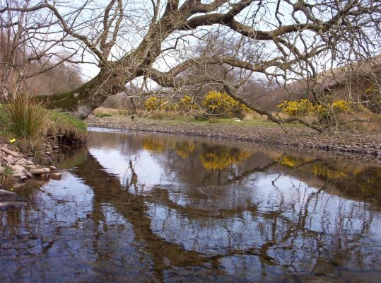
The tree looks different though. I can tell it is the same tree by the marks on its trunk and the way its branches stick out over the river but it looks a lot smaller. Looking at the tree makes me remember when I was younger.

Slide 6
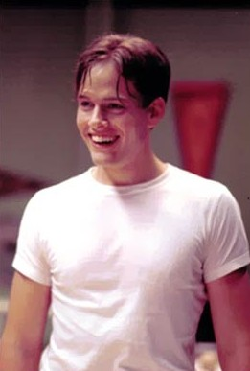
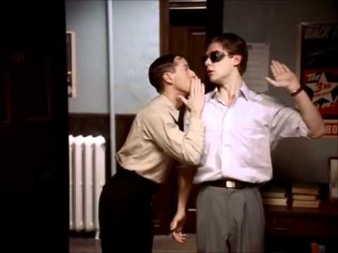
When I was sixteen and living at The Devon School, I had four best friends. One was my roommate, Phineas. The other three were Elwin, Chet, and Bobby.

Slide 7
Phineas dared us all to climb the tree and jump from the branch into the river. He did it first to show us. Then, I climbed the tree and jumped from the branch too! The other three boys were too afraid.

Slide 8
Chapter TWO

Slide 9
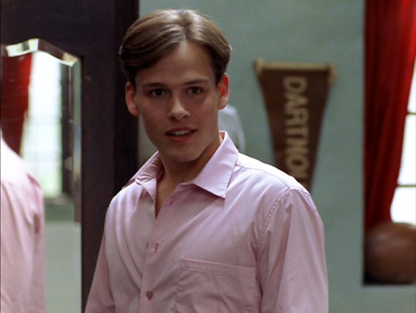
Phineas decided to wear a pink shirt. Usually boys would be teased for wearing that color but Phineas could get away with anything.

Slide 10
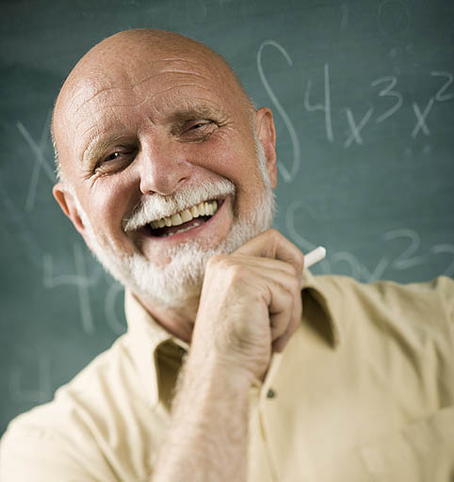
One time, Phineas even got away with wearing our school tie like a belt. A teacher saw him, but laughed.

Slide 11
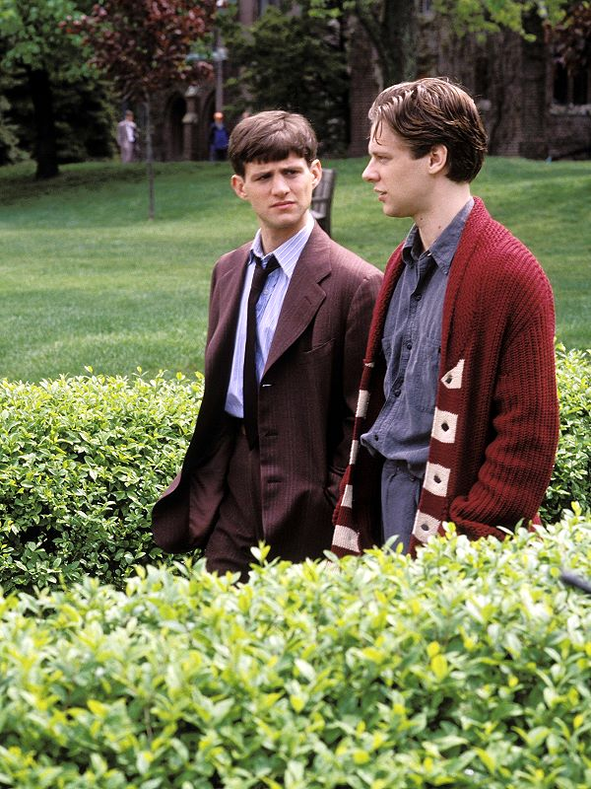
At first, I was bothered by Phineas being able to do whatever he wanted, whenever he wanted, in front of who ever he wanted. But then I decided there was no point in being bothered.

Slide 12
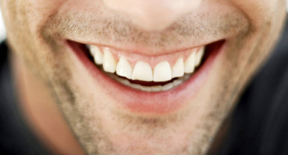
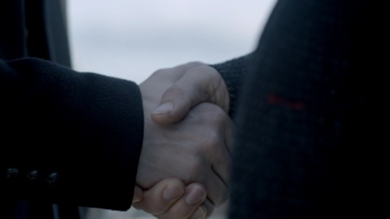
Instead, we laughed about his pink shirt and his tie around his waist. Phineas was my friend.

Slide 13
We even made a secret club together that you could only get into if you jumped from the tree branch into the river.

Slide 14
One time when I tried to climb the tree and jump, I almost fell. Phineas caught me. He saved my life.

Slide 15
Chapter Three

Slide 16
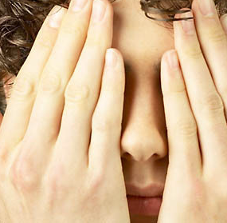
Phineas found six other boys to join our club. We would meet every night. We would start our meetings by climbing the tree and jumping into the river. Even though I never told Phineas, I was still afraid to jump. I did it anyway.

Slide 17
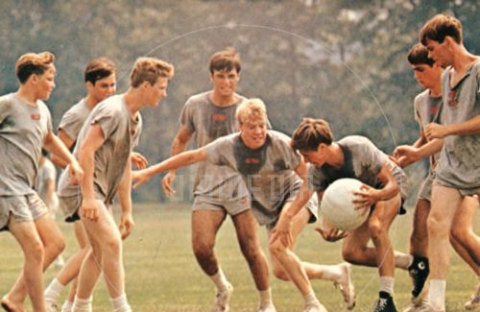
Phineas made up a game for us to play called blitzball. One person would run around carrying a heavy ball. Then, they had to pass the heavy ball to another person or they would get tackled.

Slide 18
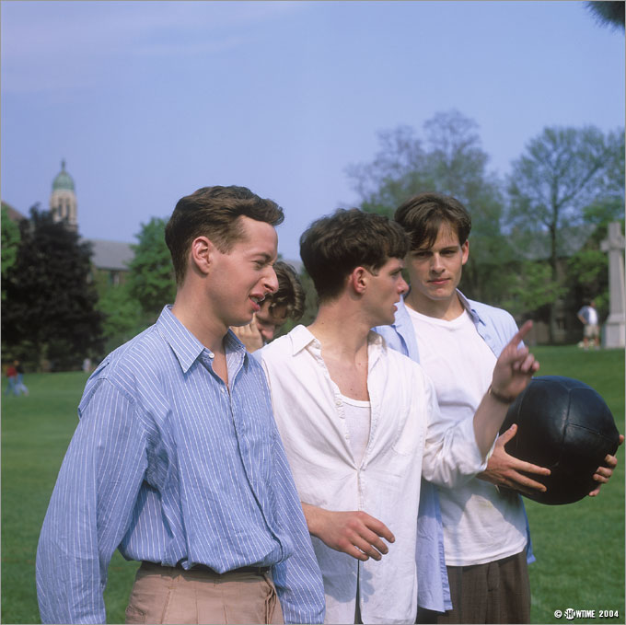
Phineas was the best at playing blitzball.

Slide 19
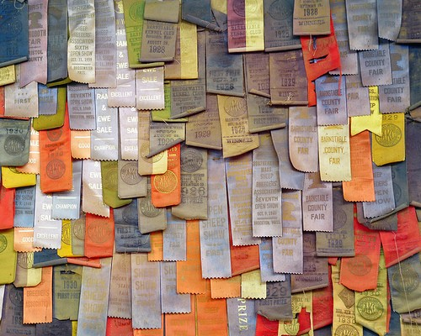
Phineas was the best at swimming too. He even broke a school record.

Slide 20
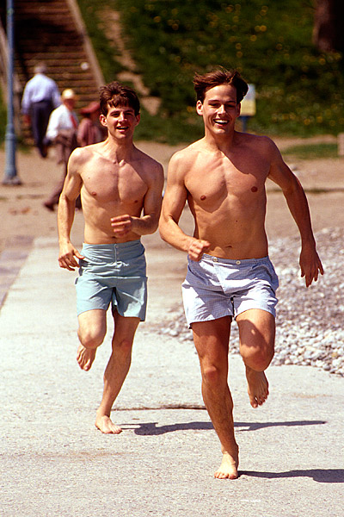
Then, Phineas wanted to swim in the ocean. We rode our bicycles for hours until we got to the shore. When we got there, we went in the water, played in the sand, and ate hot dogs.

Slide 21
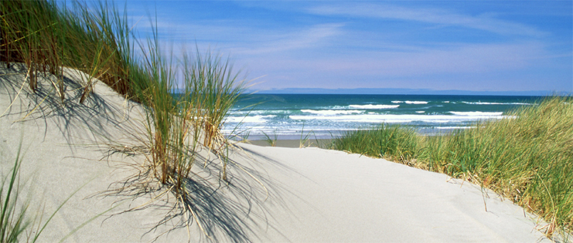
It was that day Phineas told me I was his best friend but I could not tell him he was my best friend. I just kept quiet until we fell asleep on the beach.

Slide 22
Chapter Four

Slide 23
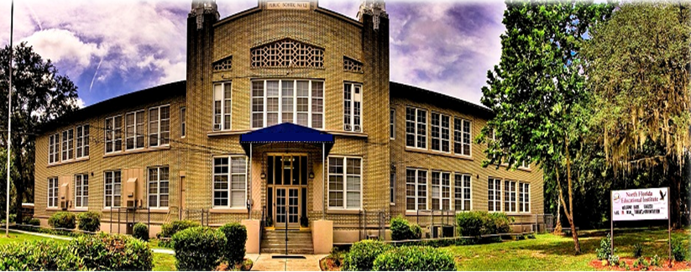
After we woke up on the beach, we had to bicycle back to The Devon School.

Slide 24
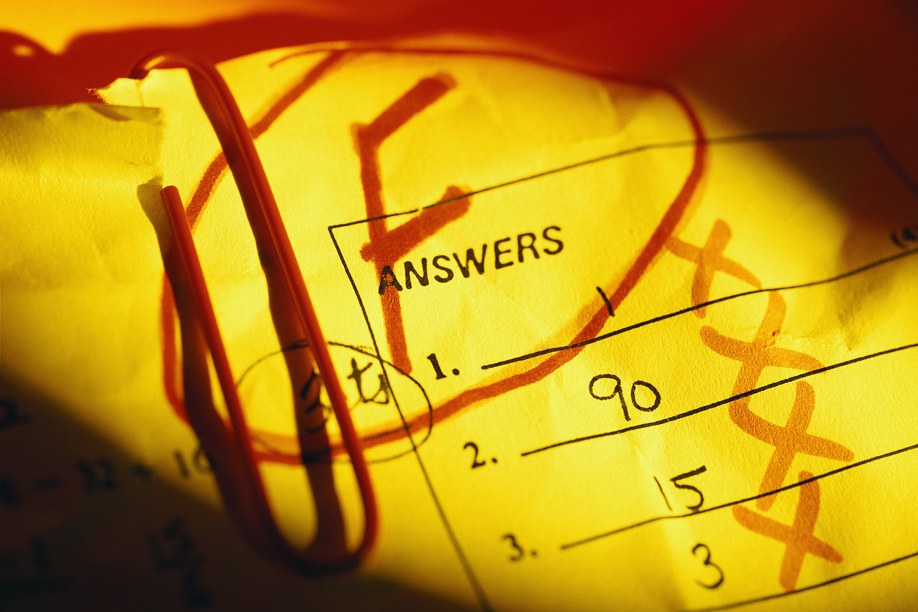
I had a math test that I did not study for. I did not do well.

Slide 25
Phineas took my mind off my bad test grade. We played blitzball and had a secret club meeting.

Slide 26
That night, I tried to catch up on my math homework. Phineas told me I studied too hard.

Slide 27
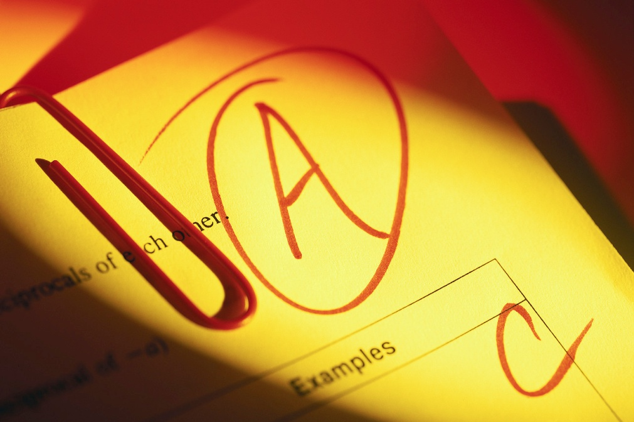
I thought it was because Phineas was jealous of me. He was bothered that I did so much better than him in school. I liked doing better than him. In fact, I wanted to be the best student in our class.

Slide 28
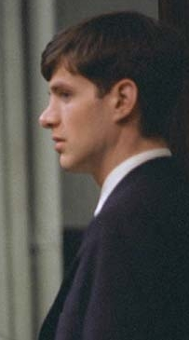
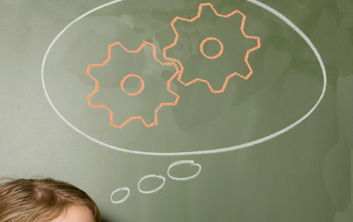
Phineas told me he admired how smart I was. I didn’t understand why he was not jealous of me the way I was jealous of him.

Slide 29
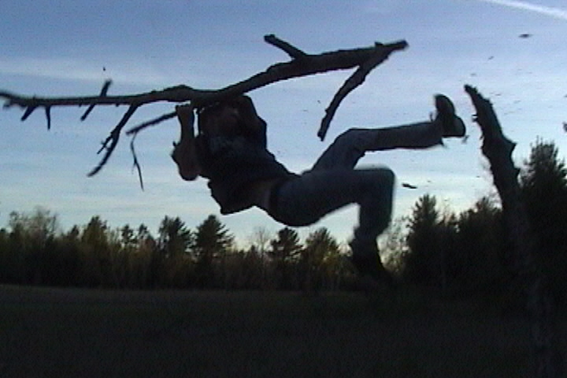
That night, when Phineas asked me to climb the tree and jump from the branch into the river with him, I said I would. But while we were standing in the tree high above the ground, I shook the branch we were on and made Phineas fall.

Slide 30
Chapter Five

Slide 31
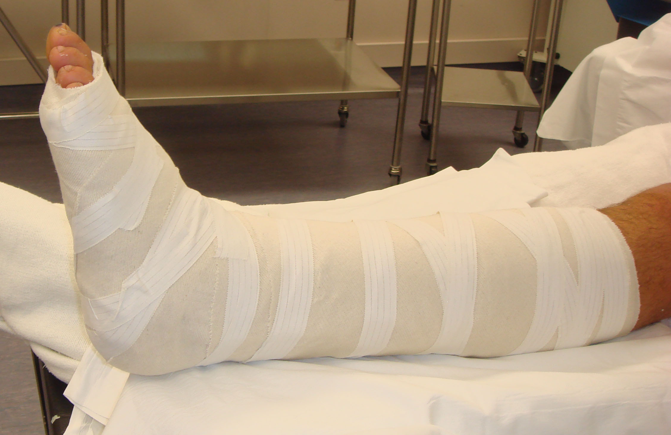
Phineas broke his leg when he fell from the tree. No one knew it was my fault.

Slide 32
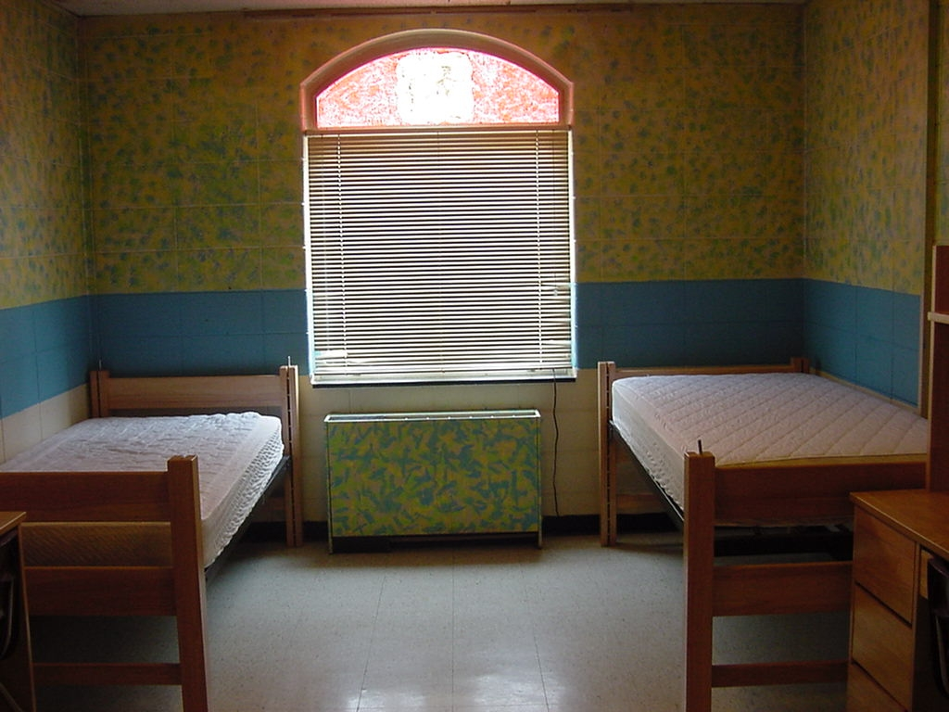
While Phineas stayed in the school’s hospital, I was all alone in our bedroom. One night, I put on Phineas’ clothes and thought I looked like him. I started to feel guilty about making Phineas fall from the tree.

Slide 33
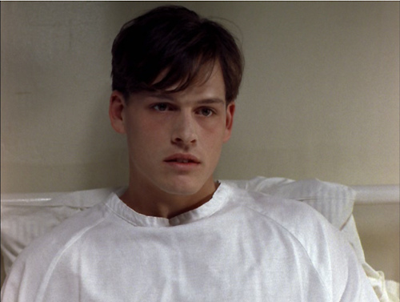
I went to visit Phineas in the hospital. The doctors told me he would be able to walk again but he would never be able to play sports. Phineas used to be the best at sports.

Slide 34
I felt guilty and nervous. Did Phineas know what I did to him?

Slide 35
At first, Phineas thought I may have shook the branch of the tree we were standing on. Then he said he was sorry for ever thinking that. Really, he was right.

Slide 36
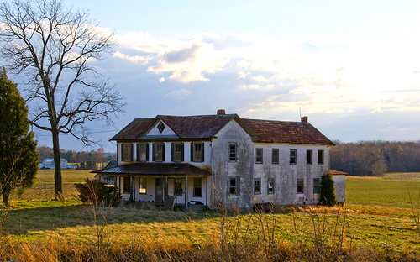
Before I could tell Phineas he was right, I had to leave. He was sent back home. Not long after, our summer classes were over and everyone else got to go home too.

Slide 37
After vacation, on my way back to The Devon School, I decided to visit Phineas. I told him I was the reason he fell from the tree. He did not believe me.

Slide 38
Chapter Six

Slide 39
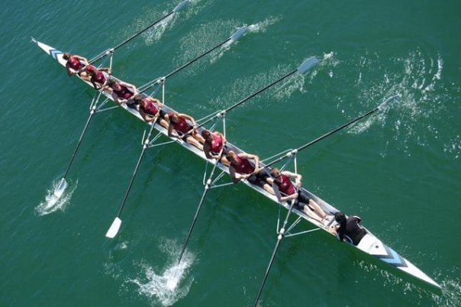
When I went back to school after vacation and after visiting Phineas, I helped out with the crew team. Crew is a sport where your team sits in a boat an paddles across the water as fast as they can.

Slide 40
After crew practice was over, one of the boys from the team started teasing me. He said I must have chosen to help out as the team’s manager because I couldn’t play the sport myself.

Slide 41
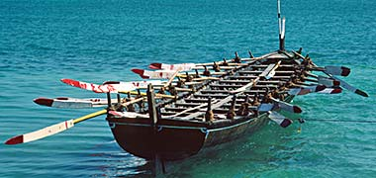
I never went back to help again.

Slide 42
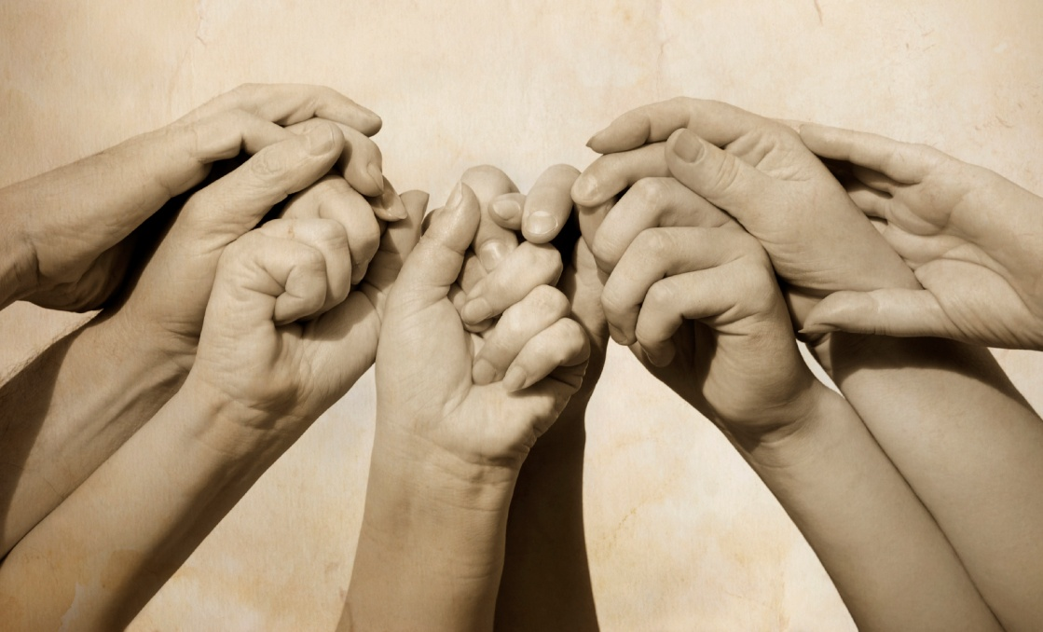
When I told Phineas about the crew team, he told me I couldn’t be in charge of the sport’s teams, I had to be on one! I was proud.

Slide 43
Chapter Seven

Slide 44
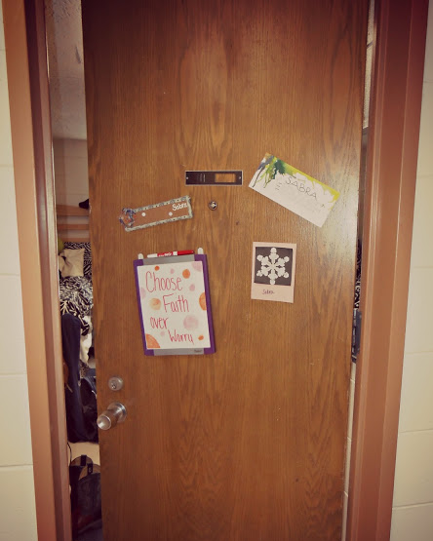
The boy across the hall said I must have gotten rid of Phineas so I could have a room all to myself. He was just teasing and didn’t mean what he said, but I thought he knew I made Phineas fall.

Slide 45
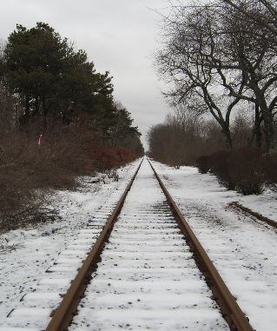
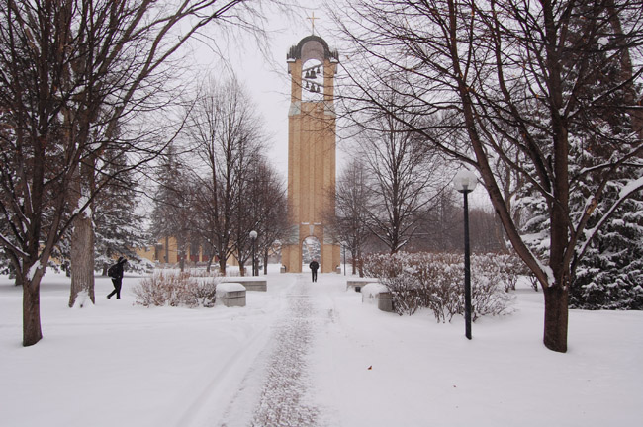
When it got colder and started to snow, the boys from The Devon School would shovel snow off of the railroad. That was how we earned money.

Slide 46
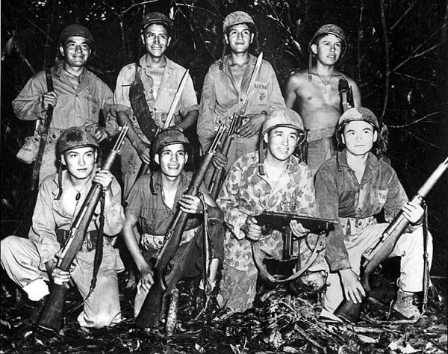
While we shoveled snow, we talked about joining the army and fighting in the war.

Slide 47
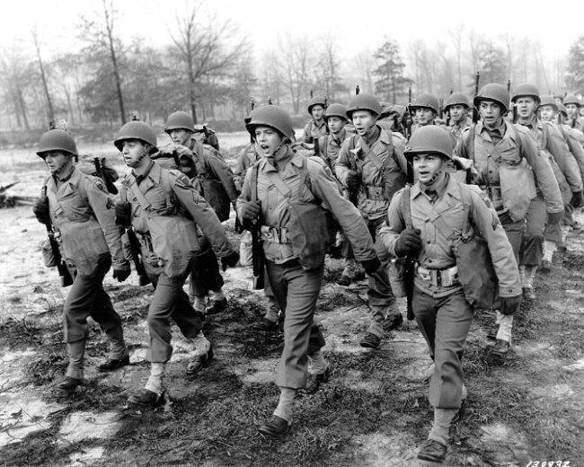
That night, one of the other boys decided he was tired of The Devon School. He wanted to join the army as soon as he could. After thinking about it for a long time, I wanted to join the army too.

Slide 48
After making my decision, I went back to my room and found Phineas there.

Slide 49
Chapter Eight

Slide 50
The boy from across the hall came in to see if I was ready to sign up for the army. I could tell Phineas did not want me to leave, so I stayed.

Slide 51
Instead of going back to classes that day, Phineas and I walked around The Devon School. Phineas wanted to see if everything was the same since he had last been there.

Slide 52
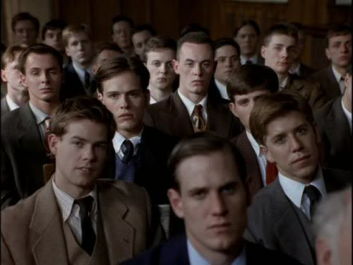
When we got to the gym, Phineas told me it was his dream to train for the Olympics but now, because of his leg, he could not. So instead, he started to train me! As payback, I helped him study for his classes.

Slide 53
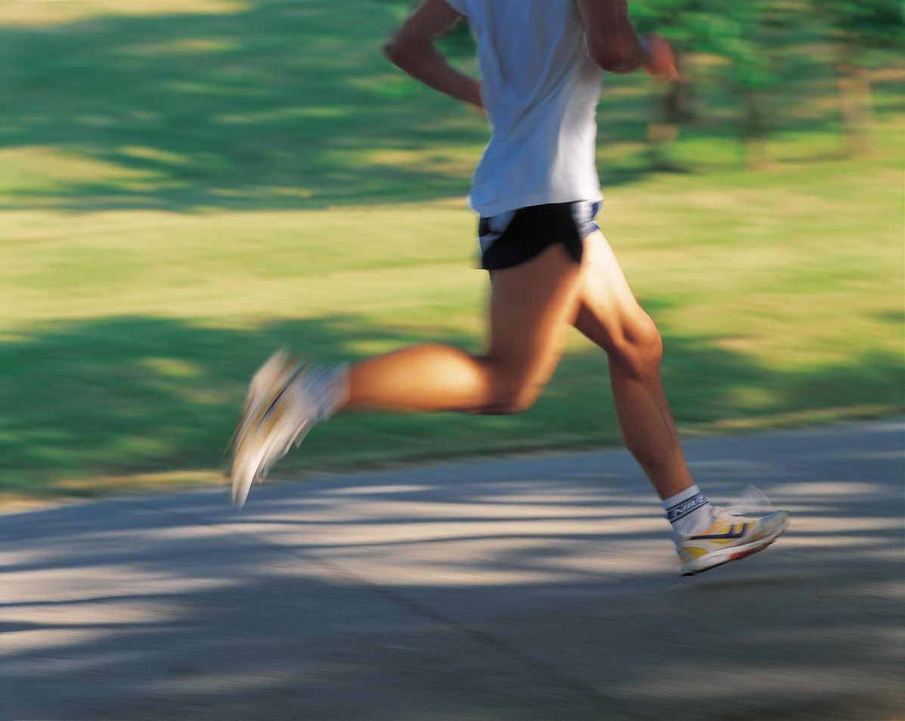
One morning, I finally felt like I knew how to run. We were told by one of the school’s teachers that all sports should be done to get ourselves ready for the war but Phineas told him I was training for the Olympics.

Slide 54
Phineas said the war was not real, that it was just a story made up by adults.

Slide 55
Chapter Nine

Slide 56
I felt like training for the Olympics was exactly what I was supposed to be doing. But other boys my age were in the army. Even my friend Elwin was fighting in the war.

Slide 57
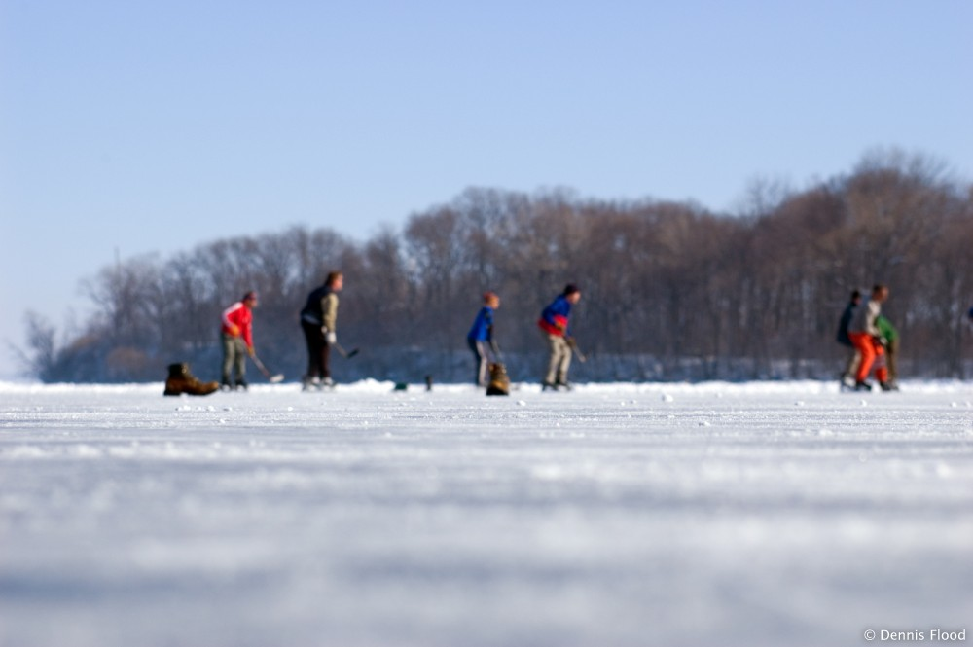
Phineas set up a winter carnival. There were different sports games, prizes, music, dancing, and apple cider.

Slide 58
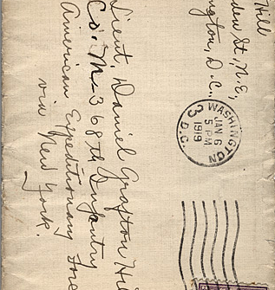
While we were at the carnival, I got a message from Elwin telling me to meet him somewhere secretly.

Slide 59
Chapter Ten

Slide 60
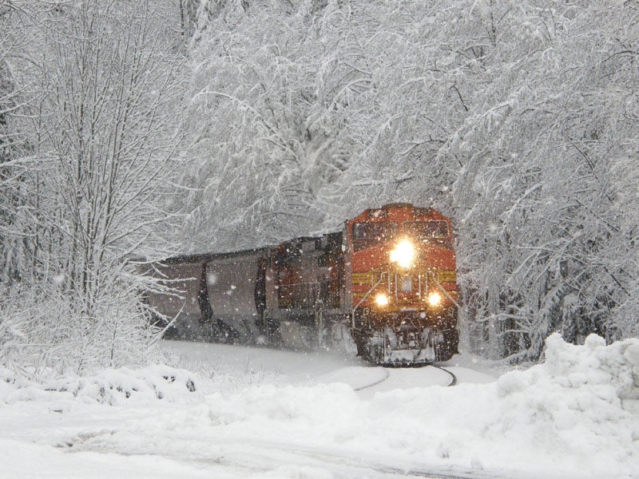
I took a train and a bus to get to Elwin’s house.

Slide 61
Elwin told me he left the army. He left because he started to see things that weren’t actually there and the men in charge thought he was insane.

Slide 62
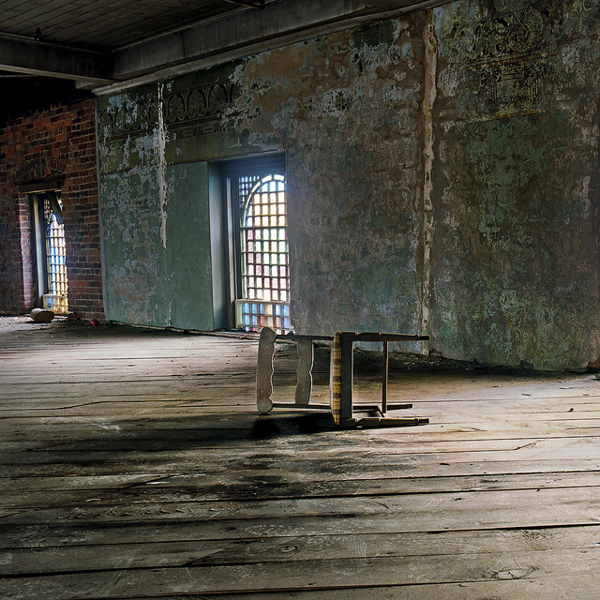
Then, Elwin told me he knew I knocked Phineas out of the tree. I was so upset, I kicked his chair over.

Slide 63
I couldn’t listen to what Elwin had to say anymore so I ran away.

Slide 64
Chapter Eleven

Slide 65
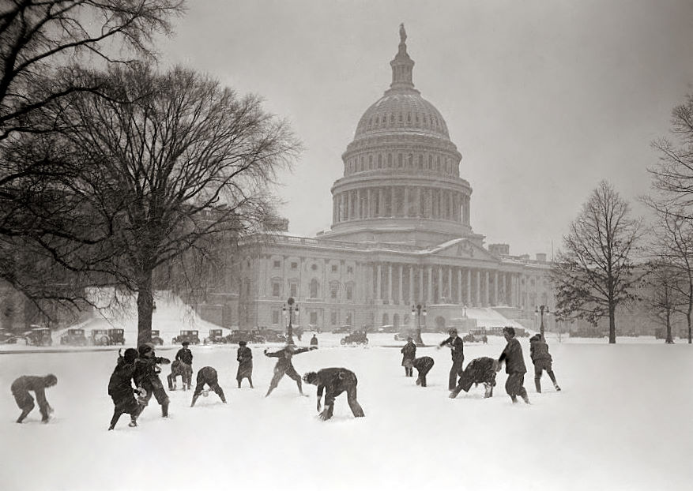
When I got back to The Devon School after seeing Elwin, Phineas was in the middle of a snowball fight.

Slide 66
We went back to our room and the boy from across the hall came over and asked about Elwin. I told him Elwin had changed, that he was insane.

Slide 67
It seemed like Phineas was starting to believe in the war. He no longer thought it was a story adults made up.

Slide 68
More and more boys joined the army, but not me. The boy from across the hallway told me he knew I was not joining because I felt guilty that Phineas could not join. He said we should talk to Phineas about his leg.

Slide 69
The boy from across the hall got together all of the other boys that saw Phineas fall from the tree. Phineas had to tell them what he thought happened. He said he just lost his balance up on the high branch. He even said I was at the bottom of the tree, that I did not climb up yet. Phineas was making up a story to protect me.

Slide 70
The other boys wished Elwin was there to help remember. That was when Phineas said he saw Elwin early that day. Elwin was back at The Devon School.

Slide 71
The boys found Elwin who said the night Phineas fell from the tree, he saw two people on the branch and one of them shook the other one off. He never said I was the one that shook Phineas off, but everyone knew it was me.

Slide 72
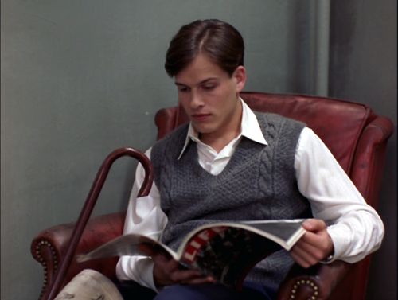
Phineas said he did not care and left the room quietly crying. We could hear the tapping of his cane on the floor, then, the sound of his body falling down the big staircase.

Slide 73
Chapter Twelve

Slide 74
The doctor said the fall down the big staircase broke Phineas’ leg again.

Slide 75
I went to see Phineas in the hospital that night. He was upset with me and asked if I came to break something else. I said I was sorry and left.

Slide 76
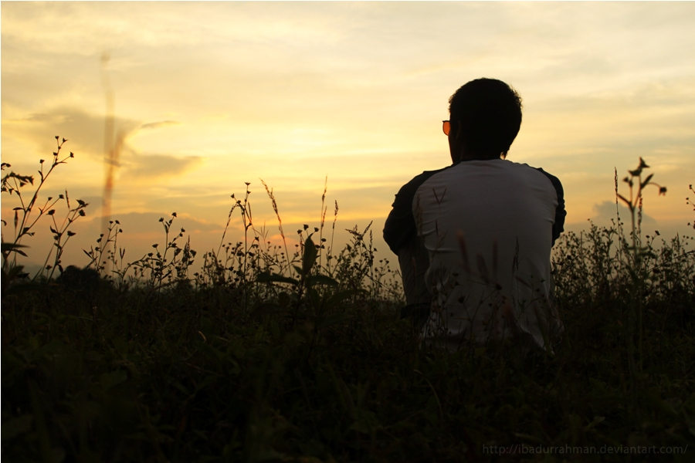
That night, I walked around The Devon School thinking. I felt like everything around me was important and that I didn’t matter.

Slide 77
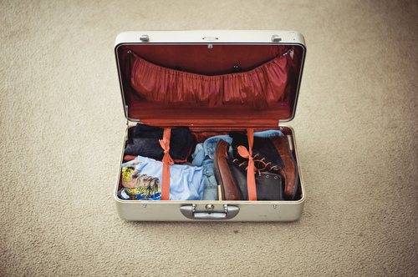
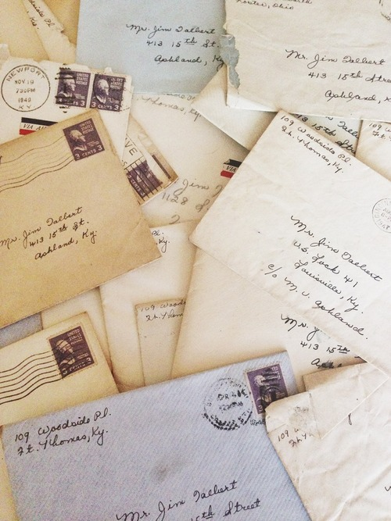
The next morning I brought Phineas clean clothes. While I was at the hospital, Phineas told me he wrote letters to the army asking if he could join. Everyone said no. Phineas pretended that there was no war because he could not be a part of the war.

Slide 78
Phineas made me tell him I didn’t mean to shake the tree branch and make him fall from the tree. He wanted to be sure he was my best friend and that I would never mean to hurt him.

Slide 79
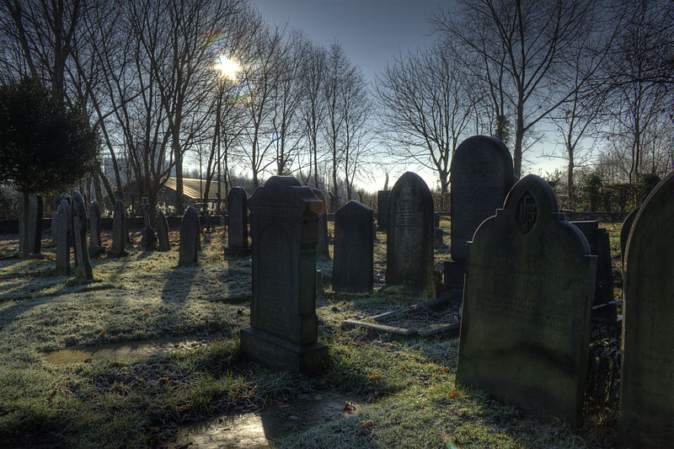
I had to leave because the doctor had to operate on Phineas’ leg. While he was in the operation, Phineas died. I did not cry at all but I felt like I died with Phineas.

Slide 80
Chapter Thirteen

Slide 81
At the end of the school year, I graduated.

Slide 82
Before leaving The Devon School, the boy from across the hall introduced me to his father. The boy’s father thought we should go off to fight in the war but neither of us wanted to.

Slide 83
I ended up having to go into the army but I never killed anyone. The only person I ever killed was Phineas.

Slide 84
I think Phineas was the only person in the world that never wanted to fight anyone. He was never angry and never afraid, but he made me feel angry and afraid. Phineas was my enemy.

Slide 85
Sometimes, who we think are our worst enemies are not our enemies at all.

Slide 86
The End

