Slide 1
Agenda
Customized Employment Overview
Needs Analysis
My Next Step
Analyze needs, devise and share plan to address identified needs

Slide 2
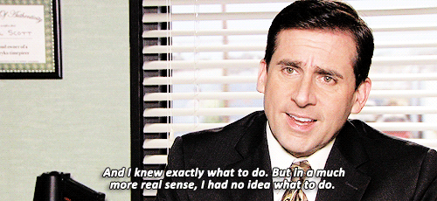
Customized Employment
Problem:
Solution:
Notes:
*You can also use stick figures to convey this idea. The following slide is what I used (forgive my artwork!).
Problems:
Unmet needs (tasks aren’t getting done at all or tasks are taking away from core priorities)
Each business has unmet needs and/or isn’t running as efficiently as it could be--all of this impacts the business's productivity and match those tasks to a qualified bob seeker.
Solution: bundle tasks that would increase a business’ productivity and match those tasks to a qualified job seeker.

Slide 3
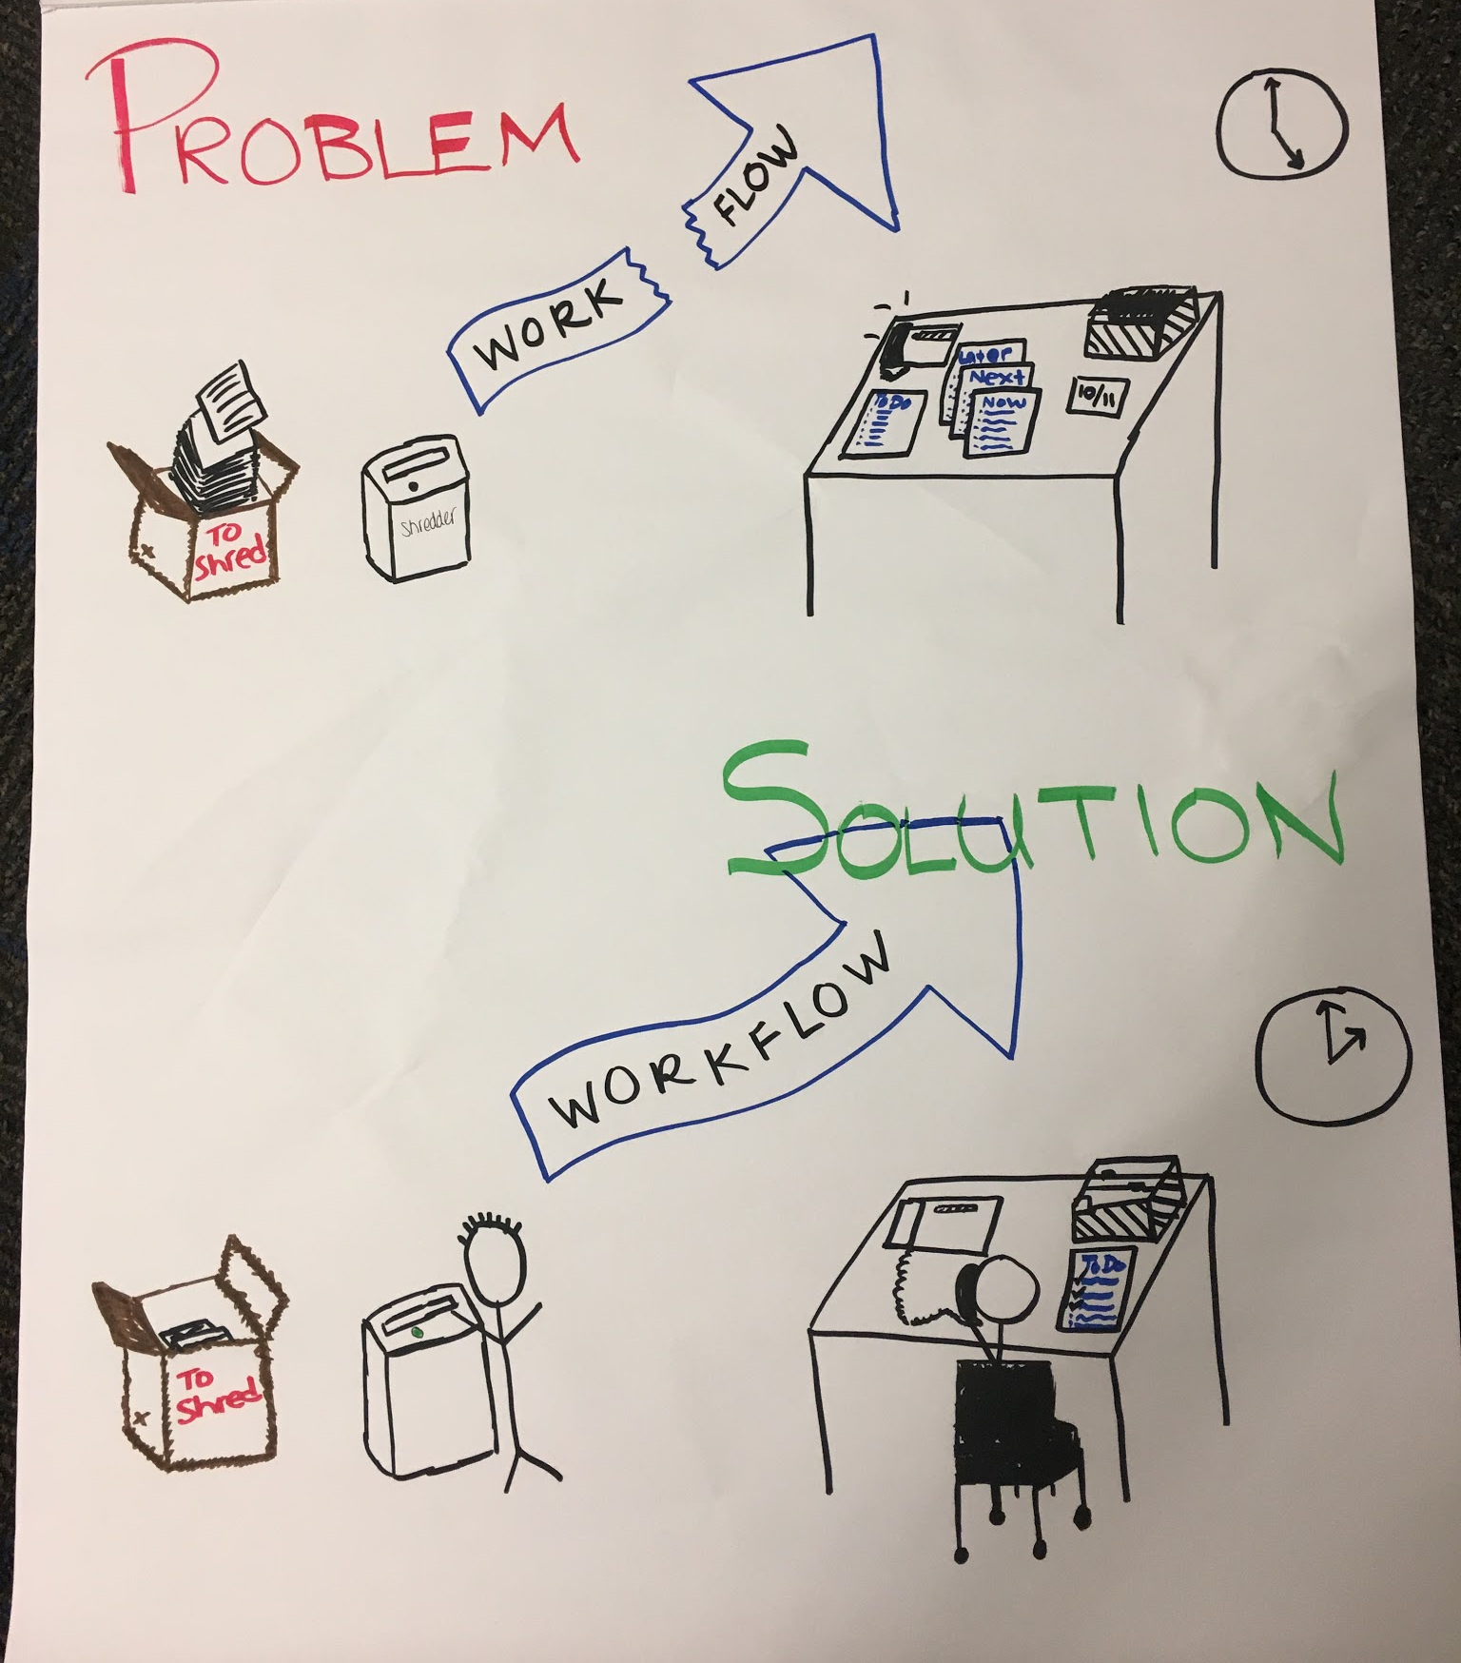
Use this
OR
the previous slide
OR
make your own!

Slide 4
Customized Employment: Needs Analysis
Let’s focus on:
Unmet Needs
Cost Savings
Improvement
Tasks that need to get done, but are not being done
Tasks that are currently bundled in job descriptions of higher paid employees that could be performed by someone at a lower rate.
Tasks that can help [company] employees and [company] operate more efficiently.

Slide 5
Identifying Needs
What are some things that never get done?
What are some things that must get done that interrupt your other work?
What are some things on your plate that…
You wish you didn’t have to do?
You wish you had help with?
Waste your time?
What are some sporadic, but important tasks?
If resources were unlimited…
Wouldn’t it be nice if….
Notes:
Slide 5 can be easily changed to add room for notes.

Slide 6
Identifying Needs

